Slide 1
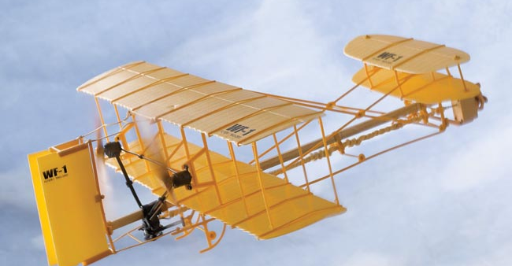
Rubber Band Powered Airplanes
By Angela Coburn
University of British Columbia Department of Physics and Astronomy

Slide 2
Outline
History of Rubber Powered Aircraft
Newton’s Second and Third Law’s
Four Forces Acting on an Airplane
Energy, Work and Power
Transport Cost
Calculations
Building Airplanes
Summary

Slide 3
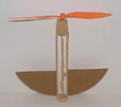
History of Rubber Powered Aircraft
1903 – Wright brothers made the first human flight.
As children they received a rubber powered toy helicopter.
When they broke it they started building their own.
This began their life long interest in flight.
Notes:
I’m sure you’ve all heard of the Wright brothers.
In 1903 they made the first human flight. They claimed that a gift they received from their father in childhood sparked their interest in flying aircrafts. When they were children their father gave them a toy helicopter made of paper, bamboo and a cork with a rubber-band to twirl its motor. They played with it until it broke and then built their own and continued making several replicas. This was the beginning of their life long interest in flight.

Slide 4
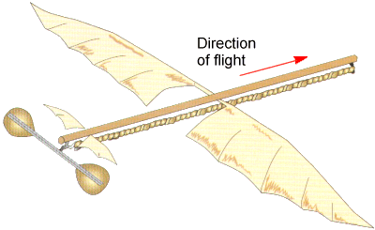
History of Rubber Powered Aircraft
1871- Alphonse Penaud flew a rubber-powered aircraft called the planophore for 131 feet in 11 seconds.
first really stable aircraft, making it one of the most important inventions leading up to the invention of the airplane.
Notes:
1871,Alphonse Penaud (the man who built the Wright brothers’ toy helicopter) amazed people by flying a rubber-powered aircraft called the planophore for 131 feet in 11 seconds. It was about 20 inches long with an 18 inch wing span with a push propellor.
It was the first public demonstration of a legitimately stable heavier-than-aircraft, making it one of the most important inventions leading up to the invention of the airplane and marked the beginning of powered flight trials.

Slide 5
History of Rubber Power Aircraft
Became an important research tool for aerodynamic engineers, as it allowed them to test numerous configurations of:
wings
rudders
elevators
fuselages for airworthiness
Notes:
Rubber-powered aircraft Became an important research tool for aerodynamic engineers, as it allowed them to test numerous configurations of wings, rudders, elevators, and fuselages for airworthiness without building full-size aircrafts.

Slide 6
Newton’s Law’s of Motion
Newton’s second law states that if the forces on an object are unbalanced then its motion will change. The bigger the force, the bigger the change in motion or acceleration.
F=ma
(Force= mass X acceleration)

Slide 7
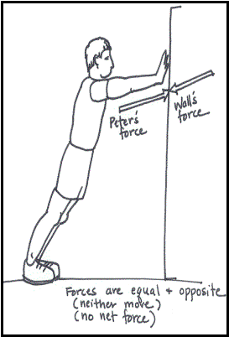
Newton’s Law’s of Motion
Newton's Third Law of Motion says that when two objects push or pull against each other, the forces that they feel are equal and opposite.
Notes:
Newton's Third Law of Motion says that when two objects push or pull against each other, the forces that they feel are equal and opposite.
An example would be staying still while pushing against a wall. The wall must be pushing back against you with an equal force otherwise the wall would accelerate away from your hand.
Newton’s third law can be used to explain the motion of flight.
The wings push the air downwards.
In turn the air reacts by pushing the wings (and therefore the airplane) upwards. The size of the force on the air equals the size of the force on the airplane; the direction of the force on the air which is downwards is opposite the direction of the force on the airplane which is upward. For every action, there is an equal and opposite reaction.

Slide 8
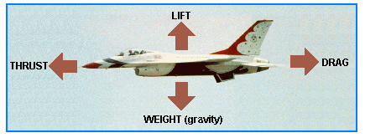
Four Forces Acting on an Airplane
Notes:
This picture shows the forces that act on an airplane in flight.
An aircraft in straight and level flight is acted upon by four forces: lift, gravity, thrust, and drag. The opposing forces balance each other; lift equals gravity and thrust equals drag. Any inequality between thrust and drag, while maintaining straight and level flight, will result in acceleration or deceleration until the two forces again become balanced. As well, an inequality between lift and weight, will cause the airplane to climb up or come down.
People can't fly. If we jump up in the air, gravity pulls us back down.
Our weight is caused by the pull of the Earth's gravity. Weight is the force with which gravity presses us against the ground. And it is equal to mass X acceleration due to gravity which is 9.8 m/s squared.
An aircraft can't float in the air like a balloon. It needs an extra force to keep it up. Its wings are tilted and specially designed to give the extra force. The force is called lift. And it is generated by the movement of air above and below the wing.
Drag is a force that opposes thrust. It resists the movement of objects.
It is generated by air not flowing smoothly across the surface of the aircraft. Drag is aligned with the direction of the airflow.
You can feel the force of drag when you walk through water.
Thrust is a force that is generated by an airplane’s engines. Thrust is opposite to the direction of the airflow.

Slide 9
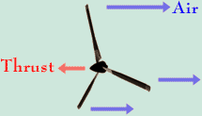
How does a propeller make the aircraft move forward?
The engine turns the propeller.
The propeller is specially shaped to push the air backwards. This results in a reaction force on the propeller that moves the aircraft forwards. (Thrust).
Notes:
Since our airplane has a propeller, let’s see how a propeller generates thrust.
The engine turns the propeller.
The propeller is specially shaped to push the air backwards. This results in a reaction force on the propeller that moves the aircraft forwards.
(Swimmers move forwards through the water in a similar way, by pushing water backwards).

Slide 10
Energy
Energy: The ability of an object do work. Has units of Joule (J) or newton-meter (Nm).
Kinetic Energy: Energy of motion.
KE=1/2mv²
Potential Energy: Stored energy.
U_{g}=mgh
Notes:
Energy is defined as the ability of a physical system to do work. The SI unit of energy is the joule (J) or newton-meter (N * m).
There are several different types of energy. Today we are going to look at kinetic and potential energy.
When the work is actually being done, we term the energy “kinetic.” When the work is waiting to be done, or when there is the potential
for work to be performed, we term the energy “potential.” In other words, Kinetic energy is the energy of motion, potential energy comes from work having been done on an object which was then stored. So we refer to it as stored energy.
For example, a rubber band zinged from your finger has kinetic energy. While it was stretched, waiting for you to release it, it had potential energy.

Slide 11
Work and Energy
Work: The amount of energy transferred by a force acting through a distance. Unit of Joule (J).
W=F∙d
What about for our model airplane?
Notes:
Work is the transfer of energy.
In physics we say that work is done on an object when you transfer energy to that object.
If you put energy into an object, then you do work on that object.
If a first object is the agent that gives energy to a second object, then the first object does work on the second object. The energy goes from the first object into the second object. At first we will say that if an object is standing still, and you get it moving, then you have put energy into that object.
For example, a golfer uses a club and gets a stationary golf ball moving when he or she hits the ball. The club does work on the golf ball as it strikes the ball. Energy leaves the club and enters the ball. This is a transfer of energy. Thus, we say that the club did work on the ball.
And, before the ball was struck, the golfer did work on the club. The club was initially standing still, and the golfer got it moving when he or she swung the club.
The amount of work is calculated by multiplying the force times the displacement or distance.

Slide 12
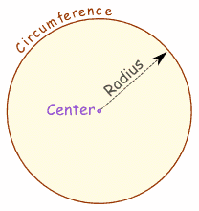
Work Done by the Propeller
The distance around the edge of a circle (or any curvy shape) is the circumference:
C = 2πr
We must also count the number of times the propeller travels around the circle.
Distance = (2πr) x turns

Slide 13
Power and Steady State
Power: The time rate of energy transfer. Unit of Watt (W) or J/s.
P=W/t
Steady State: to maintain an aircraft in flight, the power input has to be equal to the power output to its surroundings.
Notes:
Power: the rate of transfer of energy from one place (or form) to another.
Steady State: A stable condition that does not change over time or in which change in one direction is continually balanced by change in another. In other words, a system where input is balanced by output.
To maintain an aircraft in flight, the power input has to be equal to the power output to its surroundings.

Slide 14
Calculations
Using some of the equations and concepts we have just learned, let’s calculate the potential energy stored in the rubber band.

Slide 15
Our Model Airplane
Recall that the propeller provides the thrust to move the plane horizontally.
In the model, potential energy is stored in the twisted rubber band powering the propeller.
When the rubber band untwists, kinetic energy is released and work is done in turning the propeller.
Thus, the potential energy stored in the rubber band will be equal to the work.
Notes:
Airplane engines push fast moving air out behind the plane (by either propeller or jet) causing the
plane to move forward. The propeller provides the thrust to move the plane horizontally. In the
model, potential energy is stored in the twisted rubber band powering the propeller. When the
rubber band untwists, kinetic energy is released and work is done in turning the propeller. The
propeller provides the thrust, which pushes the airplane forward according to Newton’s Third
Law.

Slide 16
Model Airplane
Recall that Work= Force X distance
How can we measure the force the rubber band exerts on the propeller?
F=mass x acceleration (9.8m/s²)
What about the distance?
d= 2πr (number of turns)
For our model: W= F x (2πr) (number of turns)

Slide 17
Notes:
I wound the propeller 25 times and measured the force. Then I measured it again in increments of 25 until I reached 300. This is the winding up line. Then without letting the propeller go, wound back down in increments of 25 until I got back down to 25. This is the winding down line.
Why is the energy stored in the rubber band different when we measure it again after winding the propeller back down?

Slide 18
Model Airplane
Why is the energy stored in the rubber band different when we measure it again after winding the propeller back down?
Some of the energy was lost to heat in the rubber band!

Slide 19
Model Airplane
Now that we have calculated the work, let’s calculate the power.
How can we do this?
Power = Work/time

Slide 20
Notes:
I timed how long it takes for the propeller to unwind and divided this by the work.
However, this is not a great estimate as the propeller unwinds very fast at the beginning and then slows down towards the end.
Therefore, it would be much better to do this using calculus and integrating.
Also, when the airplane is flying, there will be air resistance. As well, the airplane will glide to the ground after the propeller unwinds. Therefore, this calculation will be different when timed while the airplane is flying.

Slide 21
Transport Cost
This is the most important measure of energy use in transportation.
Energy consumed per unit mass per unit distance travelled.
Measure of energy.
Units of J/kg/m or kWh/tonne/km.
Notes:
The most important measure of energy use in transportation is energy consumed per unit mass per unit distance travelled; this is known as the transport cost . It can be determined for the model airplane, and compared with full-sized aircraft. We call it E_{trans} (to emphasize that it is a measure of energy and not monetary cost) and the formal units are J/kg/m, kWh/tonne/km etc. but as we will see, physically it is just a constant times g, the acceleration due to gravity.
When you throw our well-balanced model airplane into still air at an appropriate speed, it flies in a straight line at a constant speed at an angle to the horizontal known as the "glide slope" and eventually hits the ground. Needless to say, the smaller this angle is, the better the glider. If you measure the mass of the glider, and the speed and the angle at which it flies, you can determine the rate at which it is losing potential energy. This is the power one would have to supply to the plane in order to keep it flying level.
I stuck a mass on the nose of the airplane the same mass as the propeller and measured the glide slope.
Then I calculated the transport cost.

Slide 22
Transport cost of a model airplane
 | Distance travelled | Measurement | 4.3 | m
 | Height drop | Measurement | 1.4 | m
 | Glide slope | Height/Distance | 0.325581395
 | g |  | 9.8 | m/s2
 | Transport cost | =PE/ mgh/d = g*(glide slope) | 3.190697674 | J/kg/m | MJ/tonne/km
 | Transport cost |  | 0.89 | kWh/tonne/km
Transport Cost of 747 is 0.5 kWh/tonne/km

Slide 23
Let’s build some airplanes!

