Slide 1
Fluid Flow
Paul Drosinis
UBC Phys 420

Slide 2
Introduction
Short history on fluid dynamics
Why bother studying fluid flow?
Difference between Newtonian and Non-Newtonian Fluids
Laminar vs. Turbulent Flow and the Navier-Stokes Equation
Reynolds Number

Slide 3
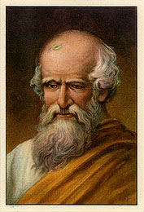
Brief History
Archimedes (285-212 B.C.) – formulated law of buoyancy and applied it to floating and submerged bodies
ischoolsfndiloy.wordpress.com

Slide 4
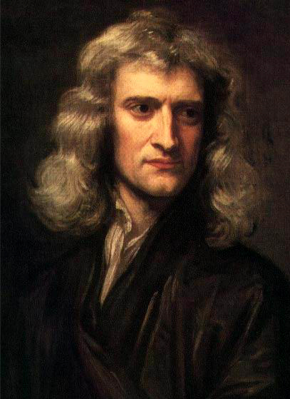
Brief History
Isaac Newton (1642-1727) – postulated laws of motion and law of viscosity of linear fluids
Frictionless fluids – many problems solved by great mathematicians (Euler, Lagrange, Laplace, Bernoulli etc.)
http://psychogeeks.com/isaac-newton/

Slide 5
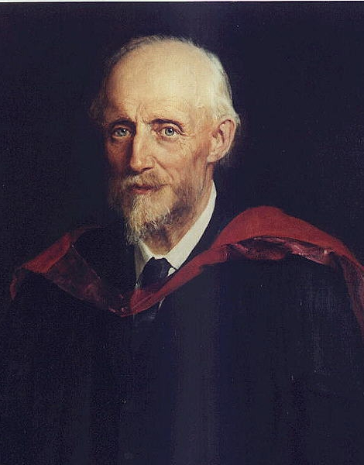
Brief History
Osborne Reynolds (1842-1912) – classic pipe experiment illustrating importance of so-called ‘Reynolds Number’
http://en.academic.ru/dic.nsf/enwiki/191600

Slide 6
Why Study Fluid Flow?
Widely applicable to many phenomena: blood flow through arteries/veins, automotive design, aeronautics
Deeper understanding can be used to design faster and more efficient ships/airplanes

Slide 7
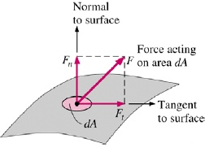
Stress and Shear
Stress: defined as force per unit area
-has magnitude and direction
Can have both normal and tangential stresses
http://www.scribd.com/doc/10119418/Fluid-Mechanics-Lecture-Notes-I

Slide 8
Finding Newton’s Law of Viscosity
We are going to model a ‘block of fluid’ as many sheets stacked on top of one another
In this way we can figure out how the shear force is related to the viscosity

Slide 9
What is viscosity?
Property of a fluid that describes its ability to resist flow
It’s a measure of the internal friction associated with this flow
Substance | Viscosity(kg/m*s)
Air | 0.02
Water | 1.00
Milk | 1.13
Blood | 4
Olive Oil | 90
Motor Oil | 320

Slide 10
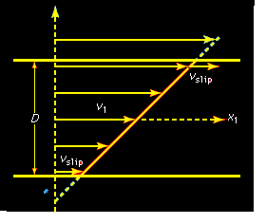
Stress and Shear
Force in a fluid acts along the surface of each sheet and is proportional to the relative velocity
http://www.britannica.com/EBchecked/topic/211272/fluid-mechanics

Slide 11
Finding Shear Force
y
x

Slide 12
Finding Shear Force
Forces act parallel to the sheets
If we talk about force per unit area, find that:
As ℇ gets smaller, the difference becomes a gradient

Slide 13
Shear Stress
If we model a body of fluid as composed of many thin sheets, find that:
Velocity
Gradient
Stress
Viscosity

Slide 14
Finding Shear Force
Constant of proportionality here is the viscosity: η
What are its units?

Slide 15
Units of Viscosity

Slide 16
Newtonian vs. Non Newtonian Fluid
Linear dependence of shear stress with velocity gradient: Newton’s Law of Viscosity
Viscosity will change only if temperature or pressure changes
Don’t resist much when a force is applied
Ex: water

Slide 17
Newtonian vs. Non Newtonian Fluid
Non-Newtonian fluids will change viscosity when a force is applied
Can cause them to become thicker or thinner depending on the substance in question

Slide 18
DEMO!

Slide 19
Navier-Stokes Equation
Set of non-linear partial differential equations that describe fluid flow
Also used to model weather patterns, ocean currents, and airflow around objects
Very difficult equation to solve

Slide 20
Navier-Stokes Equation
Rate Change in
Momentum Density
Viscous
Term
Body
Forces
Pressure Gradient

Slide 21
Reynolds Number
Ratio of inertial forces to viscous forces in a fluid
Describes the relative importance of each term
Important factor in determining the transition from laminar to turbulent flow

Slide 22
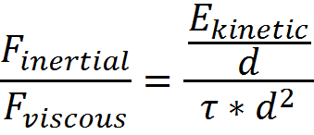
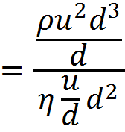
Reynolds Number
Can be calculated from the Navier-Stokes equation
More intuitively:

Slide 23
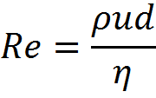
Reynolds Number
η - viscosity
ρ – density
u - velocity
d – characteristic length

Slide 24
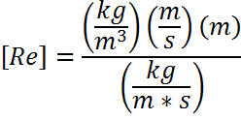
Reynolds Number Units?
Reynolds number is dimensionless!

Slide 25
Laminar Flow
Fluid travels smoothly in similar paths
No mixing between adjacent ‘sheets’ of fluid
Sheets slide over one another
All flow properties constant at any given point (velocity, pressure, etc.)

Slide 26
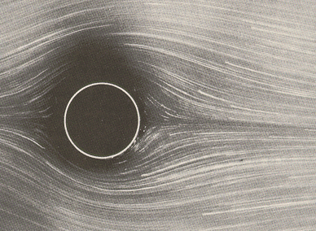
Laminar Flow
https://wiki.brown.edu/confluence/display/PhysicsLabs/PHYS+0050+and+0070+Handouts

Slide 27
Turbulent Flow
Formation of eddies and vortices associated with high Reynolds number fluids
Flow becomes chaotic
Complete description of turbulent flow still an unsolved problem of physics

Slide 28
Turbulent Flow
http://www.colorado.edu/MCEN/flowvis/gallerie/2010/Team-1/FV_popup1-8.htm

Slide 29
Laminar vs. Turbulent Flow
Fluids behave very differently depending on the value of the Reynolds number
Low Re – Laminar Flow
High Re – Turbulent Flow

Slide 30
Questions?

