Slide 1
EARTHQUAKES
Amy O’Brien

Slide 2
Why do we have earthquakes?
Fluid rock moving inside the earth
The outer layer (called the lithosphere) is solid.
The second layer (the athenosphere) is fluid.

Slide 3
Credit: U.S. Geological Survey Department of the Interior/USGS

Slide 4
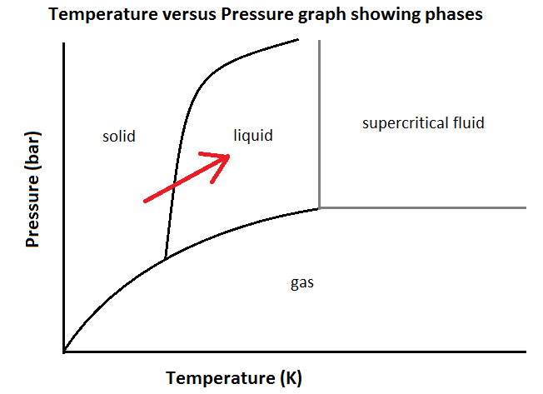
The athenosphere is fluid because it has a high pressure and temperature.

Slide 5
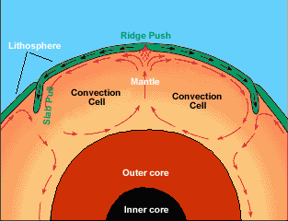
The center of the earth is hotter than the outside.
The athenosphere closest to the center gets hotter and rises towards the surface.
It cools and goes back toward the center.
Get convection currents
Eg. Lava lamp
Credit: Windows to the Universe
windows2universe.org

Slide 6
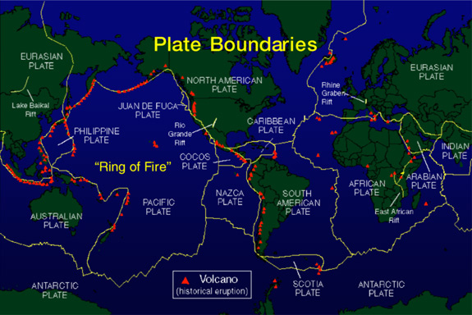
Tectonic plates
The lithosphere is broken into sections called tectonic plates.
Source: http://ferrebeekeeper.files.wordpress.com/2010/09/tectonic-map.jpg

Slide 7
What do the convection currents do to the plates?
Cause the plates to move
What do the movements cause?
Mountains
Trenches in the ocean
Volcanoes
Earthquakes

Slide 8
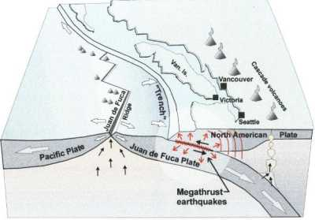
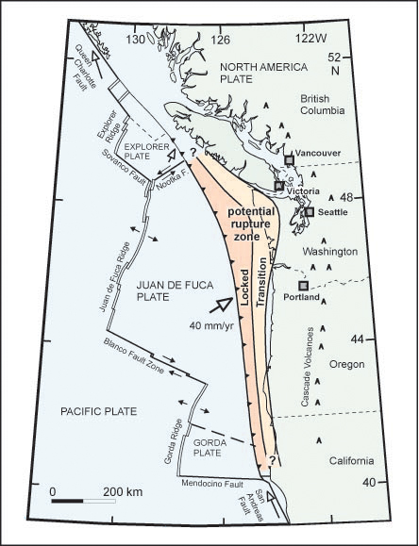
Credit: www.nrcan.gc.ca
Source: http://www.nrcan.gc.ca/sites/www.nrcan.gc.ca.earth-sciences/files/jpg/geodyn/images/ets_fig1_e.jpg
Notes:
Show different kinds of plate motion using the three demos, explaining effects.

Slide 9
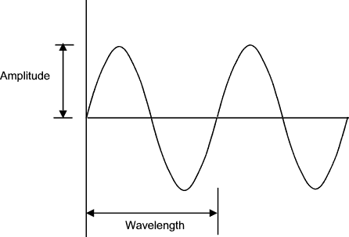
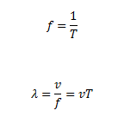
Waves
Waves travel through the earth away from the plates that moved.
What does a wave look like?
Source: http://blackandwhitecomputer.blogspot.ca/2012/09/analog-signal-and-data.html

Slide 10
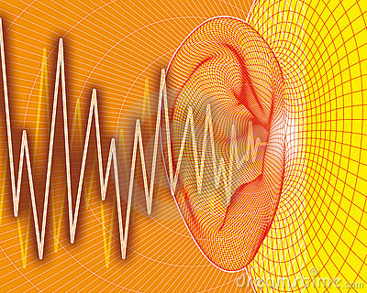
Examples of waves
http://www.physics.uoguelph.ca/~myazdani/PHYS3220/index.html
http://sciencedoing.blogspot.ca/2012/10/sound-wave.html

Slide 11
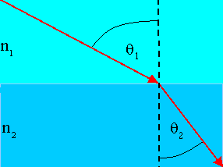
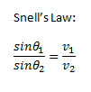
Earthquake waves
Two types of waves travel through earth:
P-waves: longitudinal, faster
S-waves: transverse, slower
The Earth has layers
Waves are refracted
Credit: http://people.physics.carleton.ca/~watson/Physics/1000_level/
1008_Waves_and_Optics/1008_Geometric_Optics.html

Slide 12
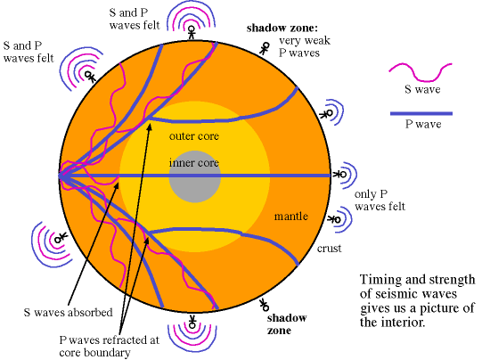
Credit: http://www.csu.edu.au/
Notes:
Do questions 1-3

Slide 13
Questions 1-4

Slide 14
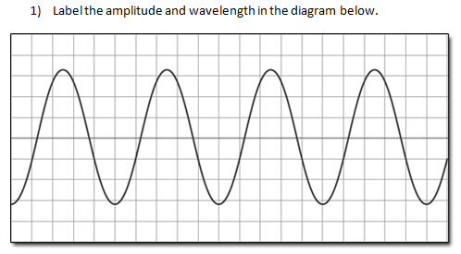

Slide 15
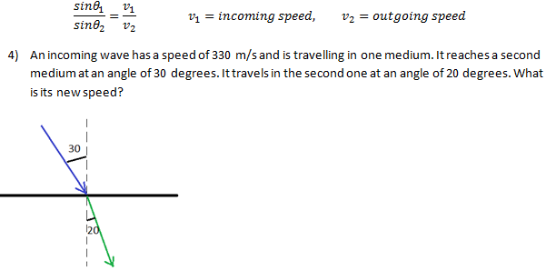

Slide 16
Solutions (Questions 1-4)
1.

Slide 17
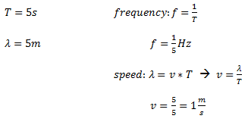
2.
3.

Slide 18
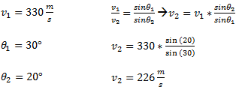
4.

Slide 19
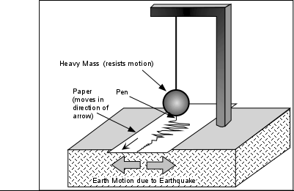
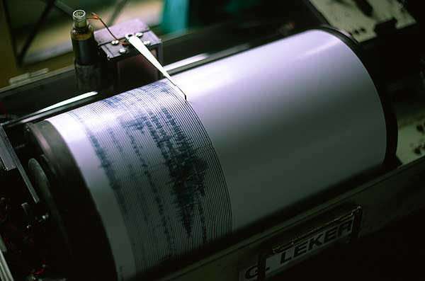
Detecting P and S waves
Use a seismograph
Credit: earthsci.org/index.html
Credit: http://aggas2nd.blogspot.ca/2011/04/ancient-seismograph.html

Slide 20
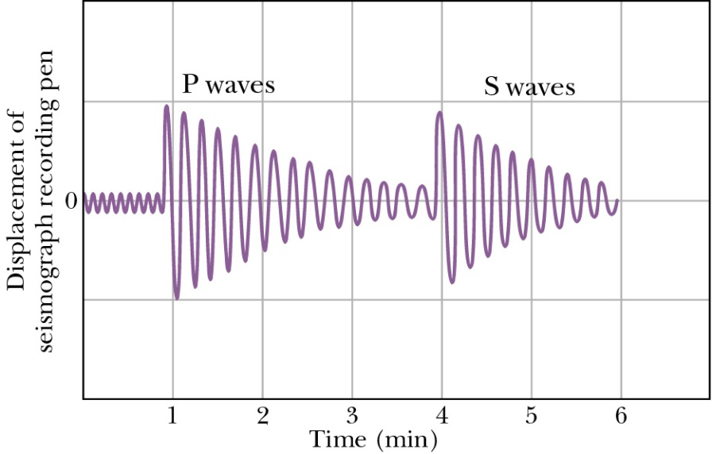
P and S waves travel at different speeds, so they arrive at different times.
Credit: ://panda.unm.edu/Courses/Price/Phys160/HW38.htm

Slide 21
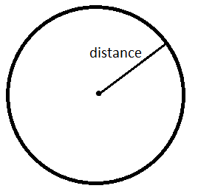
So, we can tell what distance the waves traveled based on how far apart the P and S waves are.
But we don’t know what direction the waves came from.
Get a circle of where the waves could have come from

Slide 22
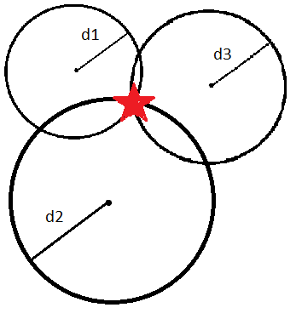
When you have data from at least three seismographs, you can find where the waves came from.

Slide 23
Richter scale
Ranks amount of energy in earthquake
Uses a logarithmic scale
Credit: http://mishunderstanding.wordpress.com/2011/01/23/what-is-the-richter-scale/

Slide 24
Richter scale examples
Ottawa
Nov 5, 2012: magnitude 4.2
Rattled houses, but no damage
Haida Gwaii (one of the islands of the coast of B.C.)
Nov 1,2012: magnitude 7.7
Shut off the hot springs
Largest recorded: Chile
May 22, 1960: magnitude 9.5

Slide 25
Surface waves
Travel away from the source along the surface
Slower than the P and S waves
Two types:
Love waves: faster, transverse waves
Rayleigh waves: slower, longitudinal and transverse waves

Slide 26
Doing damage
Resonance
Buildings have a natural frequency
If the frequency of the wave is the same as the natural frequency of the building (or a multiple of it), the building will shake a lot more

Slide 27
Questions 5-7

Slide 30
5.
6.

Slide 31
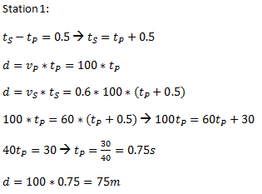
7.

Slide 32
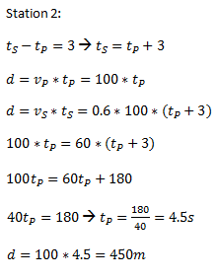
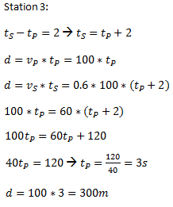

Slide 33
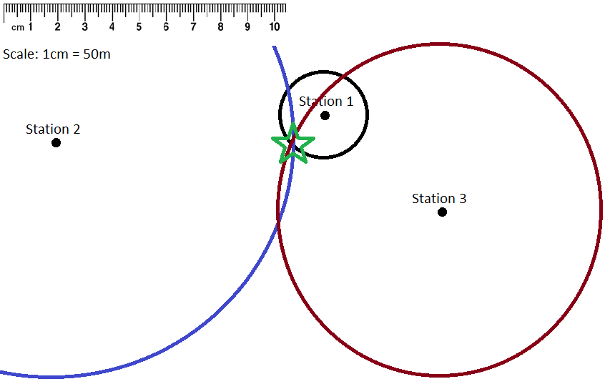

Slide 34
Summary
The athenosphere has convection currents.
The currents cause tectonic plates to move, causing earthquakes.
Waves travel through the earth and on the surface

