Slide 1
Sound and Acoustics
Chironjeev Kanjilal
Nov. 8th 2016

Slide 2
What is Sound?
Sound is our perception of a medium being set in motion at certain frequencies
When we create sound, we create vibrations that cause the air molecules around us to move
These vibrations spread out from us, causing pressure waves as the molecules transfer energy by bumping into adjacent molecules
Notes:
Why is sound important?
Everyday our world is filled with a multitude of sounds
Communication (speaking, phones)
Entertainment (music, videos, etc.)
Warnings and danger (fire alarm)
Imagine a world without sound (as some people actually experience)
Or they actually experience it differently (which we might get into later)
But what is happening?
Show tuning fork (Anyone know what this is?)
Strike tuning fork (Did anything happen?)
They probably won’t be able to hear the small one. Touch it to the table and ask again. What changed?
[So they can hear the sound but may not know what is happening]
We’ll come back to this in a moment
What we perceive as sound is the result of vibrations in our hearing processes.
[Point 1]
What does this even mean? We’ll get to that.
[Point 2 and 3]
This creates areas of high and low air pressure (i.e. more/fewer molecules) spreading away from the source
If any of this doesn’t make sense right now, don’t worry, we’ll come back to it soon

Slide 3
What is Sound?
Vibrations
Sound is a pressure disturbance that moves through a medium in the form of mechanical waves
Sound waves are made up of compressions and rarefactions
Notes:
Let’s go back to the idea of sound as vibrations and work through what I just said
[Point 1.1]
What is a medium? A medium is the thing through which energy may travel through. In this case, the medium may be any solid, liquid, or gas. A medium is the substance or material that carries the wave.
Consider news and media, you’ve heard the term there of course. The media (plural of medium) refers to newspapers or television networks or radio stations, etc. The news moves through the media. The media is the thing that is carrying the news from the source to your television set and your house and ultimately to you.
Another way to think about it, think of the ocean. The waves of the ocean travel through the water. So the water is the medium.
So now when I’m talking to you, what is the medium here? The air. But it doesn’t have to just be air.
But now, what the heck is a wave?
Have you guys heard of waves before? Can you give examples?
Ever been to a stadium or a sports arena? Watched a hockey or soccer game? Know that thing the crowd likes to do sometimes, called The Wave? A group of people jump up and sit back down quickly and then nearby people see them and do the same thing and so on
[Figure 1]

Slide 4
Waves
Compression is when particles are pressed together
Rarefaction is the opposite: the particles are given some extra space
Notes:
[Points 1 and 2]
[Work through Figure 2, see how things are squished and not squished together]
See when the red line pushes on the particles, how some parts alternate between being squished together and some parts are more spread out from the other particles.
So sound is just alternating compressions and rarefactions in the air
How does this work? Recall that sound is an energy, and it is essentially kinetic (motion). As the particles are moved from the rest position, they exert force (hit) to adjacent particles and pass this energy on.
Note when we talk about particles, we don’t have to mean a single atom or molecule. It is enough to talk about tiny concentrations of matter capable of energy transmission.

Slide 5
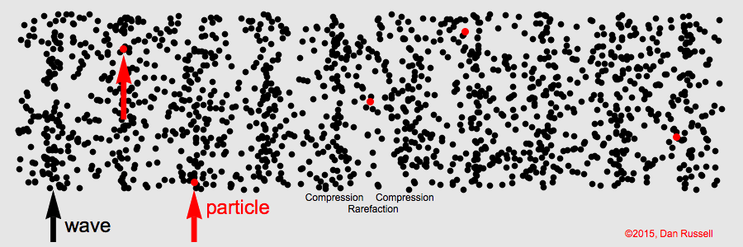
Waves
What do waves look like?
Notes:
Now what do sound waves look like?
Of course we can’t see sound waves, but we can model what is happening, using the knowledge we just acquired.
[Figure 1]
See how these particles travel side to side? This is actually what is called a longitudinal wave: the motion is in the same direction as the wave is travelling
Recall what we discussed about compression and rarefaction
[Draw something like this on the board: speaker and sound coming out: compressions and rarefactions]
Now if we were to try and plot the magnitude of how compressed these sections are as a function of time, what would we get? [Work through some points]
Another thing to note…while the wave moves, each individual typically does not! What I mean is, a particle may move up and down or side to side with the wave, but it won’t actually travel with the wave.
[Figure 2]
See how the particle (in red) moves up and down? But the wave goes on. This is known as a transverse wave and the particle motion is up and down: perpendicular
Note how this looks like what we’ve drawn on the board, but what is on the board is a measure of how packed the particles are at a point, whereas in the .gif it’s a measure of the position of the particle. Does that make sense? Great
But why should you believe me? How can I prove all this to you, or at least some of it? Well what if I attached this microphone to this oscilloscope…
[Tuning fork in the oscilloscope to show]
[Video to 1:45]

Slide 6
Vibrations
How can we see that the fork is vibrating?
Get a tub of water
Get a tuning fork
Strike the tuning fork and dip it slowly into the tub of water
What happens?
Notes:
Let’s go back to the tuning fork.
You obviously can’t see it vibrating, but if I gave it to each of you and asked you to try it out, you’d see that indeed it does. But a quicker way to prove this
[Tuning fork in water demo]
[Use doc cam for this]

Slide 7
How Do We Describe Waves?
Crests and Troughs
Amplitude
A measure of the height of the wave a particular point
Typically we measure amplitude from peak-to-peak or from the x-axis
Wavelength
Waves that repeat in a regular manner are called periodic
Each individual repetition is called a cycle
The distance from the start to the end of a cycle is a wavelength
Notes:
[Go back to the drawing on the board or draw standing wave, at least two cycles]
Let’s say we have this wave here.
[Point 1]
Now let’s draw some axes (they should know about drawing graphs like position vs. time or something)
What might we call the y-axis? We might call it something like pressure if that was what we wanted to look at or maybe position of the particle.
How about the x-axis? Usually we might call this time, although it doesn’t have to be. But let’s call it pressure and time.
Now the distance from the x-axis to a point on the wave is what is called the amplitude. The higher/bigger the amplitude, the more energy. [Point 2.0 – 2.1]
Typically, with sound, the amplitude is connected to the volume and perceived as loudness: higher amplitudes → louder sounds
[Point 2.2]
So that’s a vertically based measurement. Now horizontally, notice how the crests and troughs come back, in this case they repeat. This motion we’ve been seeing, where things repeat, this is known as periodic motion.
Waveforms that repeat in a regular manner are called periodic, because it repeats after equal intervals of time. [Point 3.0 – 3.2]
Since the wave repeats like this, we don’t need to look at the whole thing. What we can do is look at one section, for example from one crest to the next. This is a wavelength.
[Point 3.3]
We use ‘lambda’ to represent this

Slide 8
How Do We Describe Waves?
Frequency
A measure of the number of cycles of a waveform that occur in a set time
Frequency is perceived as pitch
Measured in cycles per second (c.p.s.) or Hertz
Period
The amount of time for something to complete on cycle/repetition
Period and frequency share an inverse relationship
Notes:
Another characteristic of a wave is its frequency
[Point 1.0-1.2]
The higher the frequency, the higher the pitch.
Frequency is measured in cycles per second but also in Hertz: these are the same thing, Heinrich Hertz did a lot of work with frequency-related phenomena, specifically with electromagnetic waves (another kind of wave) and the theory of light. [Point 1.3]
Note that since a rising frequency has a greater number of cycles per second, it follows that each cycle of the waveform becomes shorter in length. [Repeat].
In a given amount of time, to fit more cycles in it (increasing frequency), we have to shorten the waves (decrease wavelength)
Another measurement is the amount of time it takes for a waveform to complete one cycle. This is the period [Point 2.0].
Think of it like this: frequency is the number of things per second and period is the number of seconds it takes to do the thing.
In this way, period and frequency are related inversely.
Use 10 Hz example

Slide 9
A Quick Note
Travelling waves and standing waves
Notes:
Let’s quickly talk about something else now. See how the wave is moving to the right in [Figure 2]? This is what is known as a travelling wave: the wave is travelling or moving in a direction, here to the right.
If we go back to the drawing on the board, which is similar to [Figure 1], there is no real left-right motion. This wave can be called a standing wave. Travelling waves seem easy to visualize, so let’s talk about standing waves a moment.

Slide 10
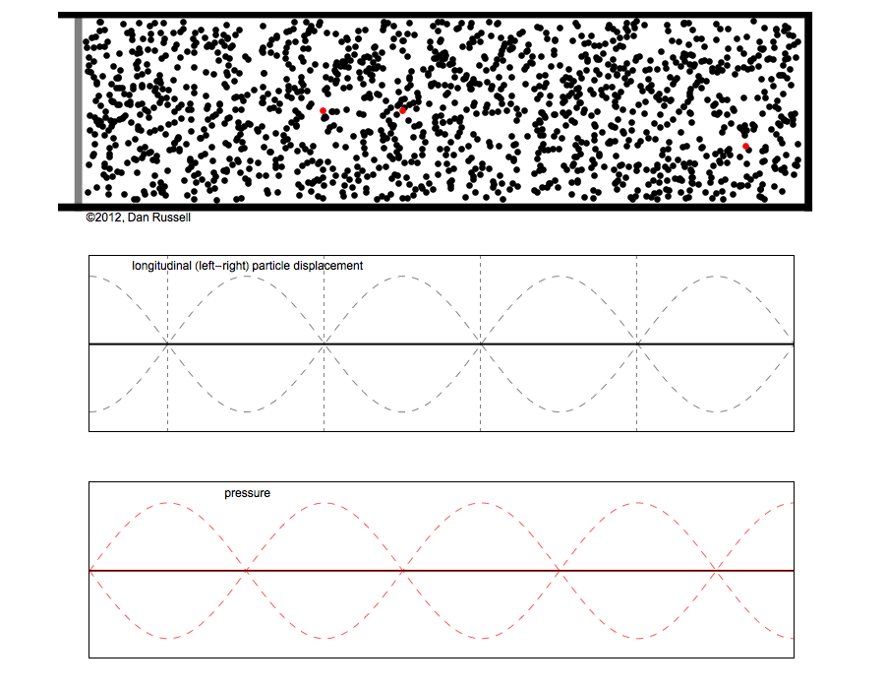
Standing Waves
Notes:
It is possible to have a wave confined to a given space and still have a regular pattern that is readily discernible
At specific frequencies, the wave looks like some points on it appear to be standing still.
[Figure 1] see how one point appears to stay in the same place and doesn’t move up and down but another point moves up and down all the time
[Figure 2] Here’s an animation that will help make this clearer
See how when the particles get squished together, we get the pressure plot going up and during rarefaction the pressure wave goes down? This is just like we’ve been discussing. Now notice however, that the place where the crests and peaks occur doesn’t move. If we follow a crest, it doesn’t move to the right or to the left.
It appears to be standing still.
The places where the wave never changes from zero are called nodes: points which don’t go up and down
Displacement nodes and pressure nodes
(We’ll be look mainly at standing waves)

Slide 11
The Speed of Sound
The speed of sound at 20°C in dry air is approximately 343 m/s
When a vehicle goes faster than the speed of sound, it is said to break the sound barrier and a sonic boom is produced
Notes:
So when I make a noise, the sound has to basically go from the source to your ears in some amount of time. This process is not instantaneous, it takes some time and sound does travel with a relatively high speed (if you compare it to our daily lives).
Imagine a baseball game. You’re at the corner farthest from the batter and when the pitcher tosses the ball, you see him hit it, but you actually don’t hear the crack for another split second.
What about lightning? You’ve noticed I’m sure that you always will see the flash of lightning well before you hear the roll of thunder. What’s happening?
Well it turns out [Point 1]
Now, the speed of sound is much slower actually than the speed of light. So this explains why we see the lighting flash and the batter hit the baseball before we hear the impact or the thunder.
If the distance from the batter to the farthest corner in the stands is about 180 m, then the time from when you see the impact and hear it is about 0.5 seconds!
What happens if we go faster than the speed of sound? [Point 2]

Slide 12
The Speed of Sound
$v_{s}=λf$
$v_{s}=343 \frac{m}{s}$ $f=440 Hz$
$$\frac{v_{s}}{f}=λ= \frac{343 \frac{m}{s}}{440 Hz}$$
$$=0.78 m$$
Notes:
We can mathematically discuss the speed of sound. There is a direct relation between the speed of sound, the frequency of a sound, and the wavelength [Point 1]
This tuning fork has a frequency of 440 Hz. We can now calculate directly it’s wavelength.
[Rest of the points]

Slide 13
Interference
When two or more waves interact with each other to produce a new wave
This new wave is the sum of the two waves
When waves interact, it is known as interference
This is called the Principle of Superposition
When two or more waves are in a medium, they may pass through each other without disturbing each other, but where they ‘collide’, the net displacement is the sum of the waves
Notes:
Before, we were just dealing with one wave. What happens if we have two or more? [Point 1.0 and 1.1 and 2]
When two frequencies occur together, at each moment in time the values of the two waves add together. This is called superposition [Point 3.0 and 3.1]
Let’s look at this more closely

Slide 14
Interference
Notes:
Imagine we have one wave coming in from the right and one from the left. What do you think will happen, based on what we just talked about? [Draw them on the board]. Well, let’s find out. [Figure 1]
What happened?
So the waves seemed to ‘collide’ then they combined for a moment and grew larger as one, then went on as if nothing happened. When they combine like this and get bigger, this is known as constructive interference

Slide 15
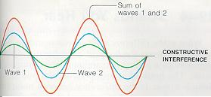
Interference
When waves combine and become larger, this is known as constructive interference
Notes:
[Talk about the points] [Throw out a question or two]
Do these waves have the same frequency?

Slide 16
Interference
When waves combine and don’t line up, they create a weaker wave that is dampened or with a lower amplitude
This is destructive interference
Notes:
[Point 1.0 and 1.1] [Figure 1] See how the summed wave is less?
[Figure 2] What is happening in this case? So the waves are the same frequency, right? And the same amplitude? But they are just offset from each other a bit, right? (We call them out of phase, when they don’t line up). So because the amplitudes are equal, when they cancel, they cancel completely and we get the red wave. Only it’s not a wave, we would actually get…nothing. Silence. Notice how the compressions and rarefactions line up.

Slide 17
Interference
Constructive Interference
Waves add and strengthen to create a wave that is has more amplitude
Destructive Interference
Waves cancel and create a weaker wave
Dead spots
Notes:
Let’s quickly summarize what we have so far.
[Point 1.0 and 1.1]
[Point 2.0 and 2.1]
[Point 2.2] Waves can interfere so destructively that dead spots can be created, or places where no sound at all can be heard.
Architects and engineers that design buildings like theatres, auditoriums, and concert halls have to take into account interference. The shape of the building they create is based on interference patterns and on amplifying (constructive interference) certain sounds and frequencies and attenuating (destructive interference) others.
[Rest of Video till 3:45]
Let’s do a quick demo!
[Audacity Demo]
Let’s look at a couple more animations quickly

Slide 18
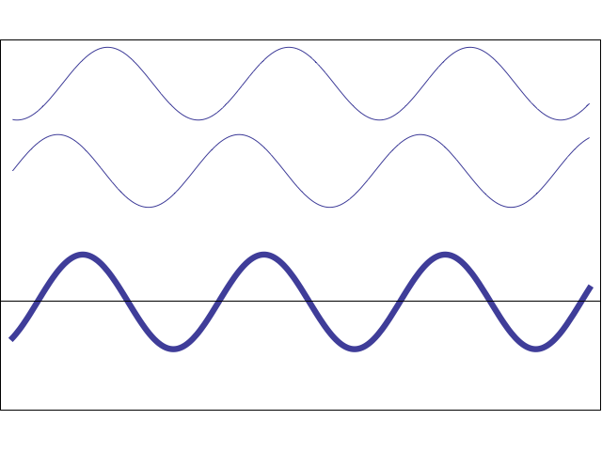
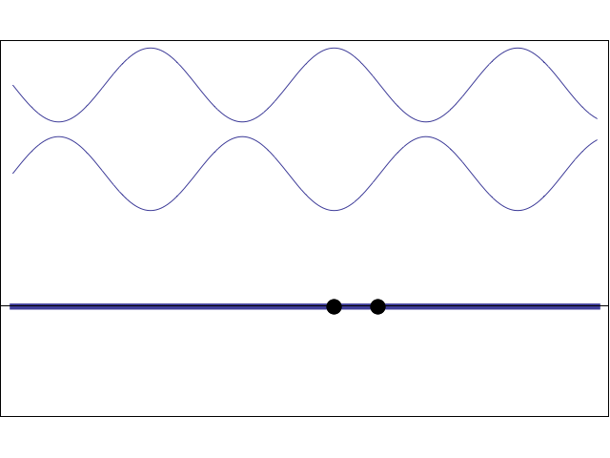
Interference
Notes:
Are the bottom two waves travelling waves or standing waves?
Notice how when they line up in just the right wave we get a dead spot!
[Figure 2]
The top two are travelling waves, right? How do we know again? But what is happening to the third wave, the sum of these two? It’s a standing wave! Just an interesting aside

Slide 19
Resonance
Objects have natural frequencies and vibrate more easily at these specific frequencies
When an object vibrates at its natural frequency, this is known as resonance
Think of singers that can break wine glasses with their voices
Notes:
[Point 1 – 3]
Imagine a wine glass [draw it on the board]
If we tap the wine glass, we’ll hear a sound coming from it. If we tap it again, we’ll hear the same sound, it’s not going to suddenly change and become deeper or higher.
This sound is caused by the vibrations that were started when we tap the wine glass.
This sound is the natural frequency of the glass.
Let’s say that the sound we hear has a frequency of 500 Hz.
Resonance is, more specifically, when one object that is vibrating, causes another to vibrate
Now let’s say we have another glass, identical. If we hit glass A and tap it, we’ll find that glass B will vibrate too, at it’s natural frequency
If we had a really loud tuning fork at 500 Hz and we struck it and brought it near the glasses, we’d find that both would begin to vibrate
Note that every sound may cause it to vibrate a bit, but at the natural frequency and resonance is when the vibrations will be most [Video]

Slide 20
Applications
Music and music technology
Buildings
SONAR
Medicine
Psychology and Speech
Oceanography
Non-Destructive Testing
Notes:
Now that we’ve really covered the basics, what is the point? What can we do with all this?
Musicians benefit from a better understanding of sound, architects need to know the science of sound to better design buildings, and many many other applications
Another use is Non-Destructive Testing

Slide 21
Active Noise Cancelling
Pre-amplifier
All-pass filter/delay
Inverting summing amplifier
Notes:
What I’ve been attempting to do, and so far so good, is create a noise cancelling unit
What I can do today is show the parts of it that are working so far.
The circuit consists of three main parts
[Point 1]
This increases the amplitude of the wave that comes in
[Use the board]
Think of it like adding a multiplicative factor
[Point 2]
This part of the circuit delays the circuit [explain how]
[Point 3]
This combines the original signal with that of the music and then inverts it
[Draw on the board the block diagram]
Mics would be attached to backs of headphones, on the outside. They’d pick up the noise and the noise would go through the circuit. At the third part, the noise gets combined with the music

Slide 22
Notes:
Go through how each component works, plug it in and show it step by step

