Slide 1
The Physics of Drifting
Chapman Kwan

Slide 2
What is drifting?
Some example videos:
https://www.youtube.com/watch?v=j3MAmVpAbEo
https://www.youtube.com/watch?v=T95p7aGg6l4
https://www.youtube.com/watch?v=VaFiAt7aPBM

Slide 3
Disclaimer
It is actually illegal to drift on the streets!
But you can do this in certain places with professionals
Or you could drift on a remote controlled car like me!

Slide 4
Agenda
History and uses
The Physics
The demonstration
The application
The discussion

Slide 5
Goals for this presentation
What is drifting?
Understanding the Physics
How the Physics is applied
What does this application tell us?

Slide 6
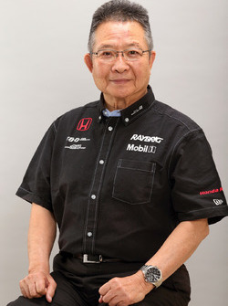
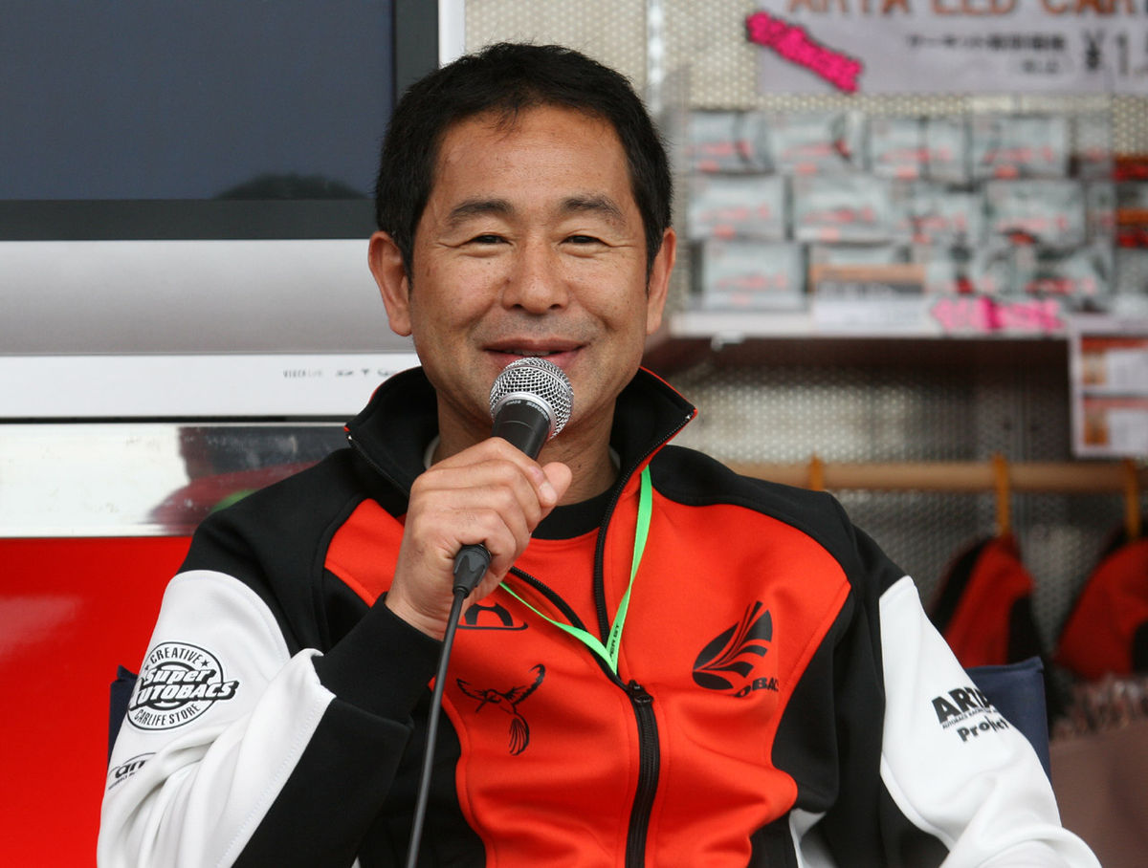
A little history
Created in 1970 by the champion of the All Japan Touring Car Championship
Kunimitsu Takahashi
Photo from: https://www.motorsport.com/driver/kunimitsu-takahashi/
Keiichi Tsuchiya Presented this style of driving in the mountains of Japan, which started an era of mountain racing and drifting
Photo from https://en.wikipedia.org/wiki/Keiichi_Tsuchiya

Slide 7
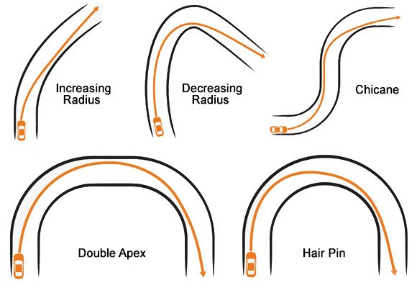
So what is drifting?
It is a manoeuvre that automobiles can perform during any turn
The most common type of turn for drifting is the 180-degree change in direction
Photo from: http://go-kart-source.com/wp-content/uploads/2014/07/Turn-Types.jpg

Slide 8
BUT WHY?

Slide 9
Because drifting is…
COOL!
But really though,
Is drifting faster? Is it more effective?
It is not necessarily faster than making a regular turn
But there are some advantages to drift in specific turns like the hairpin

Slide 10
Why?
Drifting is more advantageous because:
Enters the turn at a higher velocity
On exit, car is already facing the direction of travel!
Blocks off some of the track so people can’t overtake

Slide 11
Retrieved image from: http://www.zhutek.com/photos/alpinetour/images/image080.jpg

Slide 12
Retrieved image from: http://www.zhutek.com/photos/alpinetour/images/image080.jpg

Slide 13
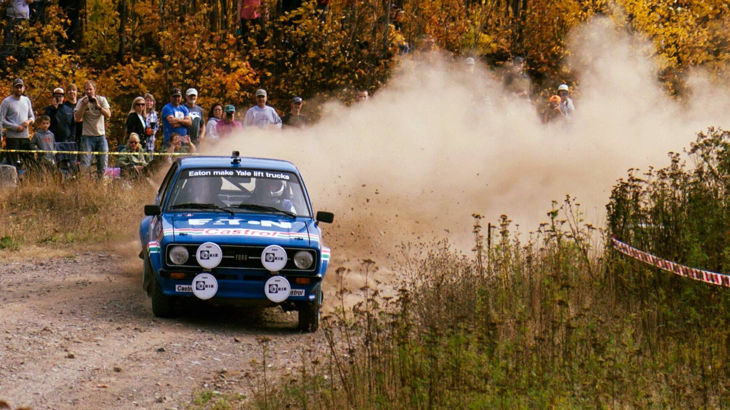
Rally races (often on dirt roads) have less traction
Less traction allows vehicles to drift easily

Slide 14
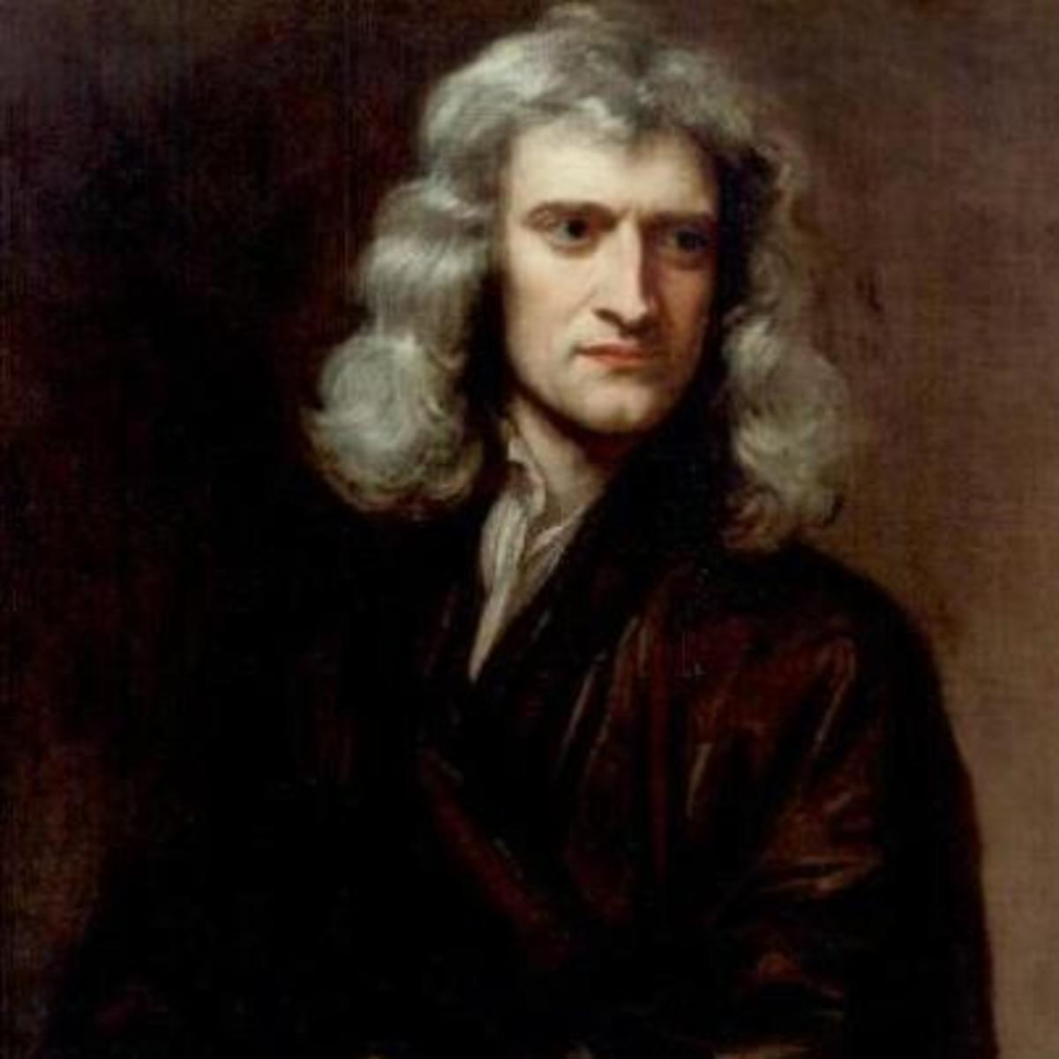
The Physics
Newton’s Laws of Motion
Inertia
Force
Action-reaction
Centripetal Force

Slide 15
Newton’s Laws of Motion
First Law:
Every object will remain at rest or in uniform motion in a straight line unless compelled to change by the action of an external force.
Second Law:
Force is equal to mass times the change in velocity per change in time.
$$F=m\frac{∆v}{∆t}=ma$$
Third Law:
For every action, there is an equal and opposite reaction.

Slide 16
Centripetal Force
Objects in circular
motion experience
a force towards
the center of the
circle in which it is
traveling in
$$v$$
$$r$$
$$F_{cent}$$
$$m$$
$$F_{cent}=m\frac{v^{2}}{r}$$
Formula from: http://hyperphysics.phy-astr.gsu.edu/hbase/cf.html

Slide 17
Centripetal demonstration
Ball on a string

Slide 18
When I swing a mass with
the string attached, the
mass will move in a
circle if I keep my end
in place

Slide 19
As I swing with a constant speed
there is a constant
centripetal force
acting on the string
Force
velocity

Slide 20
$$F=ma$$
$$F=\frac{mv^{2}}{r}$$
Force
velocity

Slide 21
The demonstration
Let us begin by looking at what a drift looks like in real life!

Slide 22
Prediction!
What if we don’t drift but we go at it at a high velocity?

Slide 23
The demonstration
I have a video recording of this demonstration in birds-eyes-view
Slowing down the video we can take a look of the manoeuvre in detail

Slide 24
Applying the Physics
CAR
$$F_{x}$$
As a car begins to move The car has an acceleration So the car has a ____
$$y$$
force
Here we have Newton’s Second Law
$$F_{x}=m_{car} a_{x}$$
$$x$$

Slide 25
Applying the Physics
As a car approaches circular motion (like the hairpin)
Hairpin turns are semi-circular motions, so if a car travels with a constant velocity (while turning) the car will experience
CENTRIPETAL FORCE
CAR

Slide 26
Applying the Physics
The car experiences
__________ force
when the car makes a turn
The force has the same
_________
throughout the entire
circular path
What changes is the
_________ of travel (velocity)
centripetal
magnitude
direction

Slide 27
Applying the Physics
Thus,
whether the car turns
regularly, or turns by
drifting; the car will
experience the same
centripetal force
throughout the same
designated path

Slide 28
Applying the Physics
The ultimate difference between these two ways of turning is the speed at which the car can travel

Slide 29
Applying the Physics
Centripetal force is the resulting force
Rather than a force that is directly applied to the car
As a car starts from 0 m/s to 15 m/s in a straight line, the applied force is its change in acceleration
$$F_{x}$$

Slide 30
Applying the Physics
The red arrow is similar to the tension force on the string attached to the ornament we discussed earlier!
$$v$$
$$F_{centripetal}$$

Slide 31
Applying the Physics
The car has applied forces (accelerates) upon entries and exits of the turn
The car experience the result of centripetal force as it changes direction during the turn
The car is able to make a quicker change in direction by using this manoeuvre
$$v$$
$$F_{centripetal}$$

Slide 32
Quick Calculation in the worksheet!

Slide 33
Take home message
Physics is applicable to everything!
Experience all of Newton’s laws of motion at all moments of our time
Centripetal force is something that occurs in driving
(Even in our daily driving) but also in other actions
Drifting may look cool, it has some benefits, though it just follows the same rules as regular turning!

