Slide 1
A Lesson on Hydraulics and Pneumatics with Heron
Julia Farry

Slide 2
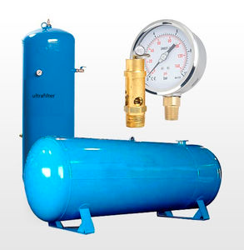
What is hydraulics and pneumatics?

Slide 3
Syringes with Air

Slide 4
Boyle’s Law
For a fixed mass of a gas at constant temperature, the volume is inversely proportional to pressure.

Slide 5
Boyle’s Law Mathematically
$P∝\frac{1}{V}$ or $P=\frac{k}{V}$where k is some constant.

Slide 6
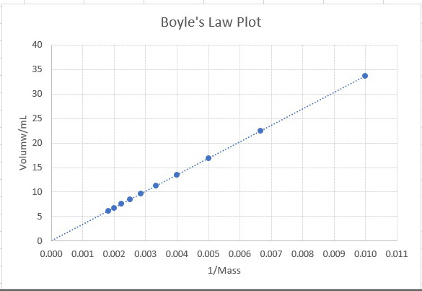
The Graphic Representation
<- Plot of Volume against Pressure
Pressure
Plot of Volume against Pressure ->
1/Pressure
https://socratic.org/questions/how-do-you-graph-boyles-law?source=search

Slide 7
Kinetic Theory of Gas
https://www.grc.nasa.gov/www/k-12/airplane/kinth.html

Slide 8
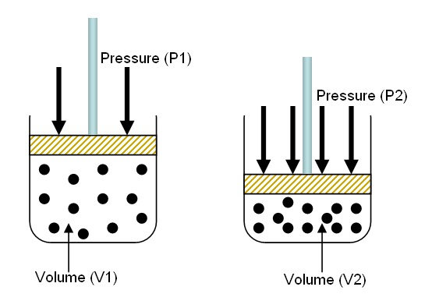
Pressure on a Microscopic Level
This idea has been converted into an equation that helps us find the force a fluid applies on a container.
$P=\frac{F}{A}$
Remember
Area of a Circle = $πr^{2}$
Circumference of a Circle = $2πr$

Slide 9
Syringes with Water

Slide 10
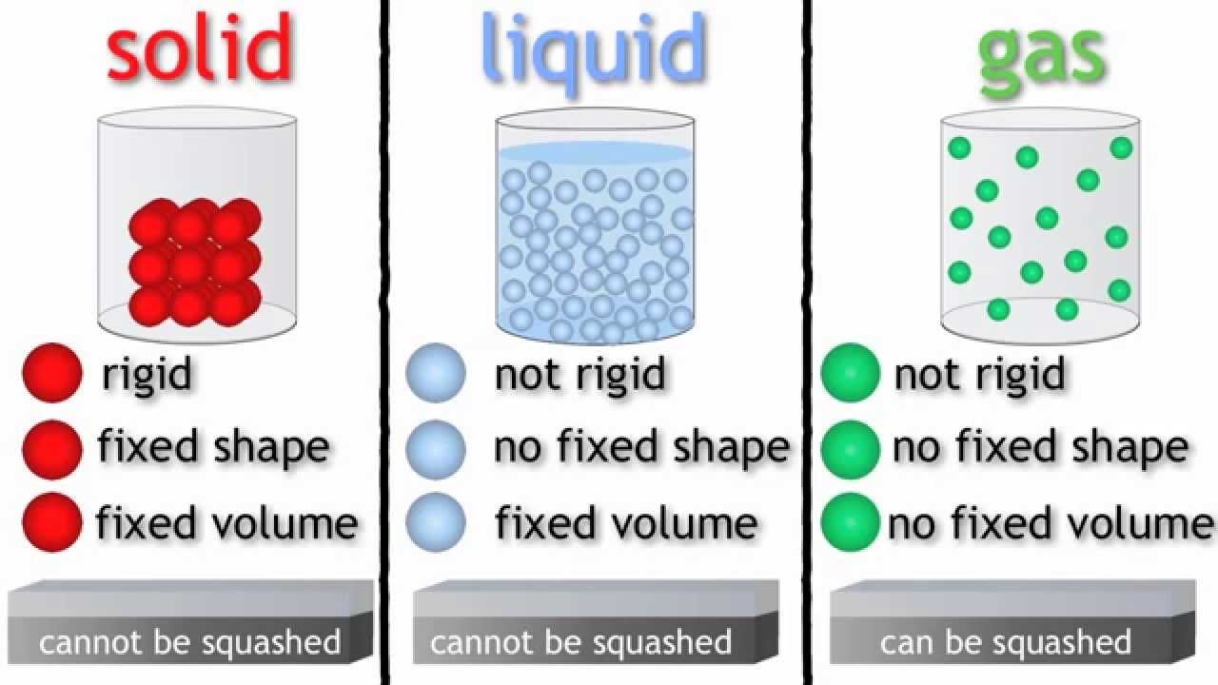
Microscopic Level
https://www.youtube.com/watch?v=21CR01rlmv4

Slide 11
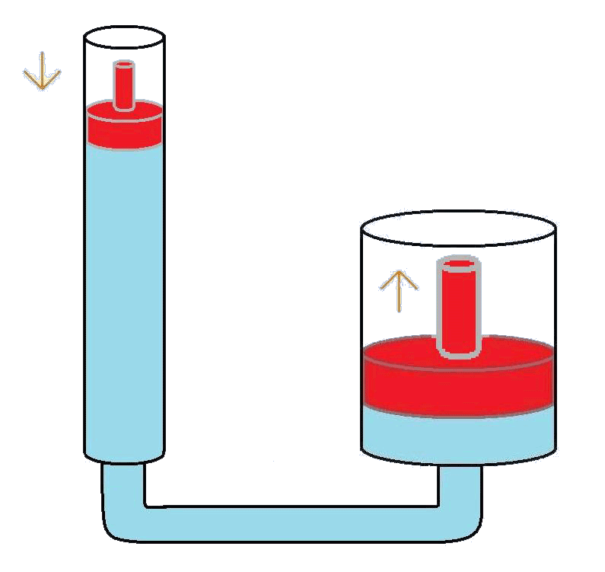
Incompressibility of Water applied in Hydraulics

Slide 12
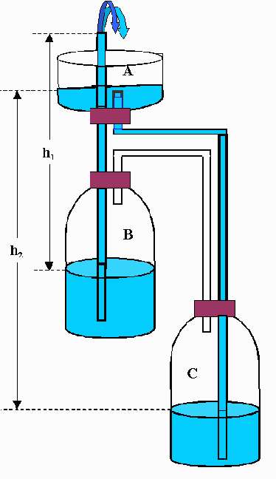
A Combination of Hydraulics and Pneumatics: Heron’s Fountain
This fountain was first constructed by an inventor and mathematician by the name Heron of Alexandria in 1st century AD.
Can anyone describe what they predict will happen when I put water in Basin A, and why?

Slide 13
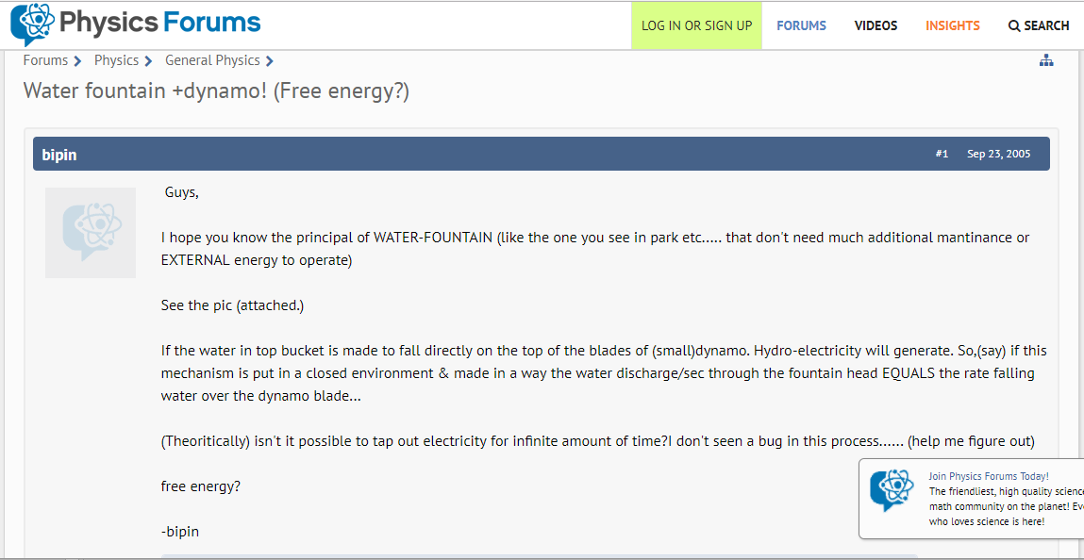
Free Energy?

Slide 14
Law of Conservation of Energy
Energy can neither be created nor destroyed but is transferred.
What is doing the work then?

