Slide 1
Exploring Electromagnetism through Eddy Current Braking
Sean Henry

Slide 2
Why are these concepts important?
Real world situations:
Motors
Transformers
Medical imaging
Loudspeakers
Trains
…

Slide 3
Background Knowledge

Slide 4
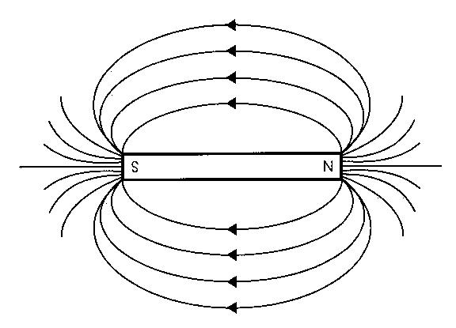
Magnetism
Magnetic fields are produced by the alignment of magnetic moments of atoms

Slide 5
Magnetism
Magnetic fields are produced by the alignment of magnetic moments of atoms
PHET simulation

Slide 6
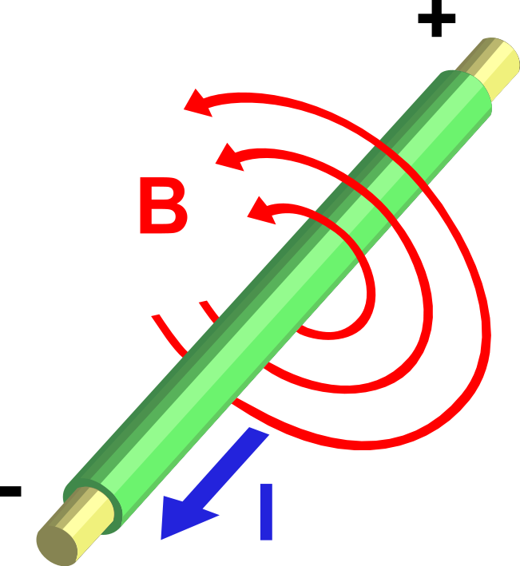
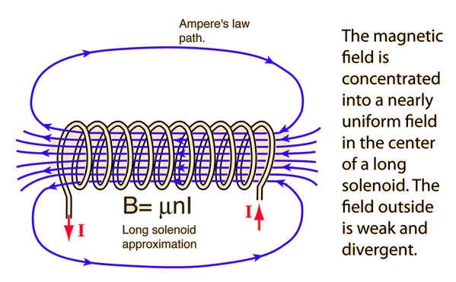
Electromagnetism
A current carrying wire produces a magnetic
field as defined by Ampere’s Law
If a metal such as iron is placed within a wrapping
of this wire, then the induced magnetic field will
align the domains within the metal

Slide 7
Faraday’s Law
A changing magnetic field will cause an electromotor force (EMF) to be induced:
$$ε=−\frac{∆Φ_{B}}{Δt}$$
Magnetic Flux
EMF
Time

Slide 8
Lenz’s Law
The direction of current induced in a conductor by a changing magnetic field due to Faraday's law of induction will be such that it will create a magnetic field that opposes the change that produced it.
PHET simulation

Slide 9
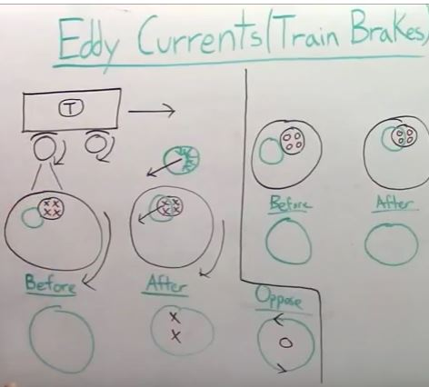
Eddy Current Brakes

Slide 10
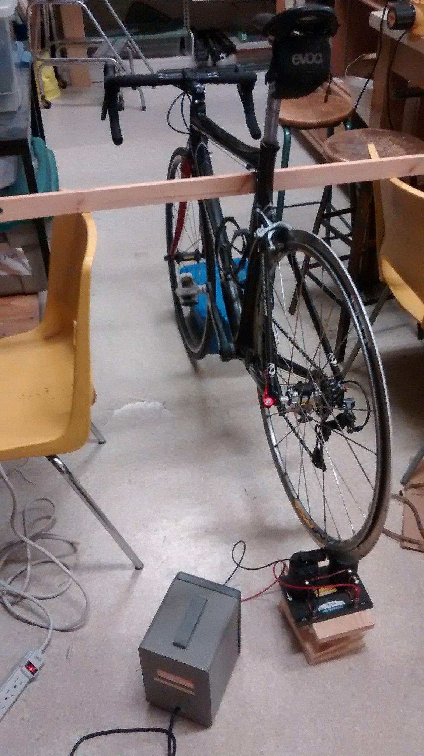
Demo Time!!

Slide 11
Predictions
The wheel will be spun to a speed of 30kmh and then left to slow down under three circumstances:
0 voltage supplied to the electromagnet
½ of max voltage supplied to the electromagnet
Max voltage supplied to the electromagnet
Order these three conditions from shortest time to bring the wheel to a stop, to the longest time taken

Slide 12
Results
 | Time taken for the wheel to come to rest
Trial | 0 Volts (seconds) | ½ Max (seconds) | Max (seconds)
1
2
3
Average

Slide 13
Questions?

