Slide 1
Sound and Resonance
By: Zaeema Choudhri

Slide 2
What is sound?
Sound is a form of energy
Sound is produced from vibrations
These vibrations create sound waves
Notes:
Ask students what they know/remember about energy. Remind them energy is the ability to do work. There are various forms of energy – light, kinetic, etc. Sound is one of them – it is able to do work.

Slide 3
What are vibrations?
Vibrations are the result of an object vibrating back and forth quickly
How do guitar strings make sound? Vibrations!
Notes:
Ask students to wave their worksheets in the air and notice that the back and forth movement produces a sound. Pass around a can with a rubber band on the top so the students can pluck the band and see how it moves back and forth. Ask students to grab the rubber band while it’s moving and note that once the band stops, the sound stops too.

Slide 4
But how do we “hear” these vibrations?
Recall that the air around us is made of small particles
The vibrations cause the air particles to vibrate, which cause other air particles to vibrate and so on
These vibrations reach our ear, which perceives them as sound
https://www.youtube.com/watch?v=3-xKZKxXuu0
Notes:
Part of interest: video at 1:38

Slide 5
What are sound waves?
Air carries sound in the form of waves
Sound waves have two main features: amplitude and frequency
The amplitude is the loudness of the sound
The frequency is the pitch of the sound
http://www.szynalski.com/tone-generator/
Notes:
Play different sounds and show students how they can be differentiated based on amplitude and frequency.

Slide 6
Quiz 1
Notes:
Worksheet question. Two different sounds will be presented and students will be asked to pick the sound whose wave has a higher amplitude. Repeat with two different sounds.

Slide 7
Quiz 2
Notes:
Worksheet question. Two different sounds will be presented and students will be asked to pick the sound whose wave has a higher frequency. Repeat with two different sounds.

Slide 8
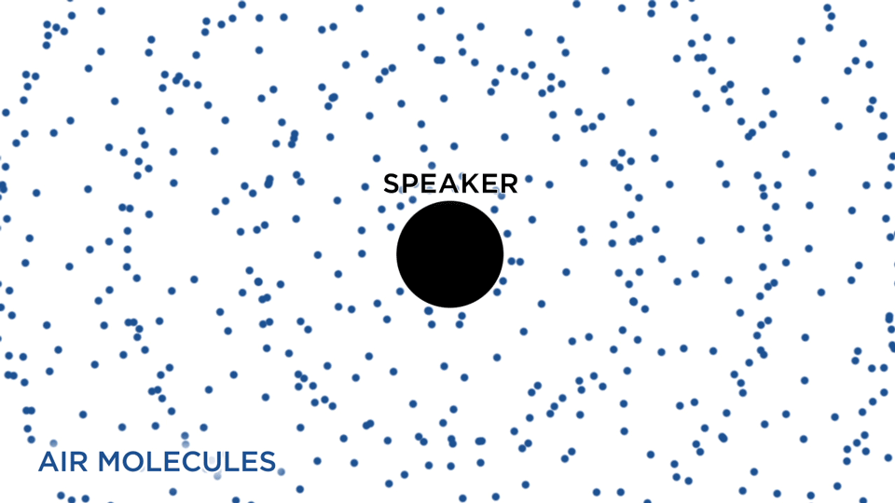
What do sound waves look like?
Similar to ripples in a pond!

Slide 9
Why do sounds have different amplitudes?
This depends on the vibrations!
The faster and bigger the vibrations, the louder the sound
Try with the rubber band!
Notes:
Demonstrate this with the rubber band. If I pluck really hard, the rubber band vibrates hard, creating a louder sound. Notice that the frequency is the same – this will be discussed in the next section.

Slide 10
Do sound waves travel forever?
Like a rolling ball eventually comes to a stop, so do sound waves
If I roll a ball hard, it will travel a large distance
Similarly, if I make a loud sound, it will be heard farther away

Slide 11
Natural frequency
Every object has a natural frequency at which it prefers to vibrate when disturbed
Try it out for yourselves!
Notes:
Have the students pluck at the rubber band gently and then hard – have them note that the rubber band makes the same pitch no matter how it’s plucked. This is because it has a natural frequency at which it prefers to vibrate.

Slide 12
Resonance
Resonance occurs when an external sound matches the natural frequency of the object
The object begins to vibrate at large amplitudes
Wine glass shattering: https://www.youtube.com/watch?time_continue=3&v=17tqXgvCN0E
Notes:
Discuss how air particles begin to vibrate, causing the object to vibrate too. When these vibrations match its natural frequency, the amplitude of the vibrations become very large.

Slide 13
Discussion
Why do you think the wine glass shattered?
What is the role of the amplitude and frequency?
Notes:
Give students a few minutes to write down what they think happened. Ask a student to volunteer his or her answer.

Slide 14
Why it shattered
The frequency of the sound matched the natural frequency of the glass, causing resonance
The glass began to vibrate very fast due to resonance, shattering
Note that the amplitude of the sound must be large, otherwise the vibrations won’t be large enough

Slide 15
What if a different frequency was played?
The glass would still vibrate but only a little
Resonance is special because vibrations are LARGE when the frequencies match

Slide 16
Helmholtz Resonators
Helmholtz resonator: a container with an opening such as a bottle
Blowing across a helmholtz resonator results in an audible sound
https://www.youtube.com/watch?v=LvDFj1B3ZgA

Slide 17
Why the different frequencies?
The frequency of the sound depends on the size and shape of the bottle
Bigger opening gives a higher frequency
Bigger volume gives a lower frequency
Longer length gives a lower frequency

Slide 18
Why do we hear sound when blowing across a bottle?
The air inside the bottle acts like a spring
https://www.youtube.com/watch?v=PZVeJ2rh6ts
The space inside the bottle allows the air to move up and down like a spring
This up and down vibration results in sound!
Notes:
Discuss video 0:45 to 1:40.

Slide 19
Demonstration
Two pop bottles (helmholtz resonator) attached to the ends of a stick
These bottles are held over a large speaker
What will happen if I play a sound that matches the bottle’s frequency?
Make sure you’re wearing ear protection!
Notes:
Give the students a few minutes to discuss what they think might happen.

Slide 20
Discussion
What if I play a different frequency?
What if I decrease the amplitude of the sound?
What causes it to spin in that direction?

Slide 21
What causes the spin?
The vibrating air rushes out of the bottles, causing them to move forward
This is similar to air leaving a balloon – the balloon propels forward!
Notes:
Take out a balloon, blow some air into it and let it go. The same is happening inside of the bottles. We recall that resonance makes the air inside the bottles vibrate back and forth – this vibrating air causes the bottles to move. The bottles will move in the direction opposite to the openings!

Slide 22
Bonus (difficult) Question
If the air is moving back and forth inside the bottles, why do they move at all?

Slide 23
Solution
Air moves outside the bottle in a more “orderly” way
When it enters the bottle, it enters from all different directions
Demonstration: https://www.youtube.com/watch?v=699WO7smx_U

Slide 24
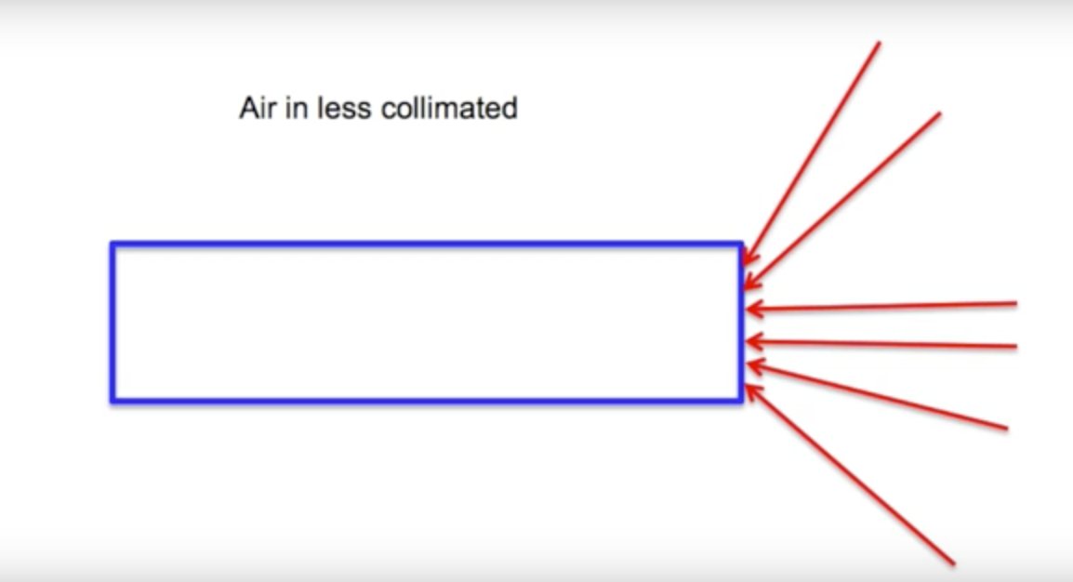
Solution (cont’d)
Air leaving the straw:
Air entering the straw:
Notes:
Diagrams from video: https://www.youtube.com/watch?v=699WO7smx_U

Slide 25
Any questions?

Slide 26
Thank you ☺

