Slide 1
The Physics of Paper Airplanes
Guanting Li
PHYS 420C

Slide 2
Goals for today!
Get to know the behind-the-scenes physics action on why our paper airplanes behave the way they do
Forces, free-body diagrams, and torque!
Fly some paper airplanes through a launcher
Get candy while learning physics
Starbursts/skittles regardless of answer correctness!
Pretty sweet deal

Slide 3
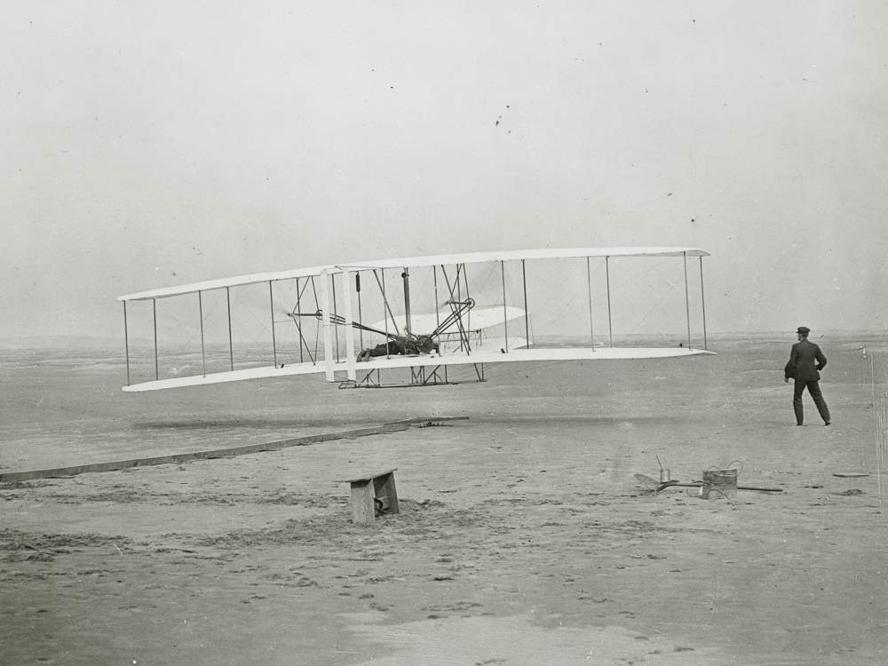
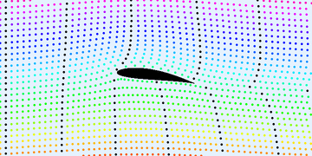
A Brief History of Airplanes
First heavier-than-air flight accomplished in 1903 by the Wright Brothers
The principle behind heavier-than-air flight involves passing air quickly enough over wings to generate lift and overcome gravity.
Image Credit:: https://en.wikipedia.org/wiki/Lift_(force)#/media/File:Karman_trefftz.gif
Image credit: https://airandspace.si.edu/stories/editorial/first-flight

Slide 4
Airplane history cont’d
Airplane designs really improved over the years, but the main theme behind these improvements are usually better engines for thrust and reduced drag for less energy waste / better performance.

Slide 5
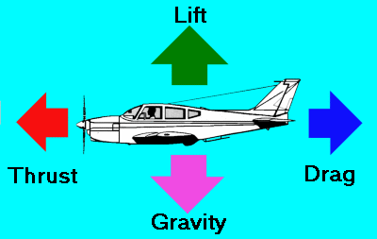
Image Credit: http://www.aviation-history.com/theory/force.htm

Slide 6
Motivation
Know a bit more on the theory behind paper airplanes!
Find the intuition behind some Free Body Diagrams (FBDs)
Apply intuitions from Free Body Diagrams and torque to the performance of airplanes

Slide 7
What are some examples of a force?
Try to name two or three forces on your worksheet

Slide 8
Some examples of forces
Gravitational force
Electromagnetic force
Frictional force
Buoyant force

Slide 9
Newton’s Third Law
Cornerstone of our lesson!
Newton’s Third Law says, all actions have an equal and opposite reaction to it
More physicsy term: every force has an equal and opposite reaction force
Example: we don’t fall towards the center of the earth!
Why is that? (Hint: the theory is in this slide)

Slide 10
Normal force!
A force that supports us directly
We give the ground a downwards force, and Newton’s Third Law gives us an equal and opposite force (upwards)

Slide 11
What are some examples we can find for Newton’s Third Law?
Feel free to write an example along with your own definition of Newton’s Third Law

Slide 12
Newton’s Third Law cont’d
For example, when you push a door, a door pushes back on you.
Hitting a stationary puck: the puck moves forward due to acceleration, and the stick receives a “push” in the opposite direction of the puck’s movement.

Slide 13
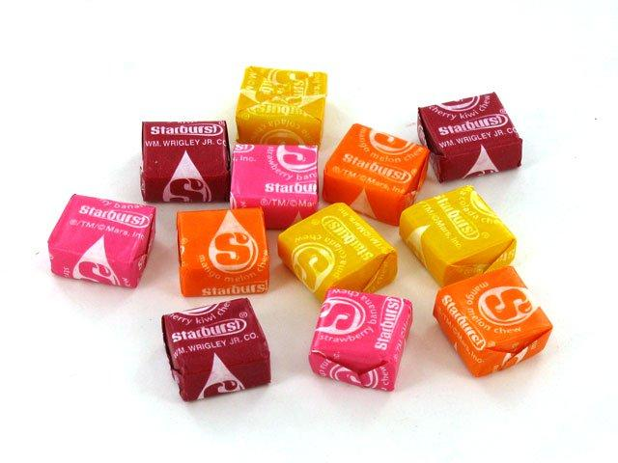
Questions so far?
Image credit: https://www.quickanddirtytips.com/productivity/time-management/how-to-use-driving-questions-to-shape-your-life
https://www.oldtimecandy.com/products/starburst-tropical-roll

Slide 14
Feel the Force!
Put your hands the other
way, and try pushing
downwards
Should feel the table…
the table can only be felt
if it’s pushing back at
you!

Slide 15
How can we represent this in Physics?

Slide 16
Free Body Diagrams!
A useful way for us to abstract our information down to just what we need
Approximate an object with point mass
No need for shape, color or size of object!

Slide 17
Okay, what does all of this have to do with paper airplanes?

Slide 18
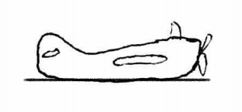
A plane on the ground

Slide 19
A plane on the ground FBD
Note that the two lines are roughly the same in length; this expresses that the magnitudes on the two forces are similar
F_{N}
F_{G}

Slide 20
What’s inconsistent with this diagram?
There is no normal force! The object in the FBD would keep on accelerating towards the earth
F_{G}

Slide 21
And this one?
Normal force is here now, but in the wrong direction! Newton’s Third Law tells us that the two forces have to be equal in magnitude, and opposite in direction.
F_{N}
F_{G}

Slide 22
Questions so far?

Slide 23
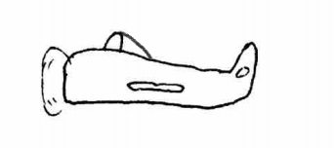
A plane flying midair, with NO acceleration in any direction!
In-class activity

Slide 24
Plane FBD
F_{Lift}
F_{Thrust}
F_{Drag}
F_{G}

Slide 25
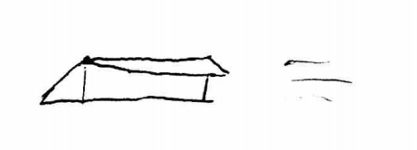
Paper airplane travelling in air
(Addendum: the paper airplane isn’t travelling fast enough, so it is falling downwards)
In-class activity

Slide 26
Paper airplane travelling in air
Note the absence of force from thrust
In here, the plane is falling because it doesn’t have enough speed to generate lift.
What happens if we throw this plane again, but faster?
F_{Lift}
F_{Drag}
F_{G}

Slide 27
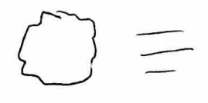
Crumpled paper ball?
In-class activity

Slide 28
Crumpled paper ball?
Paper ball has little to no lift, so there is no F_{Lift} for the ball; lots of drag however
F_{Drag}
F_{G}

Slide 29
What is FBD’s useful for?
Free Body Diagrams are good for intuition, but they also have their limitations
Mostly useful on showing net forces, and representing objects that don’t rotate too much
Torque can fill in more details on a plane’s trajectory

Slide 30
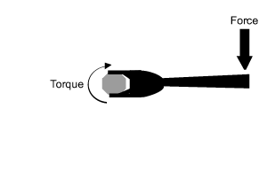
What is torque?
A force that is not applied directly on the center of mass, will result in torque
Torque makes an object turn faster in one direction (clockwise/counterclockwise)!
http://www.dynamicscience.com.au/tester/solutions1/hydraulicus/torquework.html

Slide 31
Questions so far?

Slide 32
Video and analysis

Slide 33
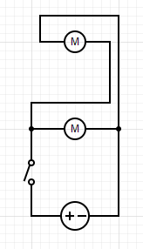
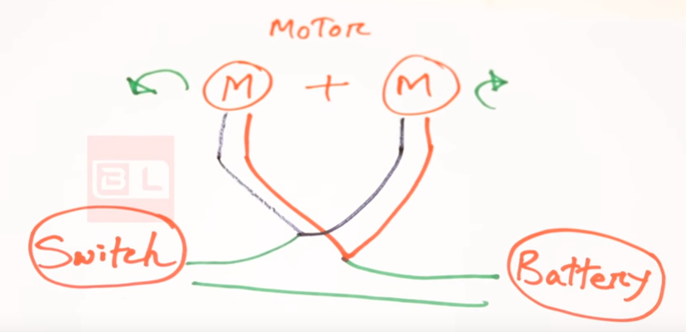
Apparatus!
Source: youtube.com/beginnerlife

Slide 34
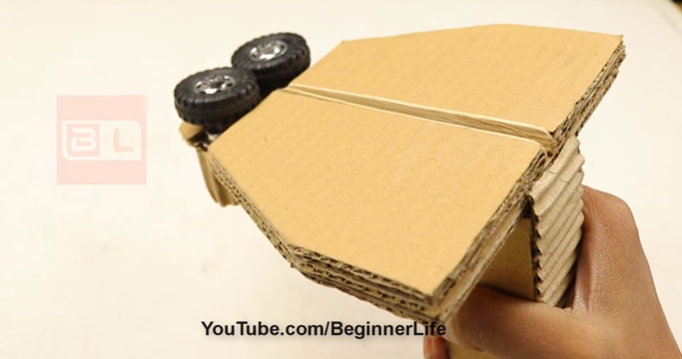
Inspiration
FYI: https://www.youtube.com/watch?v=kYITs3JG1eE

Slide 35
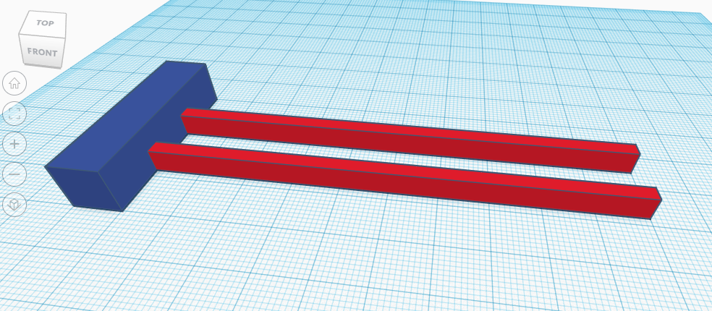
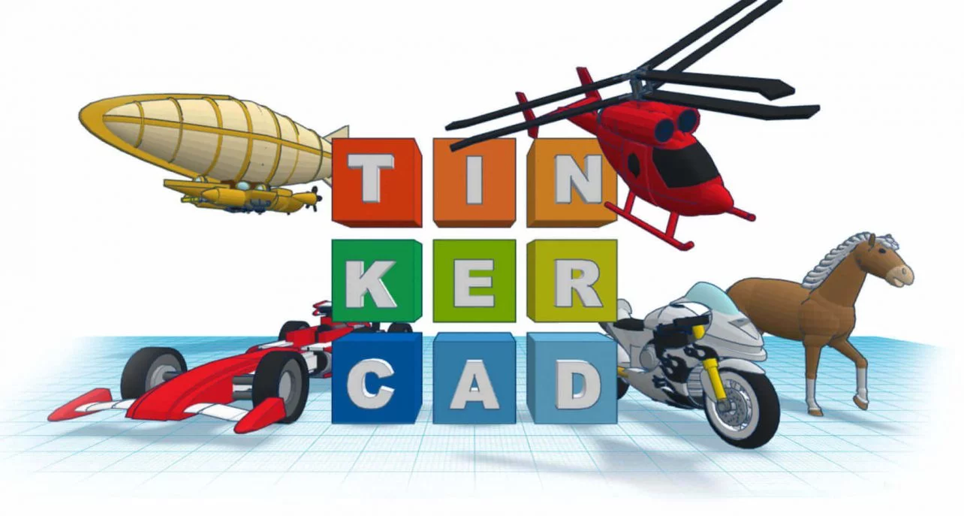
Design of motor rails

Slide 36
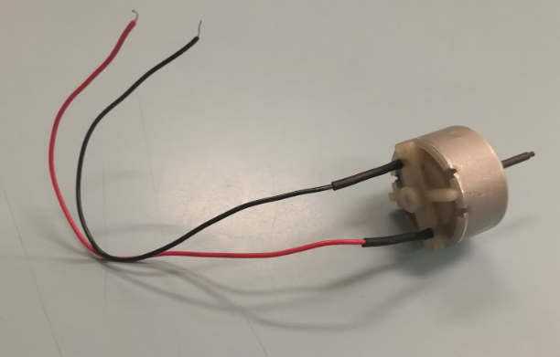
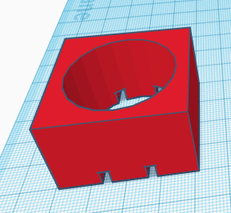
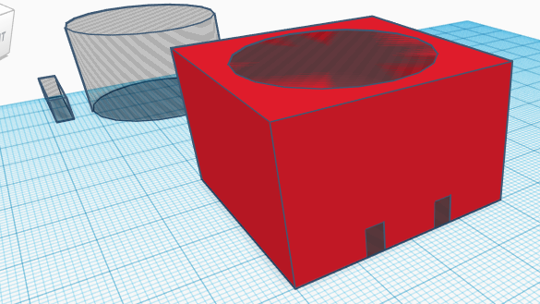
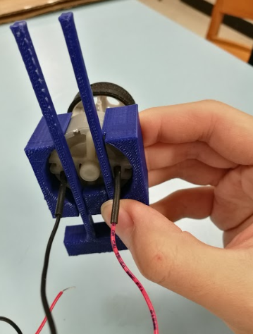
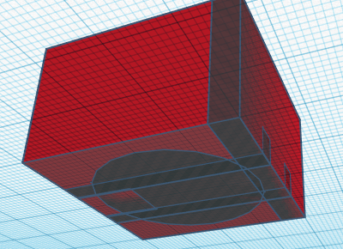
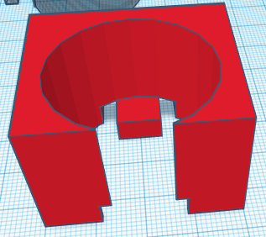
Figuring out the motor’s housing

Slide 37
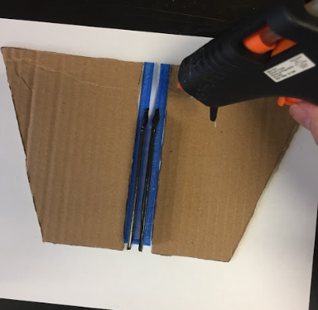
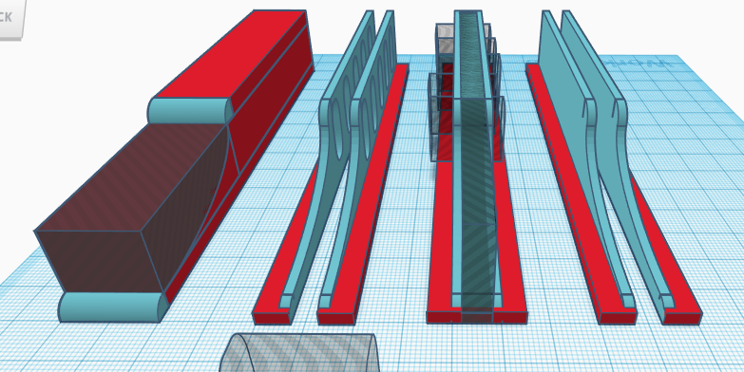
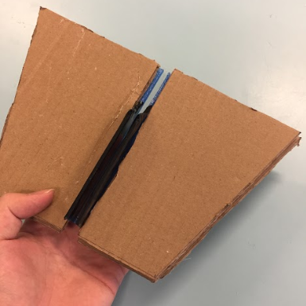
Creating the airplane guiding rails

Slide 38
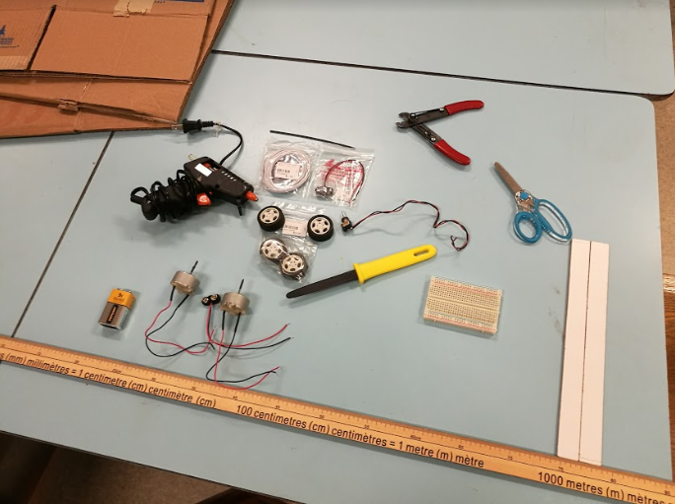
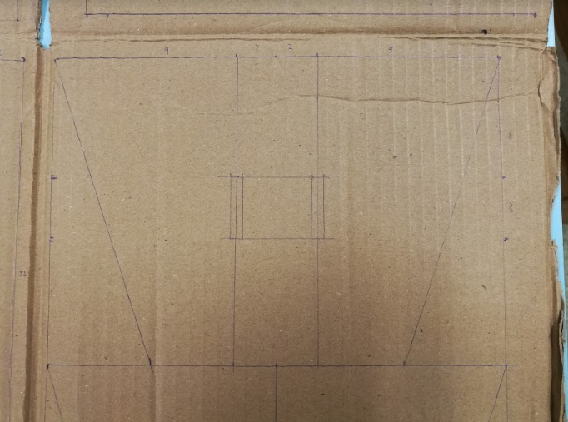
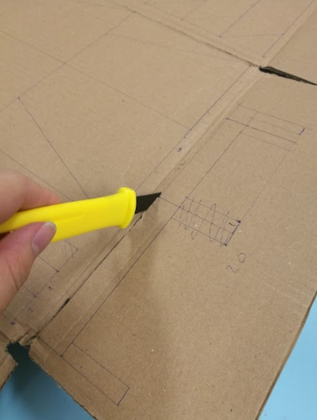
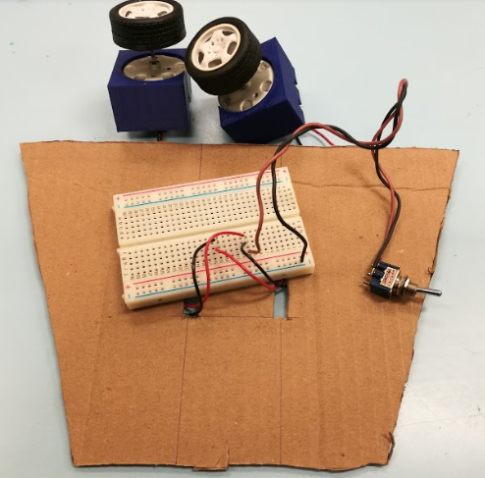
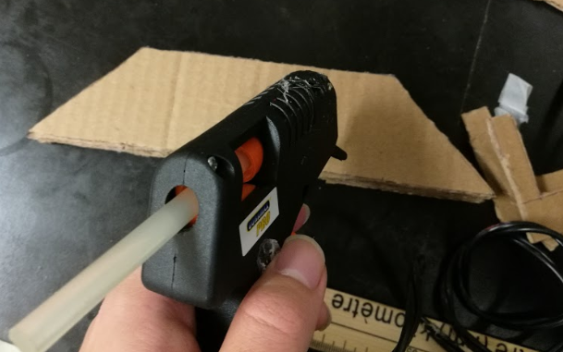
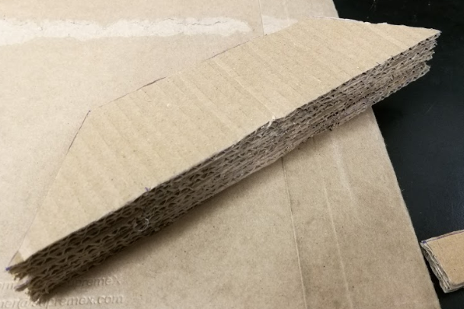
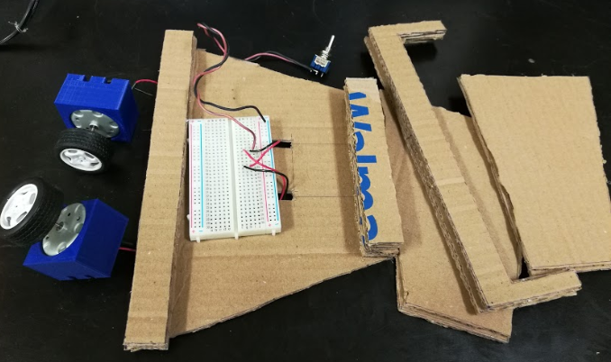
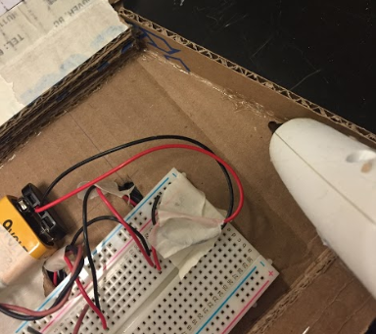
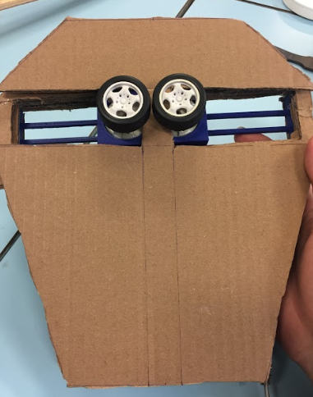
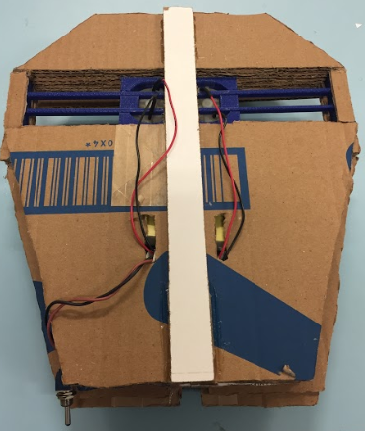
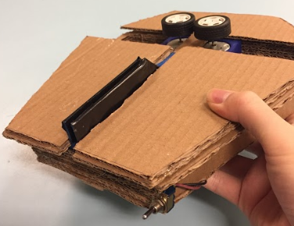
Creating the rest of the project

Slide 39
Let’s make some planes!

Slide 40
References
https://www.khanacademy.org/science/ap-physics-1/ap-forces-newtons-laws/introduction-to-forces-and-free-body-diagrams-ap/v/types-of-forces-and-free-body-diagrams
https://www.physicsclassroom.com/class/newtlaws/Lesson-2/The-Meaning-of-Force
http://www.aviation-history.com/theory/force.htm
https://wiki.mattrude.com/images/4/44/Bernoulli_Newton_Lift.pdf
https://www.youtube.com/watch?v=kYITs3JG1eE
https://www.teachengineering.org/lessons/view/cub_airplanes_lesson06

Slide 41
Further Reading
Below are some links that might interest those who enjoy flying paper airplanes:
Walkalong gliders! Quite fascinating to see
https://sites.google.com/site/controllableslopesoaring/
https://www.instructables.com/id/Paper_Airplane_Walkalong_Glider/
https://sciencetoymaker.org/airsurf/make-your-own-gliders/
More airplane designs: https://www.foldnfly.com/index.html#/1-1-1-1-1-1-1-1-2
And some more: http://web.mit.edu/swe/www/PaperAirplanes.pdf
Learn from NASA: https://www.grc.nasa.gov/www/k-12/airplane/guided.htm
Veritaseum talks about lift (Bernouilli vs Newton): https://www.youtube.com/watch?v=aFO4PBolwFg

Slide 42
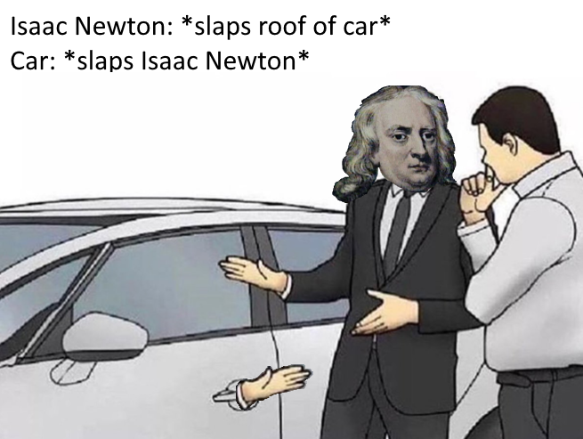
Bonus Slide
Image credit: https://www.reddit.com/r/dankmemes/comments/8x2ire/must_have_200_iq_to_understand_this_meme/

