Slide 1
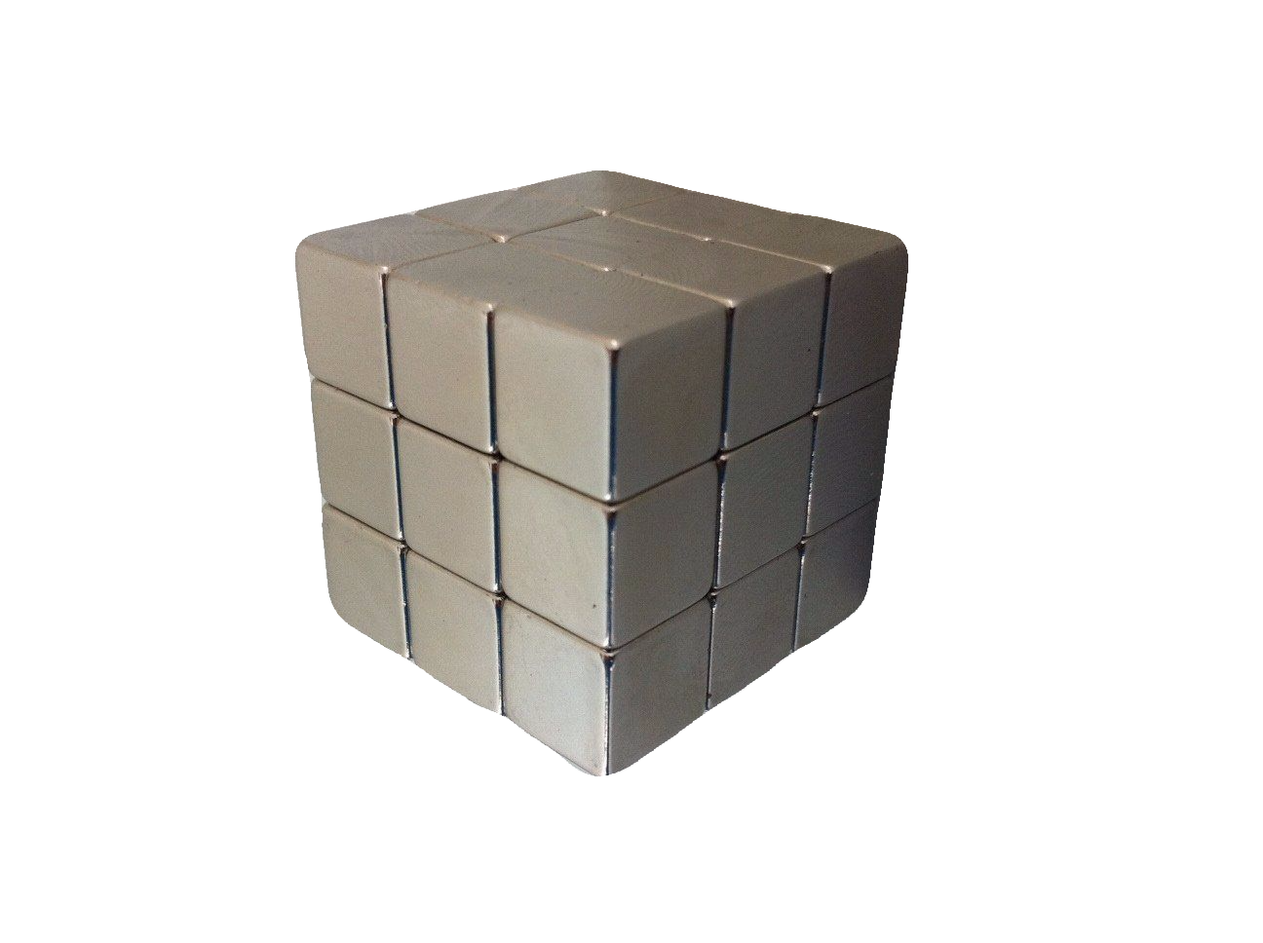
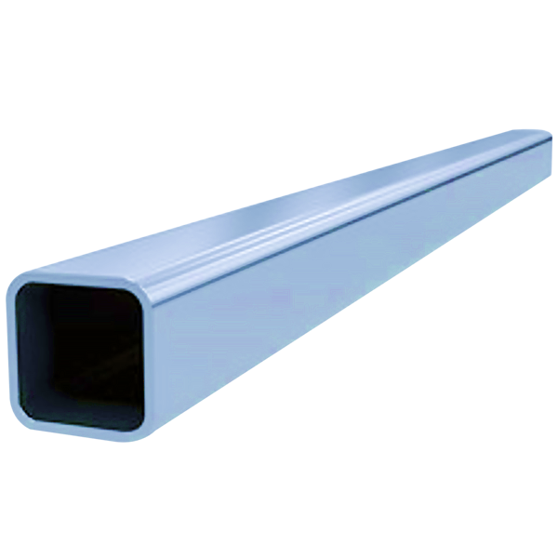
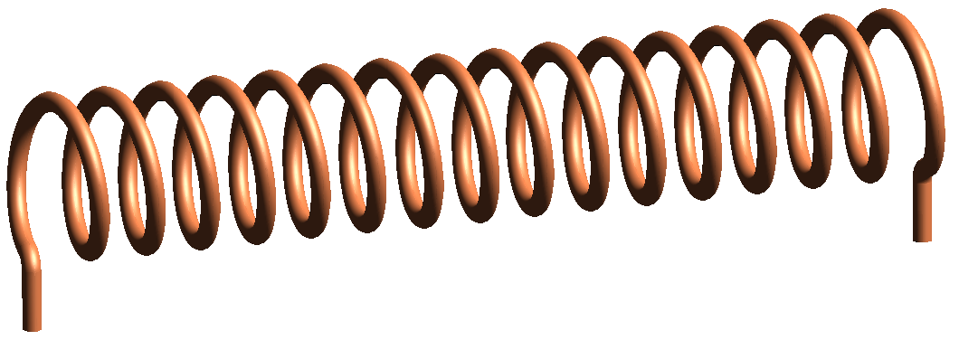
“Cubes & Tubes”
Electromagnetic Induction
& Lenz’s Law
S. David Lalonde for UBC PHYS 420C

Slide 2
Electromagnetic Induction & Lenz’s Law
Lesson Content
Electromagnetic Induction
Faraday’s Law ➔ What is Lenz’s Law?
Demonstration of electromagnetic induction, eddy currents, and Lenz’s Law.
Applications of electromagnetic induction and eddy currents.

Slide 3
Electromagnetic Induction & Lenz’s Law
Big Ideas
A changing magnetic field will induce a voltage in a conductor. It may then induce a current in a closed circuit.
The induced current flows in the direction that will create a magnetic field opposing the change in magnetic field that created it.

Slide 4
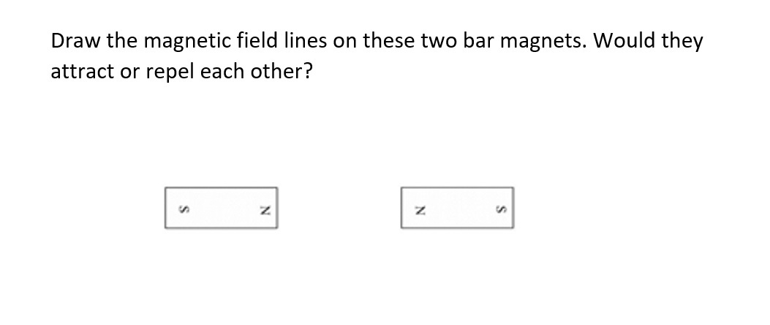
Electromagnetic Induction Lenz’s Law
Pre-Lesson Quiz – What do we know?

Slide 5
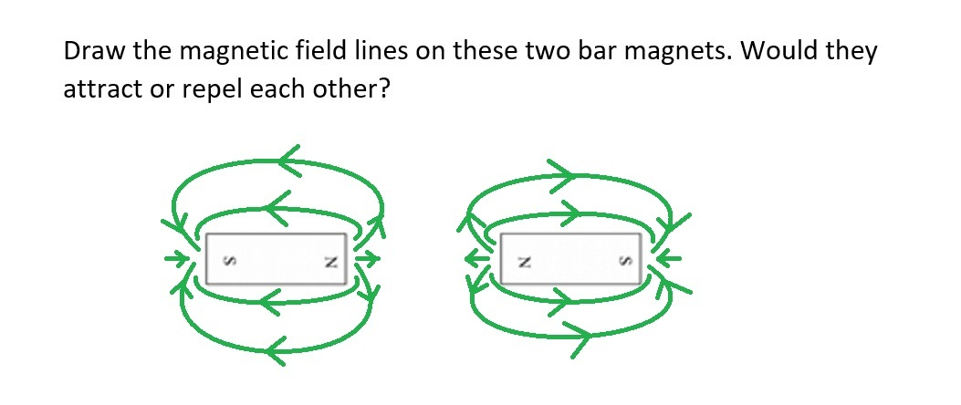
Electromagnetic Induction Lenz’s Law
Pre-Lesson Quiz – What do we know?

Slide 6
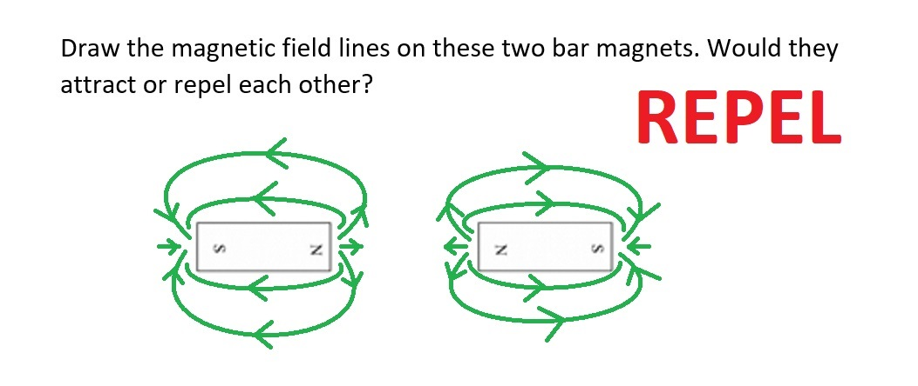
Electromagnetic Induction Lenz’s Law
Pre-Lesson Quiz – What do we know?
Notes:
And what would two south poles do? What about a north and south pole coming together, would they repel or attract each other?

Slide 7
Electromagnetic Induction Lenz’s Law
Pre-Lesson Quiz – What do we know?

Slide 8
Electromagnetic Induction Lenz’s Law
Pre-Lesson Quiz – What do we know?
Notes:
Draw a magnetic field, B, on the board, as well as a coil perpendicular to the field. Label the area, A, of the coil, and the angle it makes with the direction of the B field. This is the measure of magnetic flux within the coil.

Slide 9
Electromagnetic Induction Lenz’s Law
Pre-Lesson Quiz – What do we know?
Notes:
Does anyone know the name of this relationship?

Slide 10
Electromagnetic Induction Lenz’s Law
Pre-Lesson Quiz – What do we know?

Slide 11
Electromagnetic Induction Lenz’s Law
Pre-Lesson Quiz – What do we know?
Notes:
So this is Faraday’s Law of electromagnetic induction, it tells us what the induced EMF will be given a certain number of coils with a changing magnetic flux over time.

Slide 12
Electromagnetic Induction Lenz’s Law
Pre-Lesson Quiz – What do we know?

Slide 13
Electromagnetic Induction Lenz’s Law
Pre-Lesson Quiz – What do we know?

Slide 14
Electromagnetic Induction Lenz’s Law
Pre-Lesson Quiz – What do we know?

Slide 15
Electromagnetic Induction Lenz’s Law
Pre-Lesson Quiz – What do we know?

Slide 16
Electromagnetic Induction Lenz’s Law
Pre-Lesson Quiz – What do we know?

Slide 17
Electromagnetic Induction Lenz’s Law
Pre-Lesson Quiz – What do we know?

Slide 18
Electromagnetic Induction Lenz’s Law
Pre-Lesson Quiz – What do we know?

Slide 19
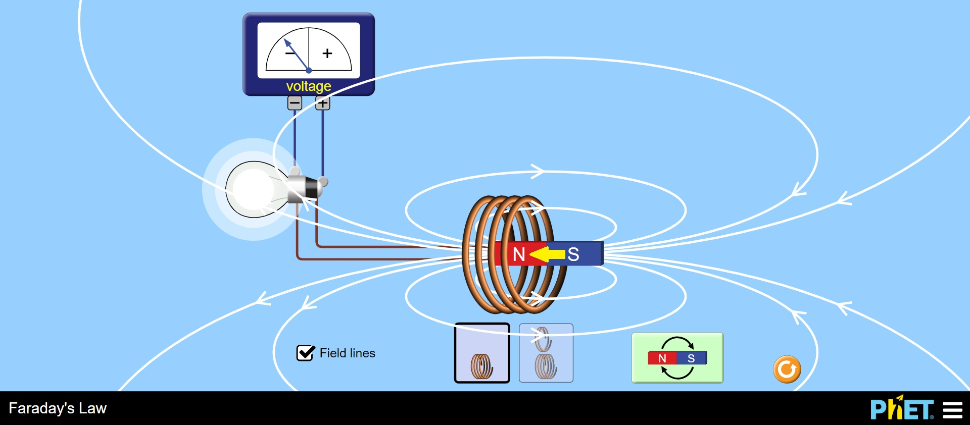
What is Electromagnetic Induction?
Electromagnetic induction is the production of an electromotive force (EMF, or voltage) across an electrical conductor in a changing magnetic field. The EMF results in the flow of charge (electrons) through the conductor.
Notes:
I will show the students how to use this PHET electromagnetic induction simulation. They can use their own phones or the supplied iPad, and I will try to get it to display on the laptop projection as well.
https://phet.colorado.edu/sims/html/faradays-law/latest/faradays-law_en.html

Slide 20
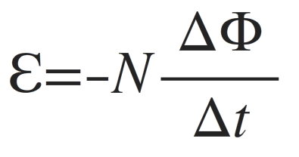
What is Lenz’s Law?
We can think of the “minus” sign in Faraday’s Law as a reminder of Lenz’s Law. It tells us the direction current will flow in a circuit due to a changing magnetic flux.
Notes:
No, this isn’t Lenz’s Law! This is Faraday’s Law, that describes how a changing magnetic flux induces an electromotive force, or voltage.
However, some people like to think of the “minus” sign in Faraday’s Law as a reminder of Lenz’s Law, a reminder to check which direction the current will flow within a given circuit and changing magnetic flux. Don’t worry, we won’t be calculating any voltages or currents today, but we will be using Lenz’s Law to predict the direction of current flow due to a changing magnetic flux.

Slide 21
What is Lenz’s Law?
Lenz’s Law states that the direction of the induced EMF (and induced current) will always oppose the change producing it.
Another way to say it is that the direction of the induced current will create its own magnetic field that opposes the changing magnetic field that induced the current.
Notes:
Lenz’s Law states that the direction of the induced EMF (and induced current) will always oppose the change producing it.
Another way to say it is that the direction of the induced current will create its own magnetic field that opposes the changing magnetic field that induced the current.

Slide 22
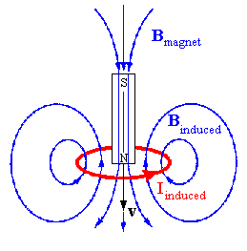
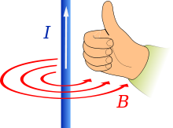
What is Lenz’s Law?
For Lenz’s Law, use the “right-hand” rule to determine the direction of current flow.
Thumb in the direction of current, fingers curl to show the direction of the magnetic field around the wire.
Notes:
With a metal hoop I will demonstrate the right hand rule showing the magnetic field due to a current flowing in the hoop.

Slide 23
What is Lenz’s Law?
It also works another way!
Point your right thumb in the direction of the OPPOSING magnetic field, then your fingers will curl to show the direction of the current in the wire.
Notes:
This will require a bit of demonstration with the hoop. I will also draw a few small diagrams on the board to show the ways it works with different orientations of magnets and coils (hoops).

Slide 24
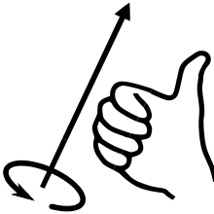
What is Lenz’s Law?
Changing Field – Increasing or Decreasing ➔ Induced Current, Direction Creates an Opposing Field

Slide 25
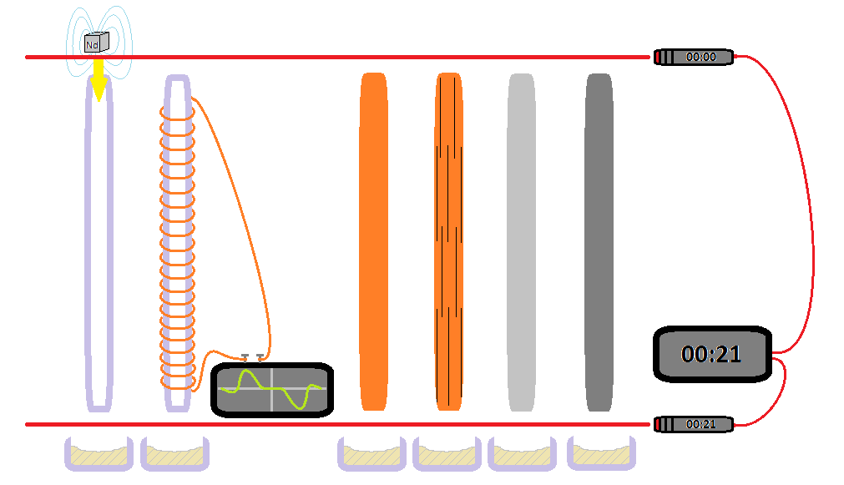
Demonstration Time!
Notes:
This was the original set-up I had planned for the demonstration, however, I was unable to secure a source of square copper tubes.

Slide 26
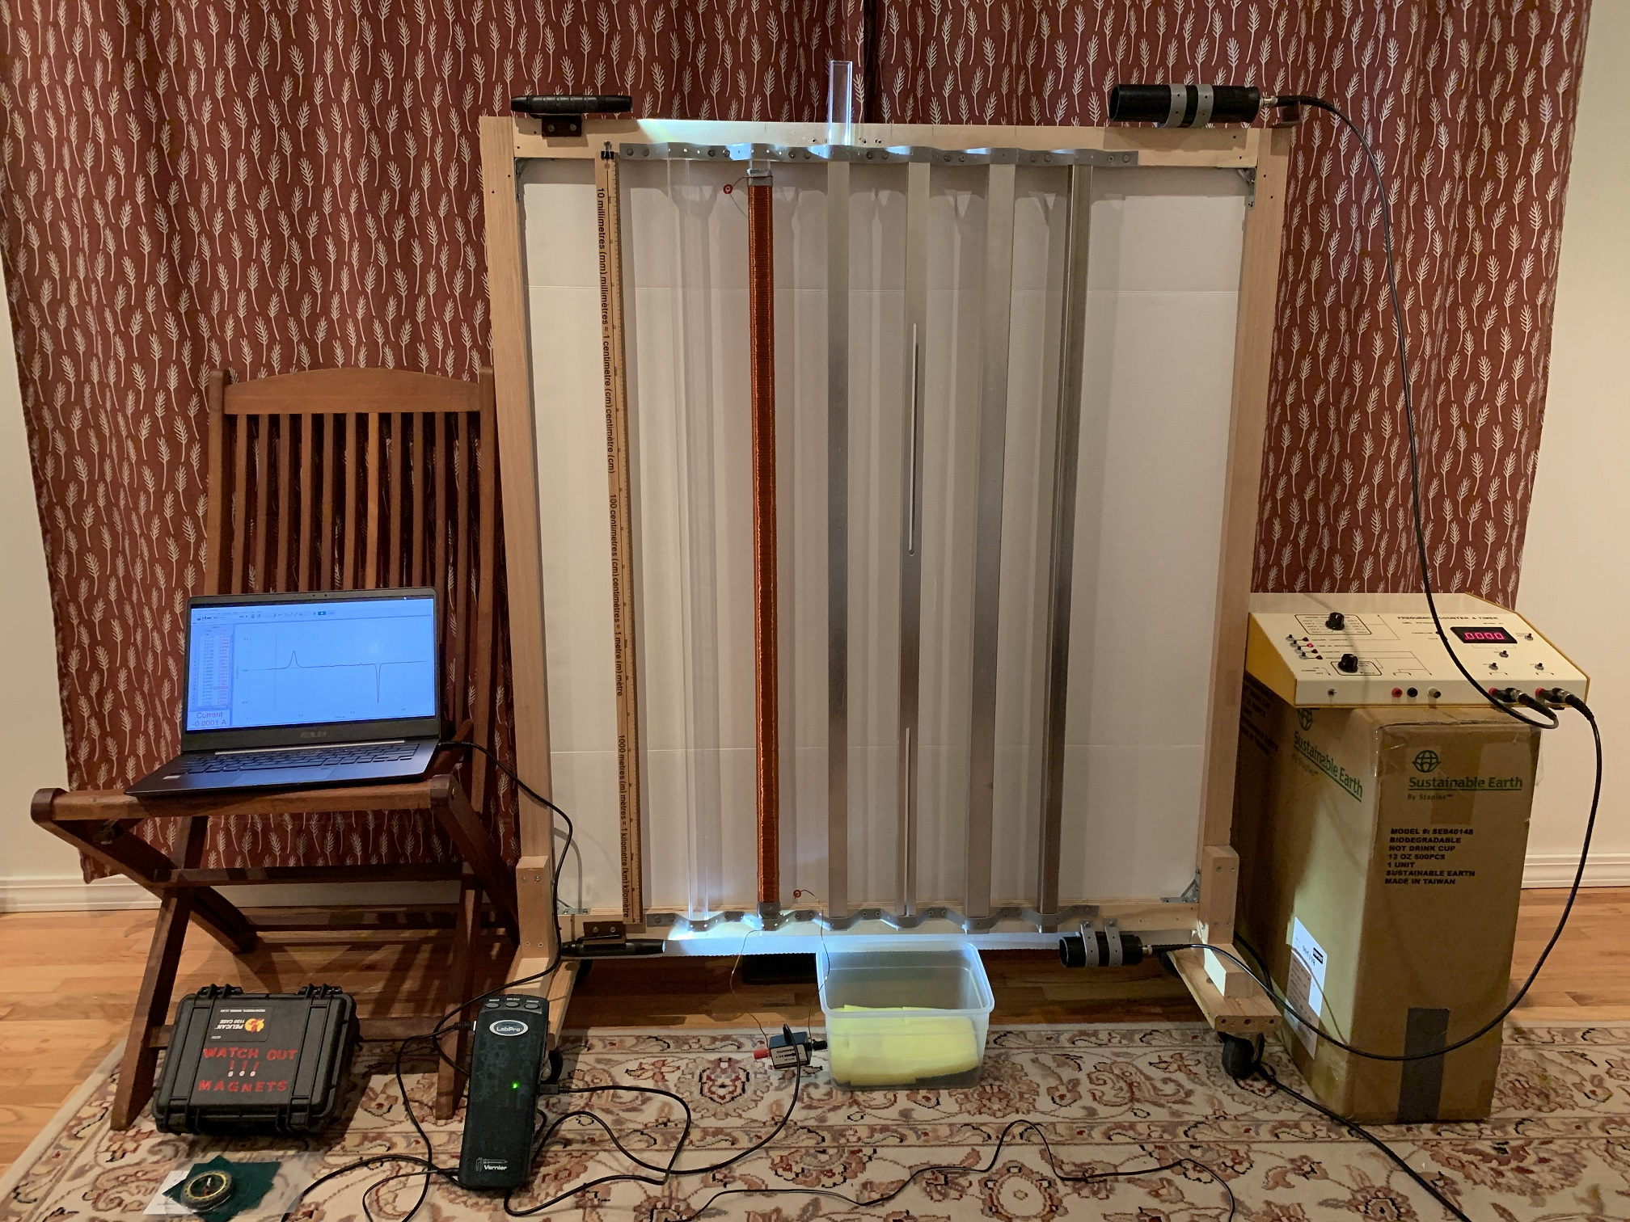
Demonstration Time!
Notes:
As you can see here, we have 6 square tubes, a clear plastic tube, a clear plastic tube with a coil of copper wire, a solid Aluminum tube, an Aluminum tube with cut slits, a thicker Aluminum tube, and finally a stainless steel tube. We will take cubes of Neodymium permanent magnets, plastic, and stainless steel, and drop them down the tubes.

Slide 27
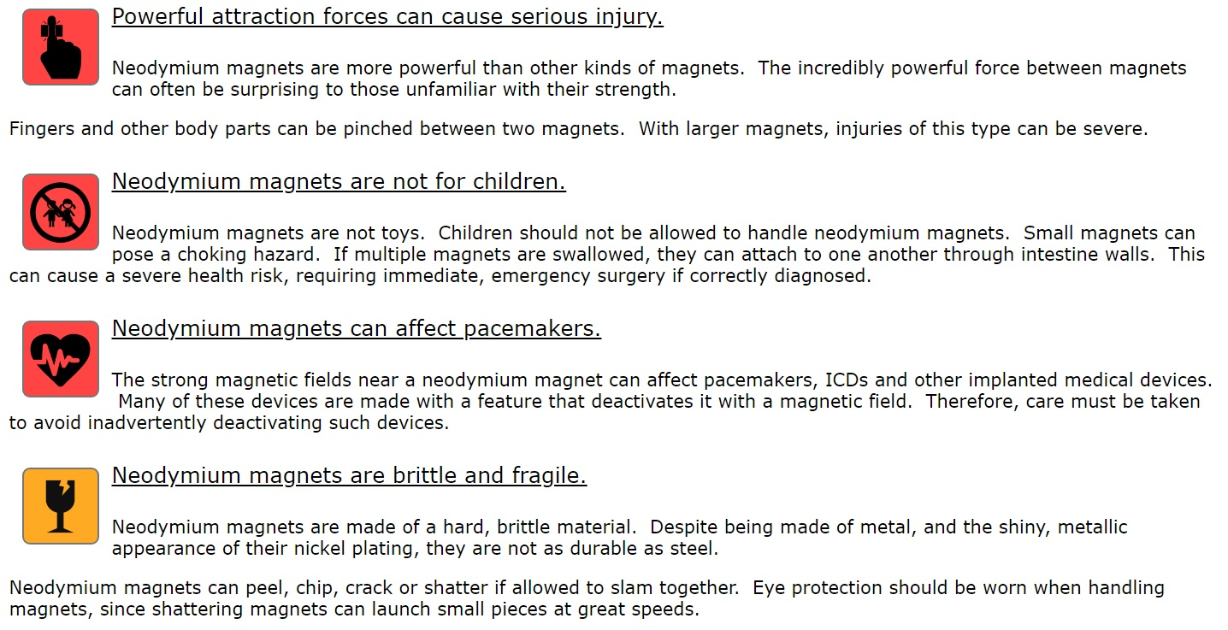
Demonstration Time! but first a short safety warning…

Slide 28
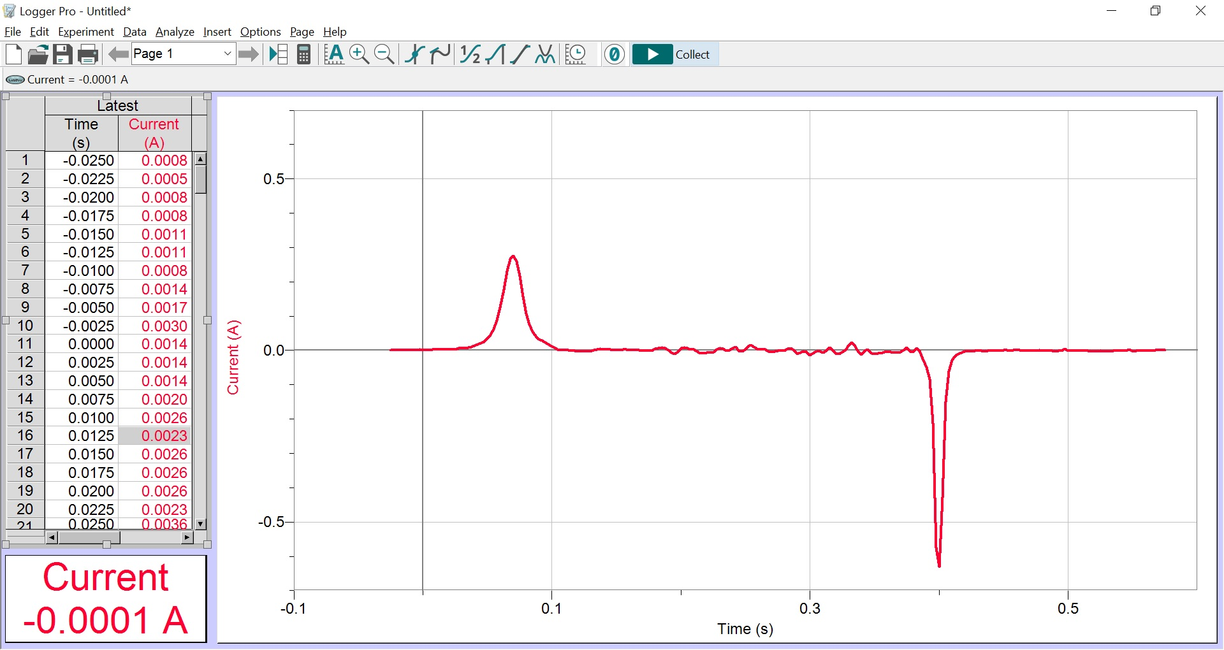
Notes:
This LoggerPro plot shows the induced current in the copper coil. As the magnet enters the coil it induces a positive current. We can use the right-hand rule to determine the direction the current flows. When the magnet is fully inside the coil the magnetic flux is still changing, but it is changing above and below the magnet as it falls, and the induced current is largely cancelled out in the single continuous coil that makes the circuit. As the magnet leaves the coil it again induces a sharp current spike (magnet is moving faster now, so greater flux) but this time in the opposite direction compared to the current when it first entered the coil.

Slide 29
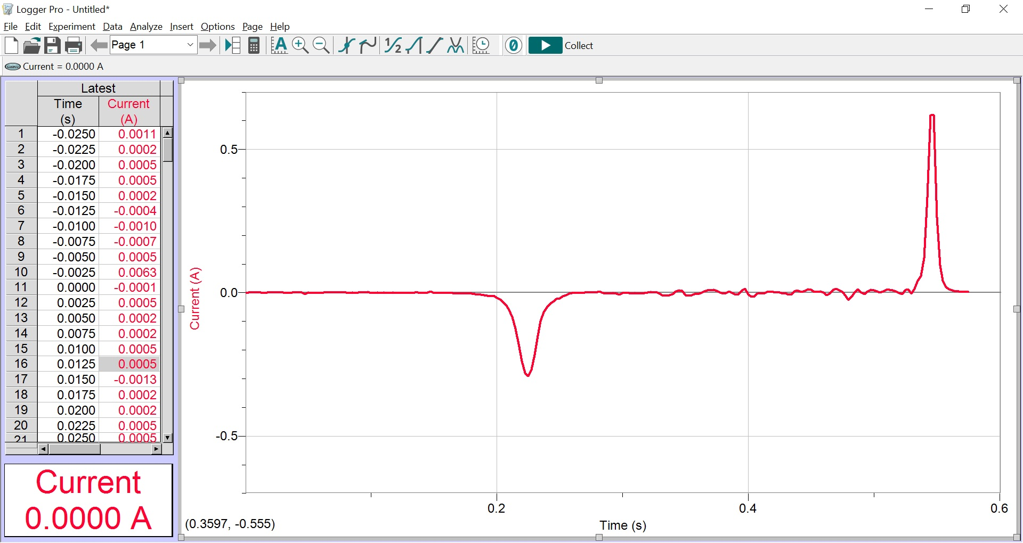
Notes:
Here we have turned the magnet upside down compared to the previous plot. Therefore, the current upon entering and leaving the coil is opposite what it was previously.

Slide 30
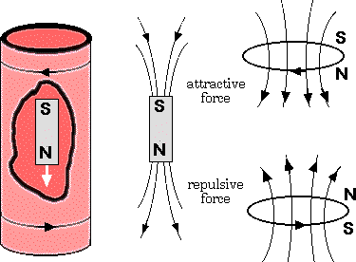
Eddy Currents
An eddy current is a current that is created in a conductor in response to a changing magnetic field.
By Lenz’s law, the eddy current rotates in a direction so as to create a magnetic field opposing the change.
In a conductor, current primarily rotates in a plane perpendicular to the magnetic field.
Notes:
The solid metal tubes also have induced currents. We call these eddy currents. You can think of the solid tube like a lot of small coils stacked upon each other. The interesting thing is that there are many more closed circuits, unlike the one large continuous coil around the plastic tube. Therefore, the currents below the magnet can be in the opposite direction of the currents above the magnet, and they can both provide a retarding force on the falling magnet.

Slide 31
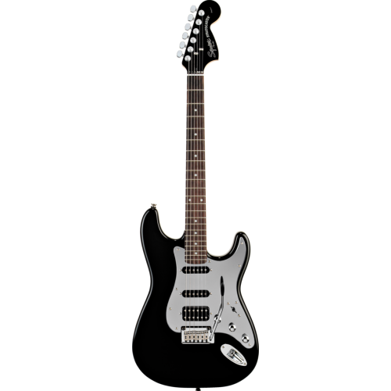
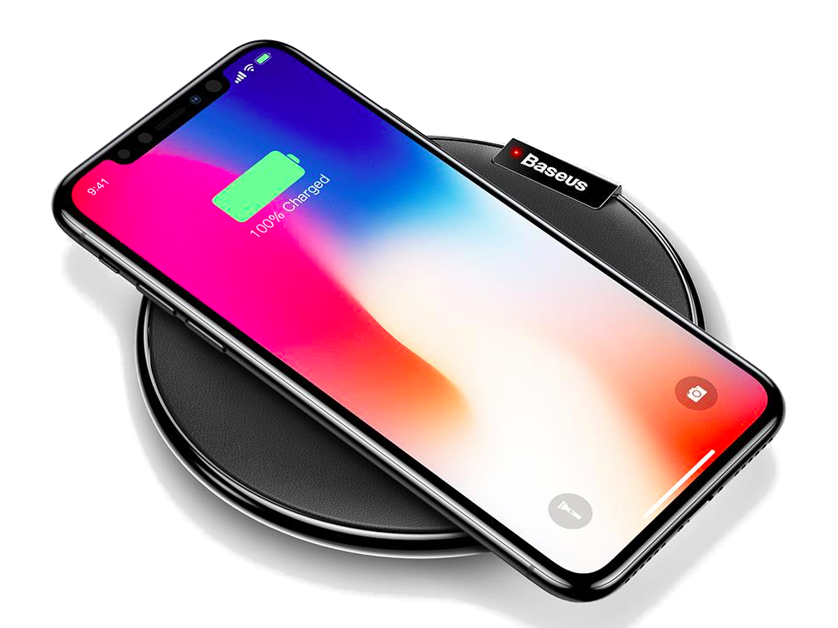
Applications of Electromagnetic Induction
Common electrical equipment - transformers, motors and generators.
Electric guitar – the vibrations of metal strings are detected and translated into sounds.
Wireless chargers – smartphones and electric toothbrushes.
Notes:
Common electrical equipment, such as transformers, electric motors and electric generators.
Electric guitar, the pick-ups detect the motion of the guitar strings and translate that into an electric current.
Wireless chargers – smartphones and electric toothbrushes

Slide 32
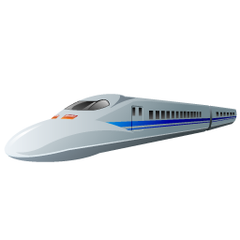
Applications of Eddy Currents
Eddy current braking – slowing down large oil drilling equipment.
Repulsive effects and levitation – maglev trains.
Structural testing – checking for cracks in aircraft structural components.
Notes:
Eddy current braking - since there is no contact with a brake shoe or drum there is no mechanical wear. However, an eddy current brake cannot provide a "holding" force and is used in combination with mechanical brakes. For example, oil drilling equipment.
Repulsive effects and levitation - In a varying magnetic field the induced currents exhibit repulsion effects. That is, a conductive object will experience a repulsion force. This can lift objects against gravity. For example, mag-lev trains.
Structural testing - Eddy currents are used for the non-destructive examination (NDE) and monitoring of metallic structures. For example, aircraft fuselage and aircraft structural components.
There are also many detrimental effects due to eddy currents. Eddy currents will occur in electrical equipment when and where you don’t want them, resulting in lost efficiency and over-heating. For example, transformers are made up of laminated sheets to reduce power loss due to eddy currents, and AC electrical transmission power lines need to be made with a larger diameter due to the eddy current skin-effect that increases the effective resistance of the power line.

Slide 33
Electromagnetic Induction Lenz’s Law
Post-Demonstration Quiz – What have we learned?

Slide 34
Electromagnetic Induction Lenz’s Law
Post-Demonstration Quiz – What have we learned?

Slide 35
Electromagnetic Induction Lenz’s Law
Post-Demonstration Quiz – What have we learned?

Slide 36
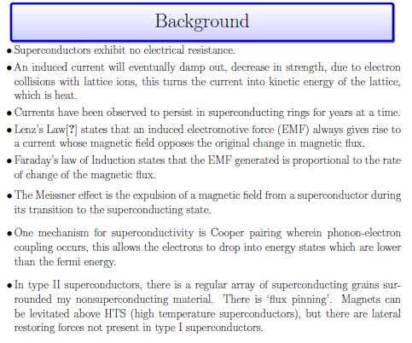

Slide 37
