Slide 1
GRAVITATIONAL WAVES
Paul Belzner

Slide 2
OuTLINE
What are gravitational waves?
Waves
Gravity
How did we find them?
LIGO
Why should we care?
Demonstration

Slide 3
WAVES
What are some types of waves that you can think of?

Slide 4
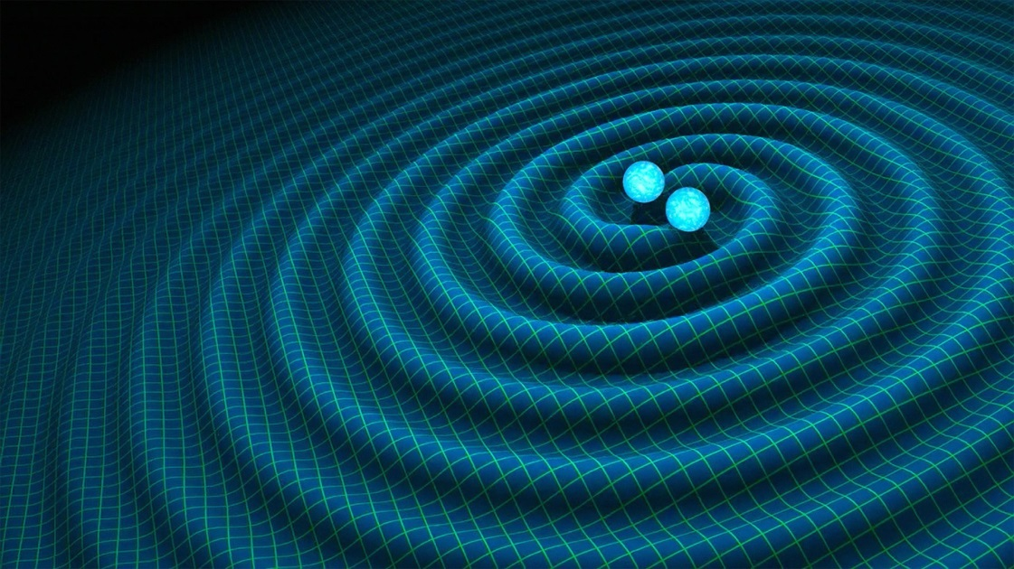
WAVES
Sound waves
Light waves
Water waves
Waves on strings
Electromagnetic waves
Gravitational waves
Image Credit: Time Magazine

Slide 5
Image Credit: Online Math Learning

Slide 6
WAVE PROPERTIES
Amplitude
Frequency
Wavelength

Slide 7
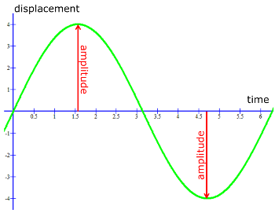
AMPLITUDE
A measurement of distance, usually notated as A
Distance between the origin and a peak or trough of wave
Image Credit: Quora

Slide 8
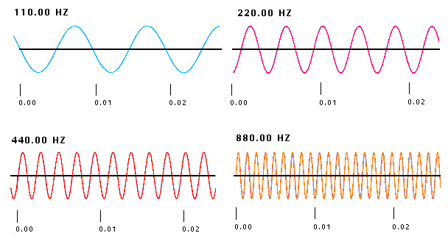
FREQUENCY
The number of cycles a wave undergoes each second
Measured in Hertz (Hz)
Image Credit: Planet Facts

Slide 9
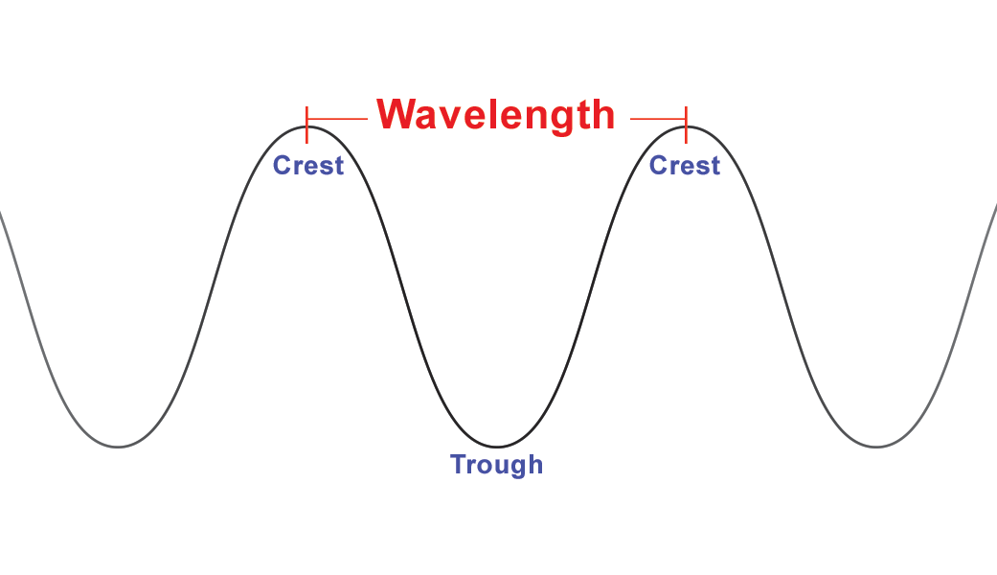
WaveLENGTH
Frequently referred to as “peak to peak” or “trough to trough” measurement
A measurement of distance, commonly seen in nanometers (nm)
Most often represented as λ (lambda)
Image Credit: NASA

Slide 10
GRAVITY
Newton’s Universal Law of Gravitation (1686)
$F=G \frac{ m_{1}m_{2}}{r^{2}}$
Breaks down in some important cases:
Mercury’s orbit around the Sun
Very strong gravitational fields (around dense and massive objects)

Slide 11
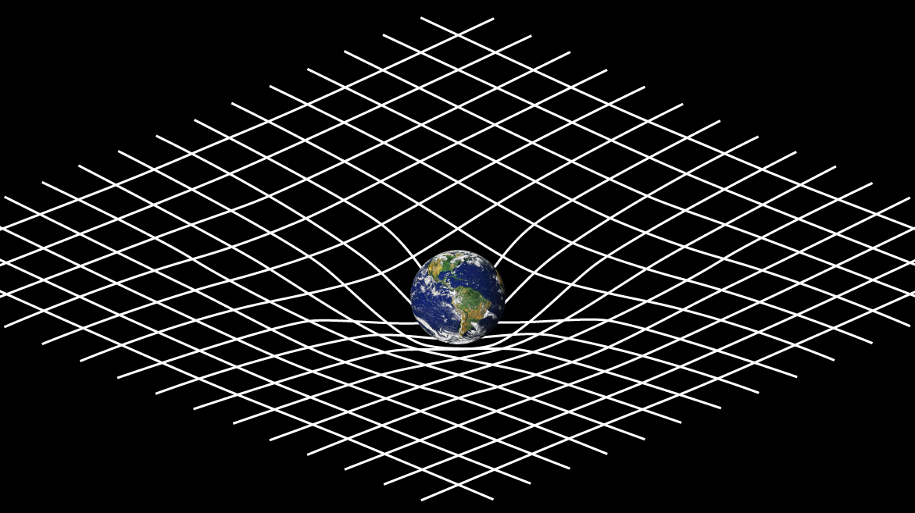
GRAVITY
A whole new way of viewing the universe: spacetime
Gravity as a distortion in spacetime caused by a mass
Developed by Einstein in his theory of General Relativity in 1916

Slide 12
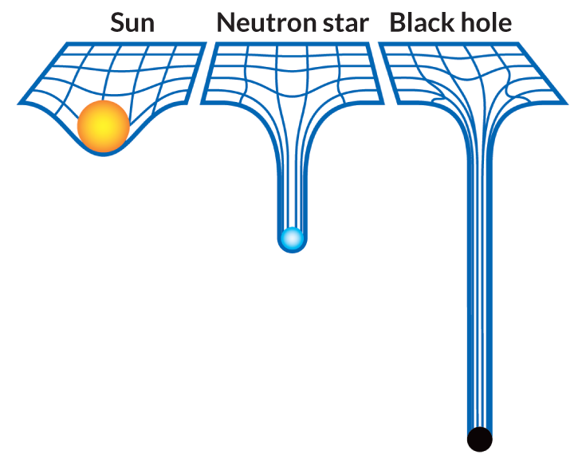
GRAVITY
Image Credit: Science News

Slide 13
GRAVITY
Try it for yourself!

Slide 14
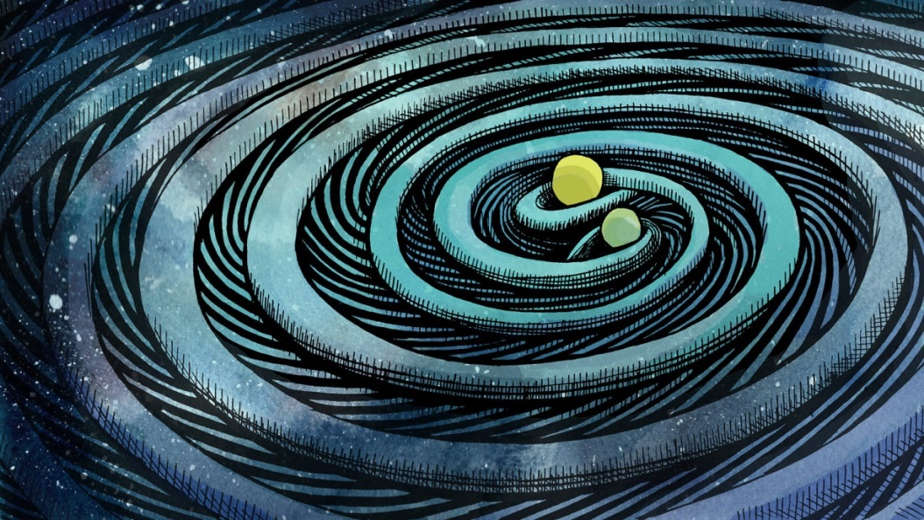
GRAVITATIONAL WAVES
A ripple of waves moving through the fabric of spacetime
Created by massive objects orbiting very quickly around each other
Detectable sources include black holes and neutron stars
Predicted as a part of General Relativity
Image Credit: Symmetry Magazine

Slide 15
GRAVITATIONAL WAVES
First detected on September 14, 2015
The “stretch” of spacetime was measured to 1.0 x 10⁻²¹
10 thousand times smaller than an atomic nucleus
Originated from two black holes, one of 36 solar mass, one of 29 solar mass
Rotated around each other at 100 times per second before they collided and merged

Slide 16
LIGO
Laser Interferometer Gravitational-Wave Observatory
Image Credit: LIGO

Slide 17
Image Credit: LIGO

Slide 18
Image Credit: LIGO

Slide 19
LIGO
What are some of the challenges that come with such a precise detector?
Background noise
Seismic noise (earthquakes)
Trucks driving nearby

Slide 21
THE SOUND OF THE UNIVERSE
Video credit: LIGO

Slide 22
WHY DO WE CARE?
A brand new way of observing events in the universe
Black holes
Exploding stars
The big bang

