Slide 1
Air hockey: A momentum demonstration
By Giovanni calderwood

Slide 2
Who am I?
I am currently in my fourth-year of a Bachelor of Science degree at UBC
My major is Physics
My career goal is to be a high school Physics teacher

Slide 3
Why am I here today?
I am here as a part of an outreach course in Physics
My demonstration will be recorded for my professors to evaluate my performance
My goal is to help you visualize some of the concepts that are integral to understanding Physics

Slide 4
Agenda
Review Physics concepts such as momentum and impulse
Demonstrate concepts visually through air hockey!
Discuss why some of the data we collected did not match exactly with the predictions we made
Discuss some of the limitations of the formulae we use in high school physics

Slide 5
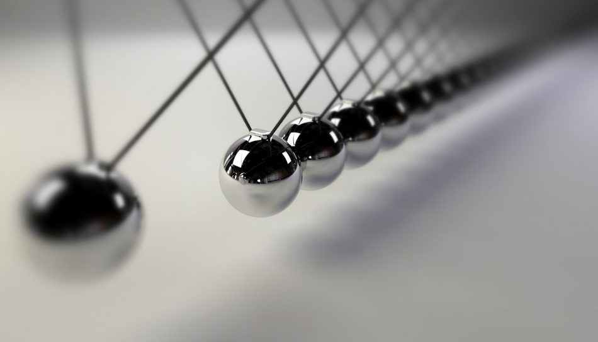
In your own words, what is momentum?

Slide 6
What is momentum?
The product of mass and velocity
If we increase the velocity of a puck, while keeping mass constant, momentum will increase
If we increase the mass of a puck, while keeping velocity constant, momentum will increase
An object with a lot of momentum is hard to stop

Slide 7
What do the laws of conservation of momentum and energy tell us? Are momentum and energy always conserved in any system?

Slide 8
Law of conservation of momentum
The law of conservation of momentum tell us that the total momentum in a system will be conserved if the system is closed and isolated.
If our system is the hockey puck then for the system to be closed the puck must experience no losses to heat, sound, or friction in the environment.

Slide 9
Law of conservation of Energy
The law conservation of energy is very similar to momentum. It tells us energy cannot be created or destroyed only transformed.
Energy in a system is conserved if the system is closed and isolated.

Slide 10
Elastic and Inelastic Collisions
Elastic Collision: a collision in which the total kinetic energy after the collision equals the total kinetic energy before the collision
Inelastic Collision: a collision in which the total kinetic energy after the collision is different from the total kinetic energy before the collision

Slide 11
Demonstration of a single puck moving over time
Following the demonstration complete part 1 of the worksheet.

Slide 12
Worksheet discussion

Slide 13
Video analysis in logger pro
This portion of the lesson will be completed in logger pro

Slide 14
Analysis of demonstration part 1
Was the data we saw in logger pro similar to what you predicted on the worksheet? What was the same? What was different?
Can we fully describe what we saw in the demonstration with the following momentum formula:
Can we fully describe what we saw in the demonstration using the following energy formula:
What if we add an extra term (Q) to account for losses due to frictional forces (ie. heat, sounds, etc…)?
$$m_{i}v_{i}=m_{f}v_{f}$$
$${\frac{1}{2}m}_{i}v_{i}^{2}={\frac{1}{2}m}_{f}v_{f}^{2}$$
$${\frac{1}{2}m}_{i}v_{i}^{2}={\frac{1}{2}m}_{f}v_{f}^{2 }+Q$$

Slide 15
Demonstration of two pucks colliding
Following the demonstration complete part 2 of the worksheet.

Slide 16
Worksheet discussion

Slide 17
Video analysis in logger pro
This portion of the lesson will be completed in logger pro

Slide 18
Analysis of demonstration part 2
Was the data we saw in logger pro similar to what you predicted on the worksheet? What was the same? What was different?
Can we fully describe what we saw in the demonstration with the following momentum formula for two objects in a collision:
Can we fully describe what we saw in the demonstration using the following energy formula:
What if we add an extra term (Q) to account for losses due to frictional forces (ie. heat, sounds, etc…)?
$$m_{1}v_{1i}{+ m}_{2}v_{2i}=m_{1}v_{1f}{+ m}_{2}v_{2f}$$
$${\frac{1}{2}m}_{1}v_{1i}^{2}+{\frac{1}{2}m}_{2}v_{2i}^{2} ={\frac{1}{2}m}_{1}v_{1f}^{2}+{\frac{1}{2}m}_{2}v_{2f}^{2}$$
${\frac{1}{2}m}_{1}v_{1i}^{2}+{\frac{1}{2}m}_{2}v_{2i}^{2} ={\frac{1}{2}m}_{1}v_{1f}^{2}+{\frac{1}{2}m}_{2}v_{2f}^{2}$ + Q

Slide 19
Demonstration of a moving puck colliding with a stationary puck
Following the demonstration complete part 3 of the worksheet.

Slide 20
Worksheet discussion

Slide 21
Video analysis in logger pro
This portion of the lesson will be completed in logger pro

Slide 22
Analysis of demonstration part 3
What have we discovered in this portion of the demonstration?
Did our results agree with what was predicted by the equation(s):
$$m_{1}v_{1i}{+ m}_{2}v_{2i}=m_{1}v_{1f}{+ m}_{2}v_{2f}$$
$${\frac{1}{2}m}_{1}v_{1i}^{2}+{\frac{1}{2}m}_{2}v_{2i}^{2} ={\frac{1}{2}m}_{1}v_{1f}^{2}+{\frac{1}{2}m}_{2}v_{2f}^{2}$$
${\frac{1}{2}m}_{1}v_{1i}^{2}+{\frac{1}{2}m}_{2}v_{2i}^{2} ={\frac{1}{2}m}_{1}v_{1f}^{2}+{\frac{1}{2}m}_{2}v_{2f}^{2}$ + Q

Slide 23
Demonstration of two pucks colliding and sticking
Following the demonstration complete part 4 of the worksheet.

Slide 24
Worksheet discussion

Slide 25
Video analysis in logger pro
This portion of the lesson will be completed in logger pro

Slide 26
Analysis of demonstration part 4
Was the data we saw in logger pro similar to what you predicted on the worksheet? What was the same? What was different?
Can we fully describe what we saw in the demonstration with the following momentum formula for two objects in a collision:
$$m_{1}v_{1i}{+ m}_{2}v_{2i}={(m}_{1}+m_{2})v_{f}$$

Slide 27
Demonstration of moving puck colliding and sticking to stationary puck
Following the demonstration complete part 5 of the worksheet.

Slide 28
Worksheet discussion

Slide 29
Video analysis in logger pro
This portion of the lesson will be completed in logger pro

Slide 30
Analysis of demonstration part 5
Was the data we saw in logger pro similar to what you predicted on the worksheet? What was the same? What was different?
Can we fully describe what we saw in the demonstration with the following momentum formula for two objects in a collision:
Can we fully describe what we saw in the demonstration using the following energy formula:
What if we add an extra term (Q) to account for losses due to frictional forces (ie. heat, sounds, etc…)?
$$m_{1}v_{1i}{+ m}_{2}v_{2i}={(m}_{1}+m_{2})v_{f}$$
$${\frac{1}{2}m}_{1}v_{1i}^{2}+{\frac{1}{2}m}_{2}v_{2i}^{2} ={\frac{1}{2}(m}_{1}+m_{2})v_{f}^{2}$$
${\frac{1}{2}m}_{1}v_{1i}^{2}+{\frac{1}{2}m}_{2}v_{2i}^{2} ={\frac{1}{2}(m}_{1}+m_{2})v_{f}^{2}$ + Q

Slide 31
Time for some scientific discussion

Slide 32
Let’s brainstorm some sources of error!

Slide 33
What about the formulae we used?
Which formulae took into consideration losses due to frictional forces?
Which formulae did not?
Was our system closed and isolated?
Which collisions were elastic and/or inelastic?
Is any real-world system ever perfectly closed?
Are any of the collisions we witness in our everyday lives ever perfectly elastic?

Slide 34
What about the formulae we used?
Maybe we should modify our questions from the previous slide:
Instead of asking: Was our system closed and isolated?
We could ask: To what extent was the system closed and isolated?
Instead of asking: Which collisions were elastic and/or inelastic?
We could ask: To what extent were the collisions we modelled elastic?

Slide 35
What did we cover today?
We discussed momentum and energy
We observed and analyzed the motion of air hockey pucks on a table
We observed and analyzed transfer of kinetic energy in collisions
We observed and analyzed momentum conservation in collisions
We discussed our findings
We learned about scientific discussion

Slide 36
Questions or further discussion points?

Slide 37
Thank you! I hope to see many of you again next year studying physics with me at UBC!

