Slide 1
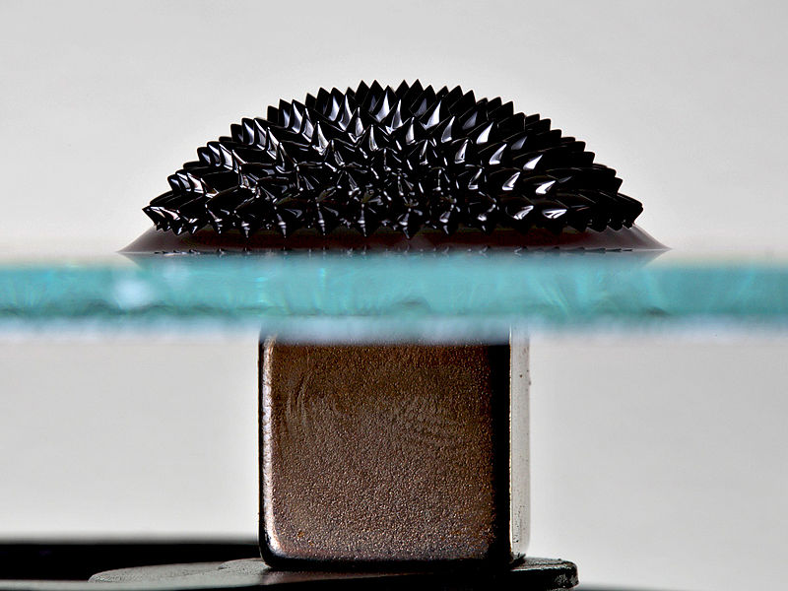
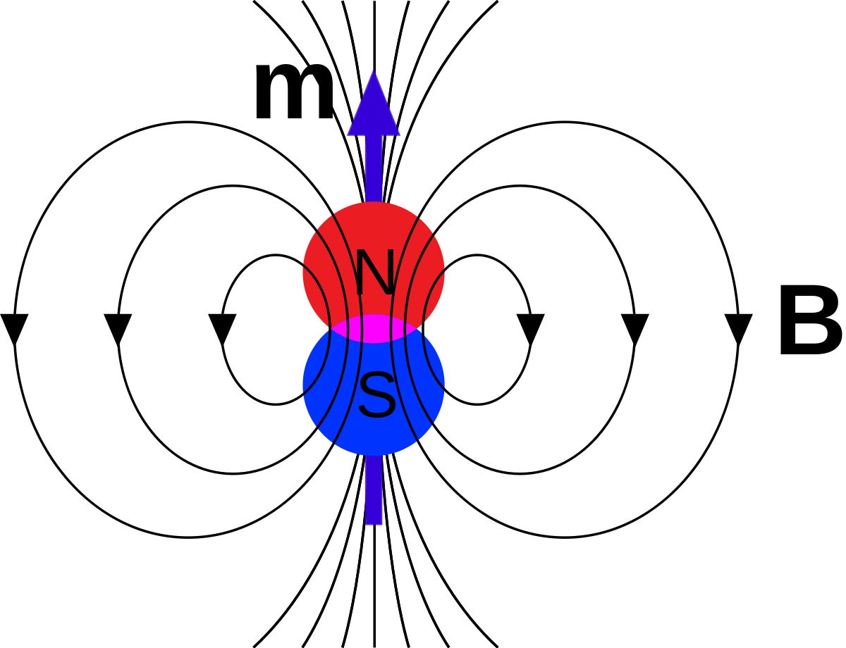
Ferrofluid and Magnetism
A demonstration!
James Ward, PHYS 420
Fall 2019

Slide 2
Magnets
- How do we define a magnet?
- Magnets attract and repel other magnets…
- Magnets stick to some (but not all substances)
- Are these substances magnets? Can we predict what substances will attract a magnet?

Slide 3
A magnetic field
We can visualize a magnetic field by drawing field lines: Here are some rules for dipole fields:
- Field Lines form complete loops, and don’t cross
- Field Lines go from N to S outside the magnets, and from S to N inside the bar
- Field Lines like to spread out as much as possible
-The number of lines corresponds to the strength – for simplicity, we have 4 lines per magnet

Slide 4
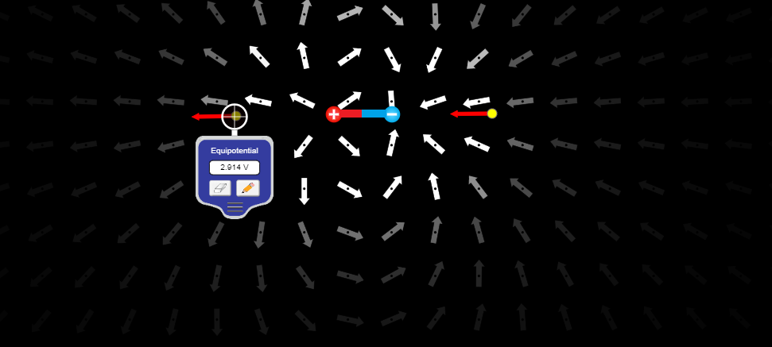
Dipoles
- The field of a single dipole – with field strength indicated

Slide 5
Pairs of Dipoles – fields cancelling and adding
Anti-Parallel Dipoles – Tiny Field
Parallel Dipoles – Doubled Field

Slide 6
Principle of Minimum Energy
- A fundamental physics principle: Systems tend to minimum energy
- A bigger field is a higher energy configuration – so smaller fields are favored. As before, field strength is proportional to the number of field lines.
- Given this, how do two dipoles prefer to be arranged?
- How about an arrangement of 3 dipoles, or 4?

Slide 7
Dipoles like to form opposing pairs!
- When dipoles form pairs, with their “magnetic moments” pointing in opposite directions, their fields cancel out.
- A useful metaphor is labeling the ends of a dipole “North” and “South” and claiming north attracts south.
- But why does this matter? Why Dipoles?

Slide 8
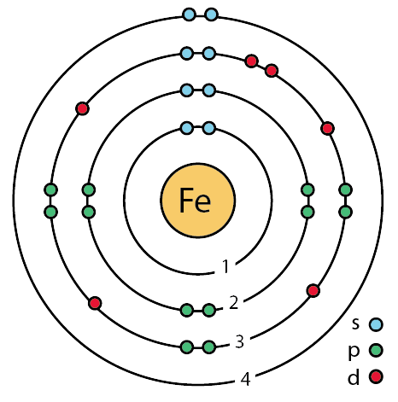
Electrons
Every electron in every atom has an intrinsic dipole field
So, naturally, electrons want to pair up! Remember chemistry?
- Electrons form pairs in opposing directions, and these pairs have no net field anymore.
- Some atoms, such as iron, have unpaired electrons though. Their fields roughly cancel too.

Slide 9
Magnetization
There is another important effect:
- In the presence of a strong external magnetic field, a dipole prefers to line up with that field.
- If we put stick some atoms in a strong field, all the electrons will want to line up with the field.
- The electrons should combine, as dipoles do, to create a really strong magnetic field! This is induced magnetization.

Slide 10
A balance of forces: paramagnetism
So, under a strong external field, we have a tug of war:
- Dipole-dipole interactions want to make the dipoles point in opposite directions,Induced magnetization wants all the dipoles to line up
- Normally, the dipole-dipole effect wins, and the induced magnetization is tiny.
- This is paramagnetism, Most things work like this.

Slide 11
Ferromagnetism: The Exchange Interaction
But what about the metal stand?
- There is one more effect that comes into play, in some situations.
- This occurs only in crystal structures with some atoms (Iron, Nickel, Cobalt + Some Rare Earths).
- The solid structure causes unpaired electrons near each other to prefer to line up. This is due to quantum mechanics.
We call this Ferromagnetism!

Slide 12
Ferromagnetism: Domains
Since electrons near each other want to align, they form regions of lined up dipoles in the solid called “domains”
- A strong enough external field will cause the domains to merge into one single alignment
- In permanent magnets, the domains have stuck into being aligned mostly in the same direction (which can be changed!)
AND THAT IS HOW MAGNETS WORK!

Slide 13
A ferromagnetic fluid?
Could we have a stable ferromagnetic fluid? Why or why not?
Remember what needs to happen:
- To support the exchange interaction, need to have a careful crystal structure
- A stable fluid should remain a liquid and not settle out of solution

Slide 14
Normal fluid instability
How about those spikes? These are called a normal field instabiliy. Any hypothesis as to why?
Once again, minimizing energy, and there are a balance of forces:
- Gravity wants the fluid to stay low. Higher means higher gravitational energy.
- Surface Tension: surface tension wants the surface to stay smooth
However – the fluid wants to move towards the region of highest flux.

Slide 15
Normal fluid instability: Flux
What is flux? Flux is the density of field lines in a certain area.
Clearly, near a magnet, the flux is the highest, so the fluid will try to move there.
- The field is deflected through all the tiny particles of iron the fluid.
- The fluid creates little pockets of high flux, and so the fluid tries to move on top of itself, in a feedback loop.
- If it could, the fluid would climb into the air along the dense field it creates, but is eventually stopped by gravity and surface tension

Slide 16
Fluid leaps into the air, towards the solenoid
Why is the fluid attracted into the air?
- Once the field from the coil is strong enough, the high flux of the solenoid eventually outweighs the restraint of gravity and surface tension.
- Then, the fluid can climb up toward the solenoid, and once it does, surface tension can actually help keep it there, even at lower field strength.
- Notice how surface tension creates the roundest smoothest possible shape here

Slide 17
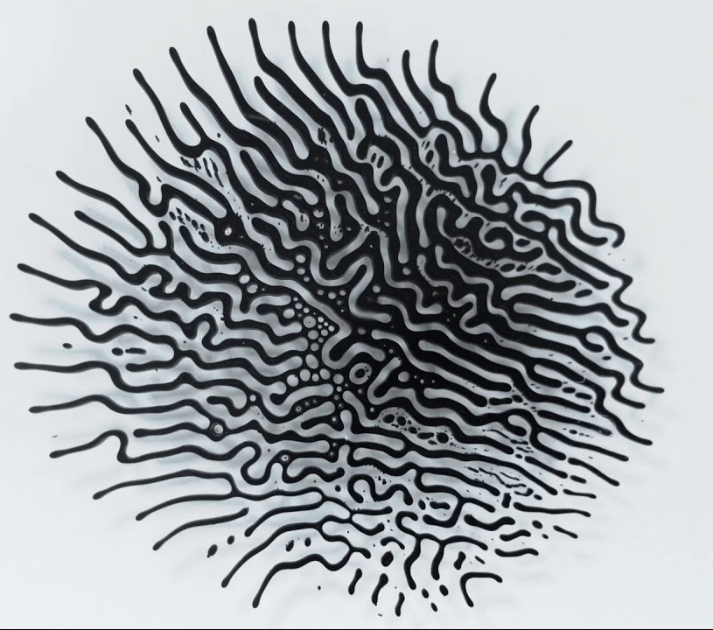
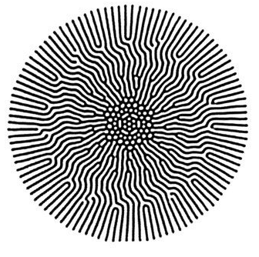
Labyrinth Patterns: Photos I found online

Slide 18
The end!
Thanks everyone for listening!
I hope everyone finds Ferrofluid and magnetism as exciting and fascinating as I do.
Feedback is strongly appreciated, of course.

