Slide 1
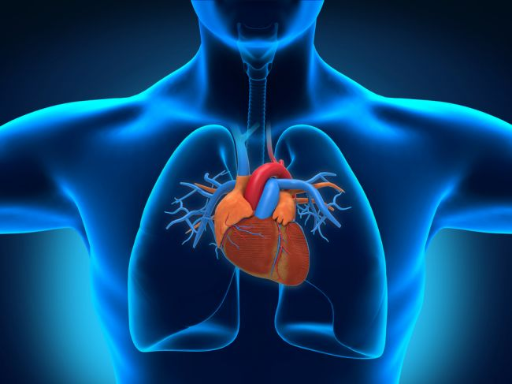
Circuitry and the Heart
By Suvvy Kular
Image retrieved from
https://www.livescience.com/45201-tech-makes-animal-organs-viable-for-transplant.html

Slide 2
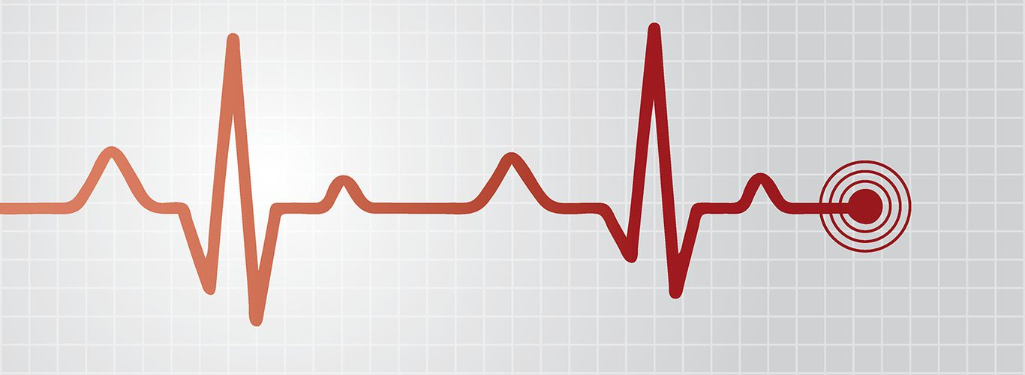
What’s a pulse?
Image retrieved from
https://www.southwales.ac.uk/study/subjects/nursing-health-sciences/short-courses/ecg/

Slide 3
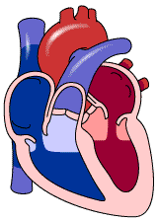
Heartbeat definition
# of heart beats / time
Beats per min (BPM)
Beat: contraction of ventricles
Image retrieved from https://www.pinterest.ca/pin/448108231656876988/

Slide 4
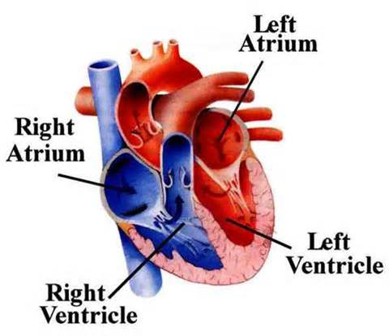
Image retrieved from https://www.medicinenet.com/script/main/art.asp?articlekey=3674

Slide 5
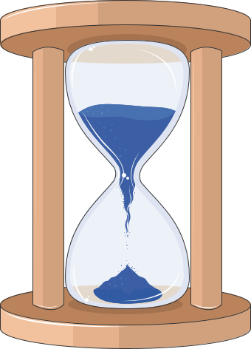
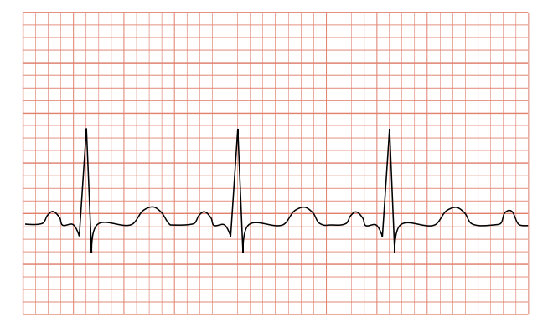
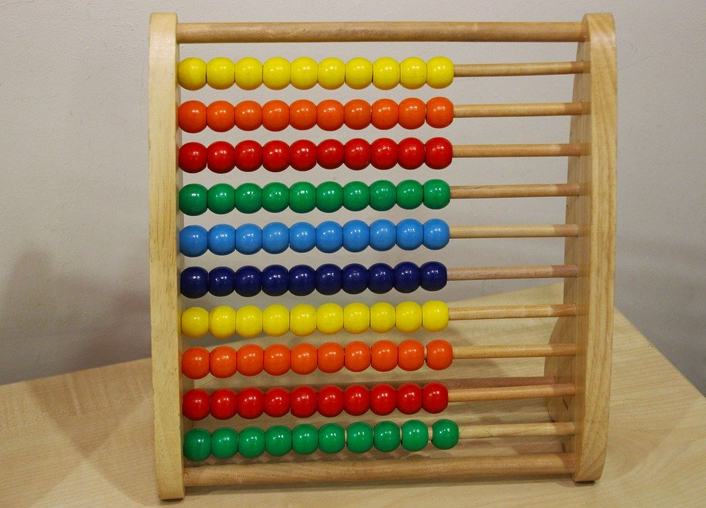
How do we find it?
a sensor
2 ways to measure: manually or
Today we will explore both
Images retrieved from Clip Art

Slide 6
Activity (5 min, warmup)
Find a partner (max group of 3)
Pick a group leader
Determine and ‘apply’ method to calculate, resting and active heart rates of the team leader
Record results
Discuss, in groups and as a class

Slide 7
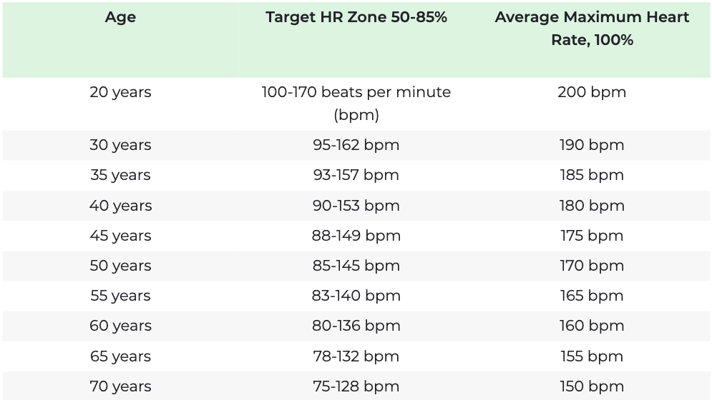
Background
Determining pulse (beats per minute)
Average 60 -100BPM
Max heart rate is ~ 220 - your age
Image retrieved from https://www.heart.org/en/healthy-living/fitness/fitness-basics/target-heart-rates

Slide 8
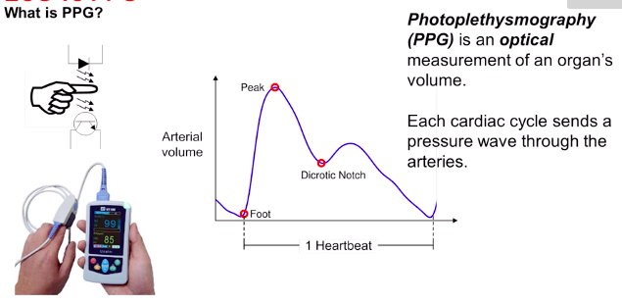
Photoplethysmography (PPG)
Optical measurement of an organ's volume
Commonly use red or Infared LED
Image retrieved from https://training.ti.com/how-measure-ecg-ecg-vs-ppg

Slide 9
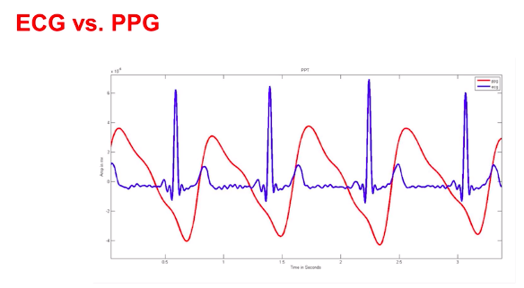
Electrocardiography (ECG)
ECG monitors cardiac muscle contractions
Image retrieved from https://training.ti.com/how-measure-ecg-ecg-vs-ppg
Notes:
Image and text for this and PPG slide

Slide 10
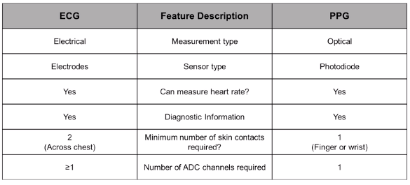
ECG vs PPG
Image retrieved from https://training.ti.com/how-measure-ecg-ecg-vs-ppg

Slide 11
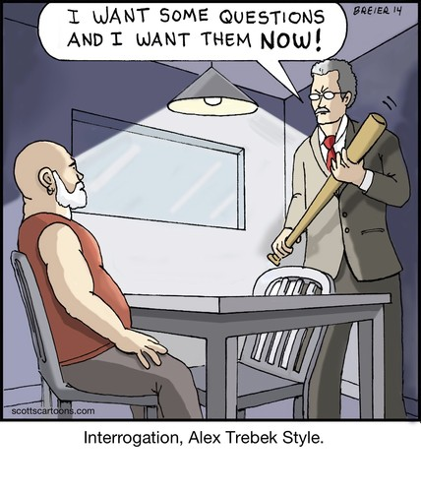
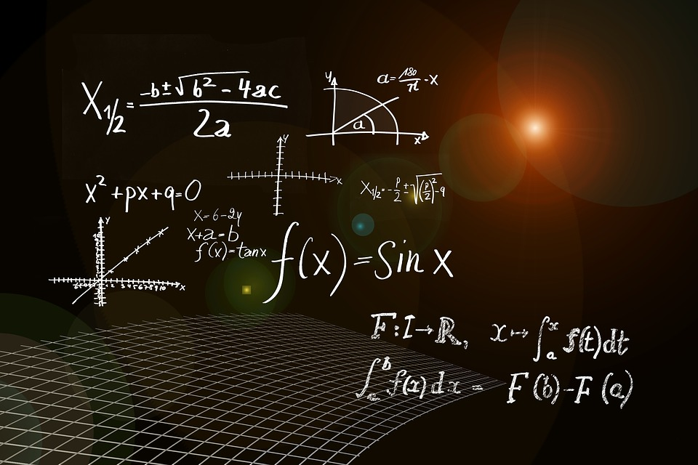
The Physics Problem
Generating a signal
Passing it through the human body
Measuring and interpreting
Simulating the pulse or heart rate
Image retrieved from Clip Art
Image retrieved from https://www.toonpool.com/cartoons/Interrogation_224551

Slide 12
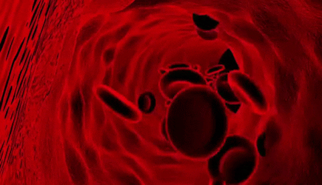
Image retrieved from https://gfycat.com/mistydigitalhammerheadshark

Slide 13
Putting Them Together
Red blood cells (RBCs) reflect/transmit Infrared light
Knowing this, we can make a sensor consisting of a Phototransistor and LED emitting Infrared Light
The heart pumps blood into the body, causing the blood (full of RBCs) in the fingertip (our measurement point)
Thus a PPG is created!

Slide 14
Physics Concepts and Purpose
Circuitry, Optics
Physics and Biology of Blood Flow…..NOT really...
Interpreting information from the body

Slide 15
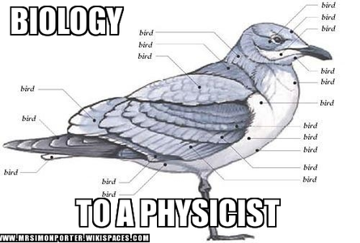
End of Biology Portion
Image retrieved from https://www.pinterest.ca/pin/38702878025793517/

Slide 16
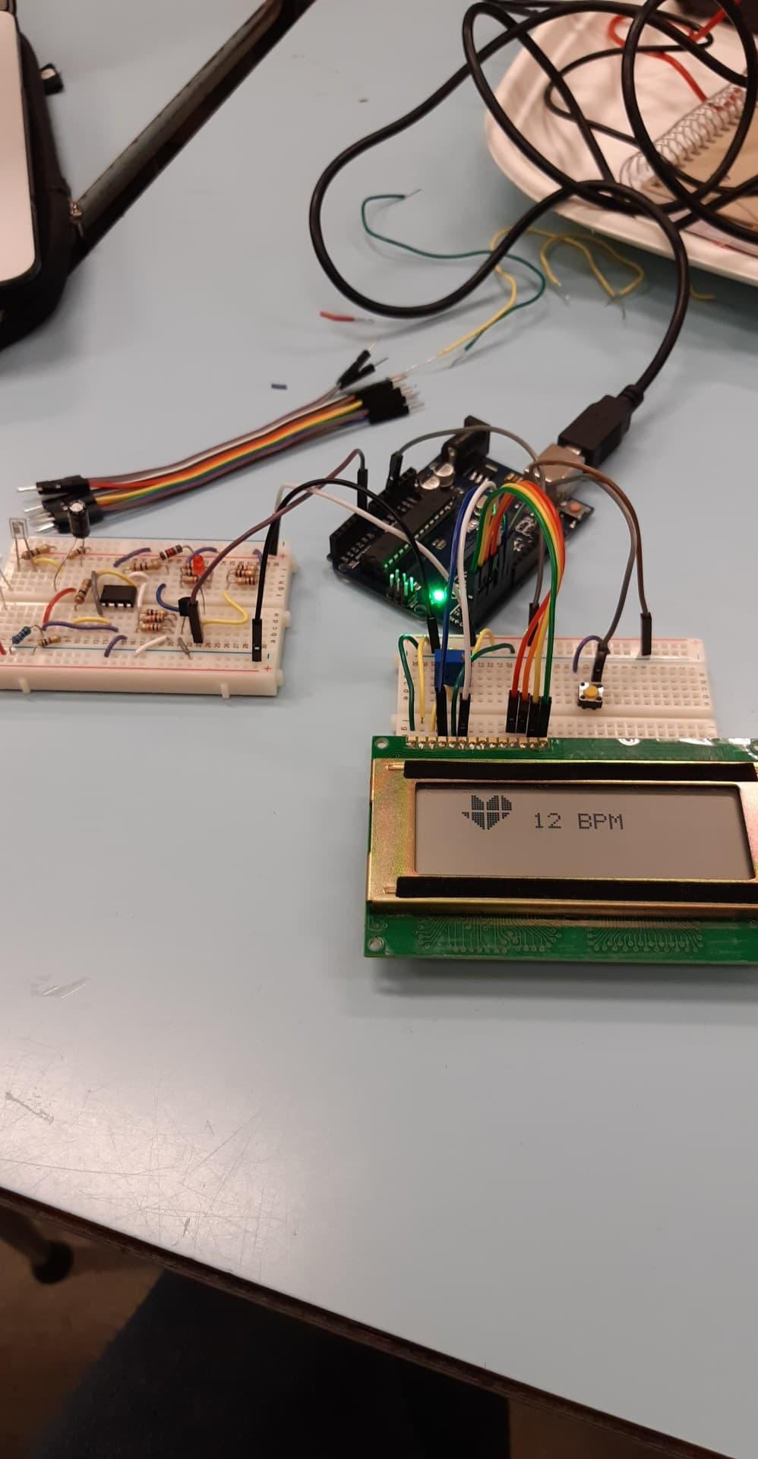
It’s alive...kinda...
The Heart Beat Sensor

Slide 17
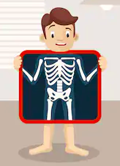
The Skeleton
Image retrieved from https://www.shutterstock.com/search/x+ray+cartoon

Slide 18
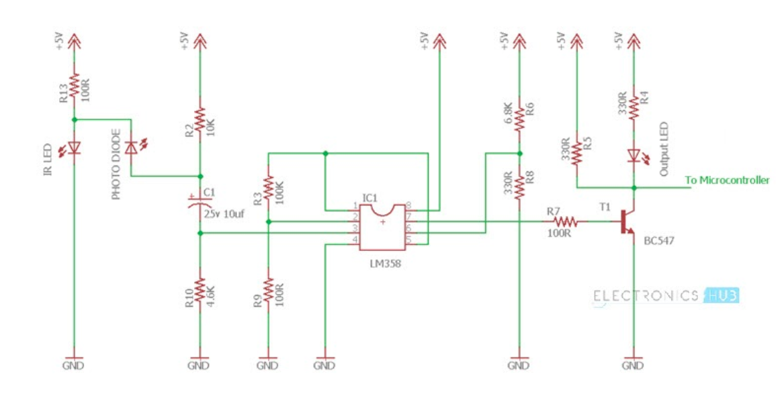
Image retrieved from https://www.electronicshub.org/heartbeat-sensor-using-arduino-heart-rate-monitor/

Slide 19
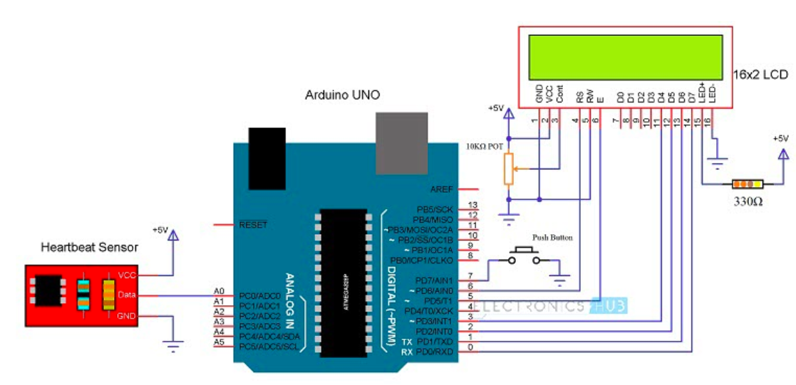
Image retrieved from https://www.electronicshub.org/heartbeat-sensor-using-arduino-heart-rate-monitor/

Slide 20
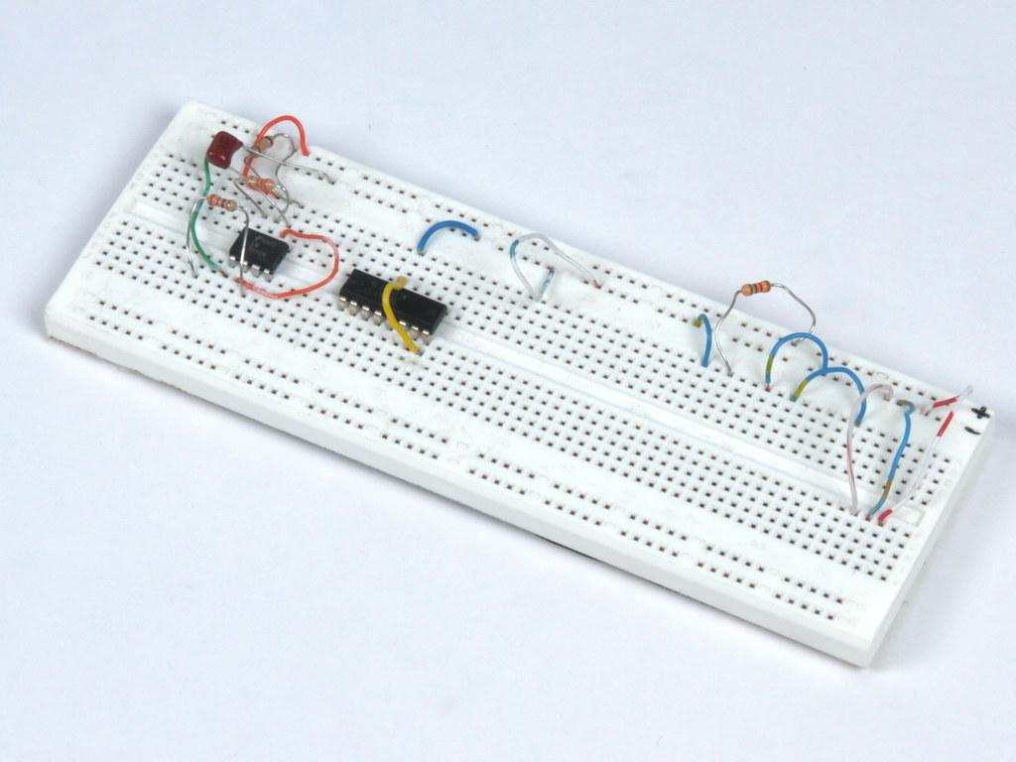
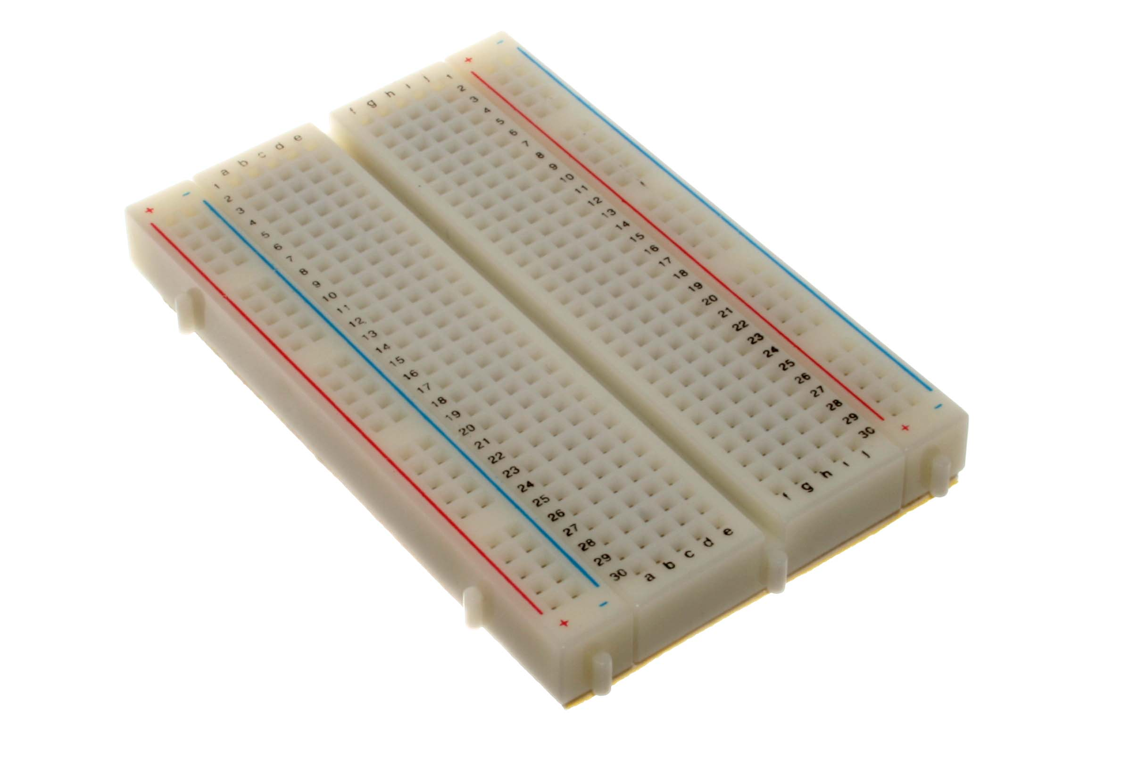
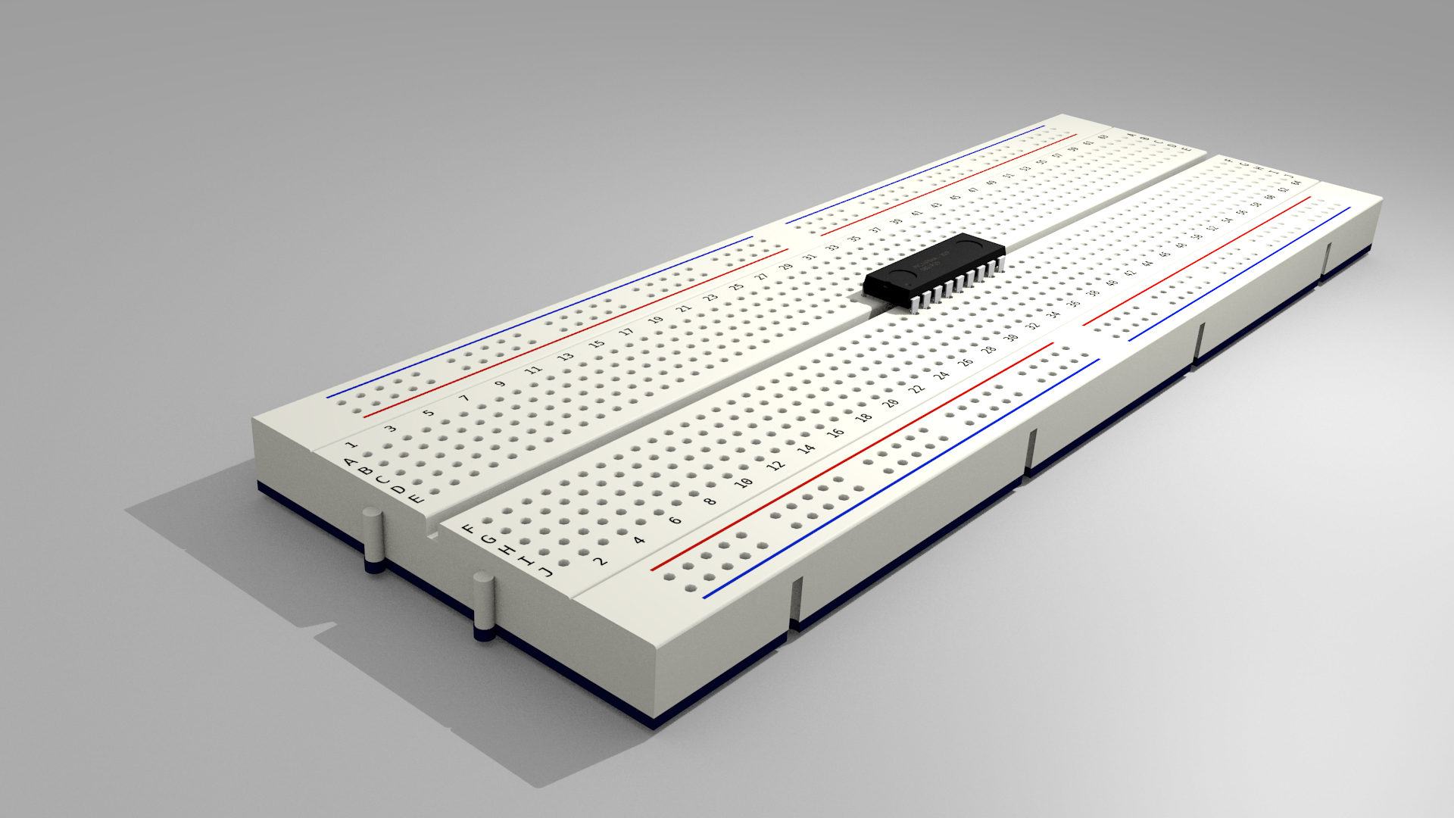
What we need to know
Bread boards
Resistors
Capacitors
LED’s (IR and regular)
Transistors
High and low pass filters
Amplifiers
Microcontroller
Liquid Crystal Display (LCD) *optional
Breadboard Images retrieved from Clip Art

Slide 21
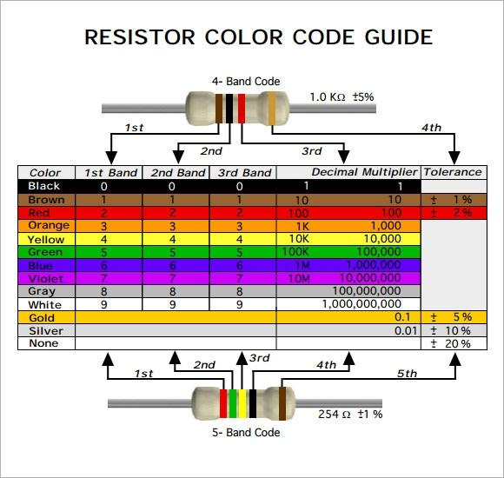
Resistors
1 - 100Ω resistor (brown black brown)
1 - 1KΩ resistor (brown black red)
1 - 1.5KΩ resistor (brown green red)
1 - 10KΩ resistor (brown black orange)
1 - 20KΩ resistor (red black orange)
1 - 47KΩ resistor (yellow purple orange)
Image retrieved from https://www.sampletemplates.com/business-templates/resistor-color-code-chart.html

Slide 22
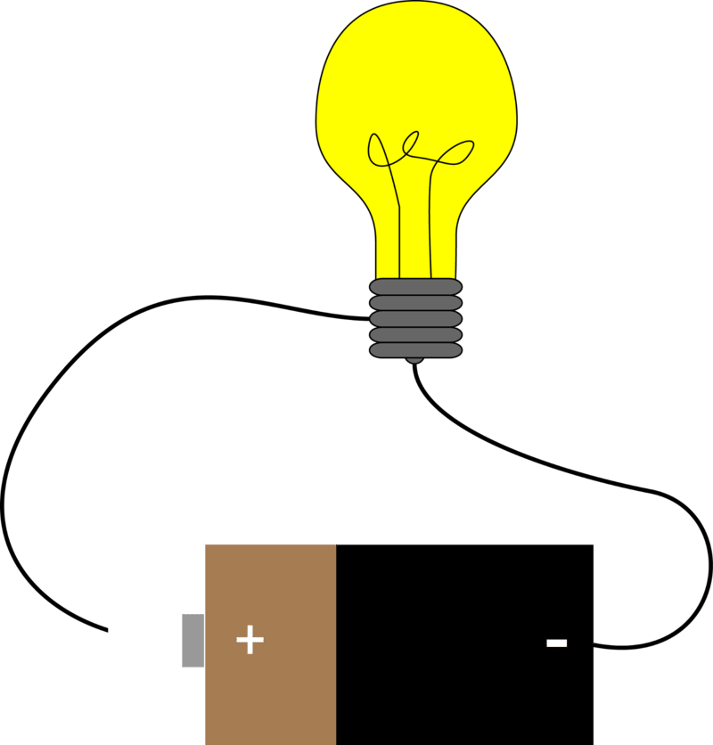
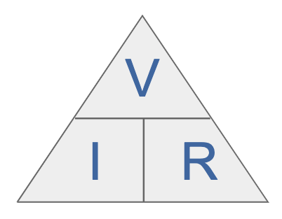
Refresher
Image retrieved from
https://www.ck12.org/c/physical-science/circuit/lesson/Electric-Circuits-MS-PS/
Image retrieved from
https://www.electronics-notes.com/articles/basic_concepts/resistance
/what-is-ohms-law-formula-equation.php

Slide 23
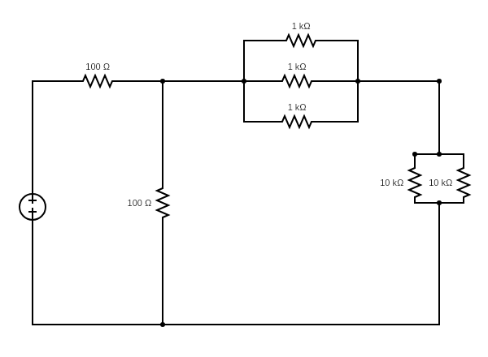
Circuitry Review
Determine the initial current, knowing:
Ohm’s Law: V = IR
V =12V
Notes:
0.0635Amps

Slide 24
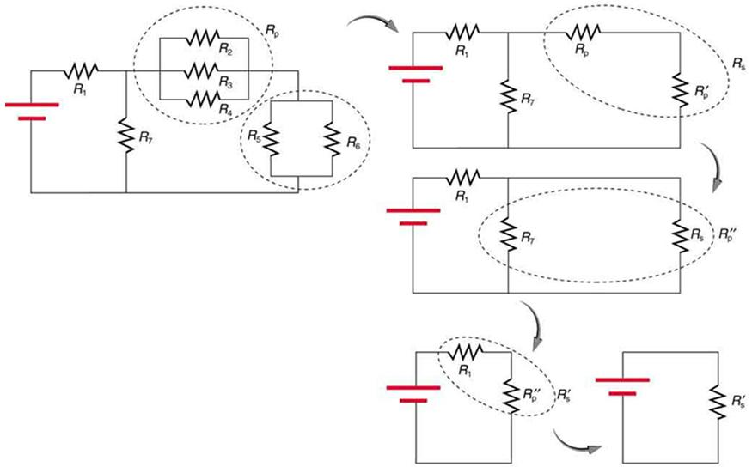
Circuitry Review
Determine the initial current, knowing:
Ohm’s Law: V = IR
R1 =R7, R2=R3=R4 and R5 =R6
R1 = 100Ω, R2=1kΩ, R6=10kΩ
Image retrieved from
https://opentextbc.ca/physicstestbook2/chapter/resistors-in-series-and-parallel/

Slide 25
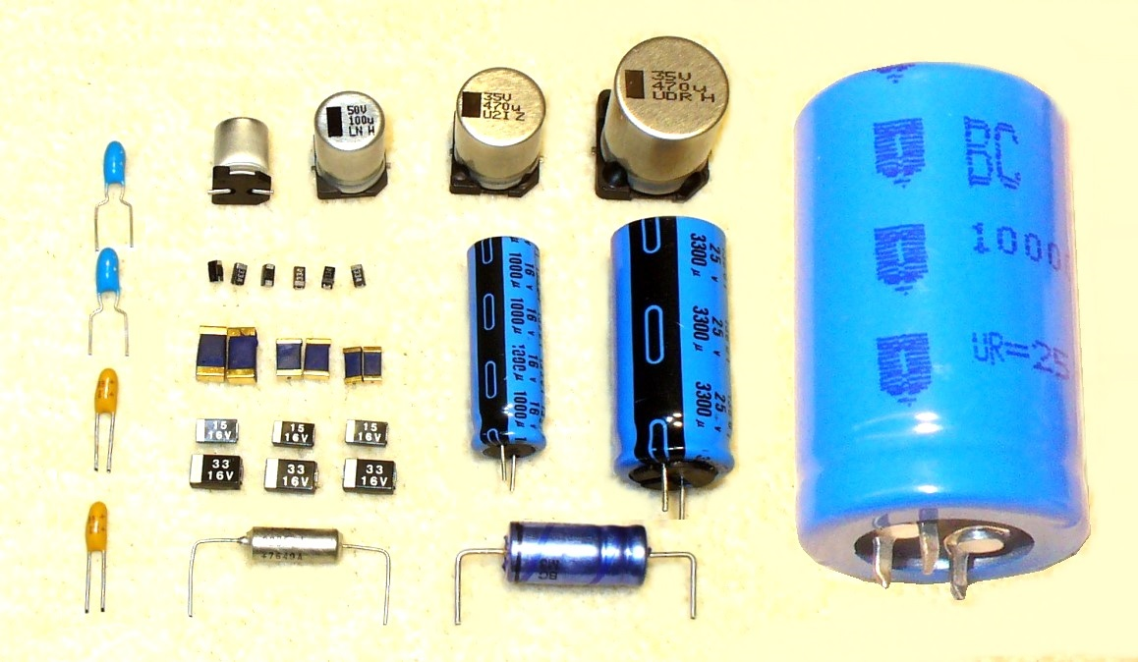
Capacitors
Image retrieved from Phys 158, UBC, notes Dr. Hasinoff

Slide 26
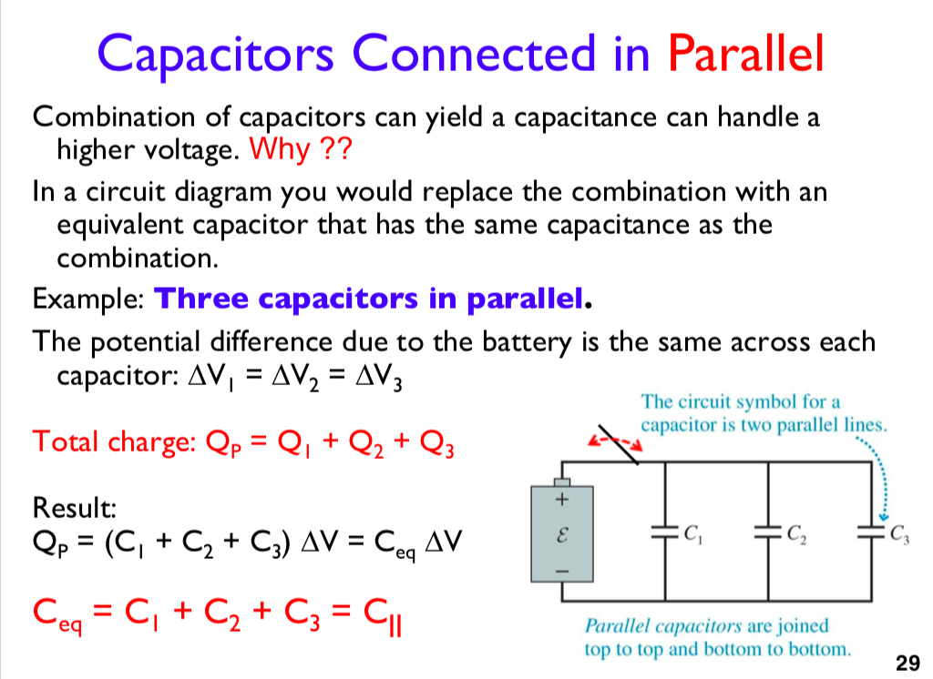
Phys 158
Image retrieved from Phys 158, UBC, notes Dr. Hasinoff
Notes:
Slide from phys158

Slide 27
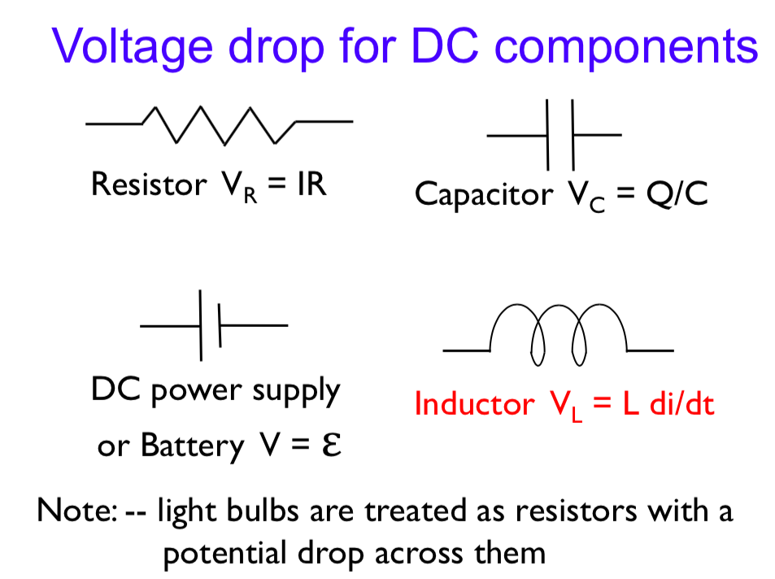
Image retrieved from Phys 158, UBC, notes Dr. Hasinoff

Slide 28
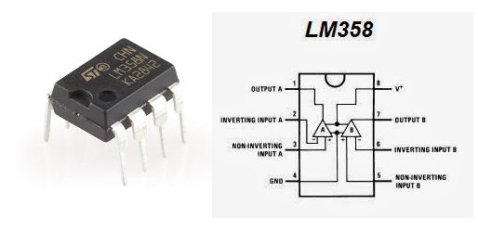
Amplifiers (OpAmp)
Signal detected by the sensor ~3-4mV
Filters unwanted noise and amplifiers / condition the signal so that it is “readable”
Image retrieved from https://48projectsblog.wordpress.com/2015/12/22/37breadboard-electronics-opamps/

Slide 29
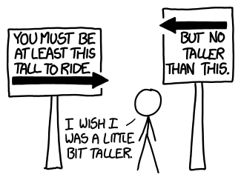
Filters
High and low pass filters allow frequencies of a certain range to pass through
Remove noise
“Signal Conditioning”
Image retrieved from https://what-if.xkcd.com/77/

Slide 30
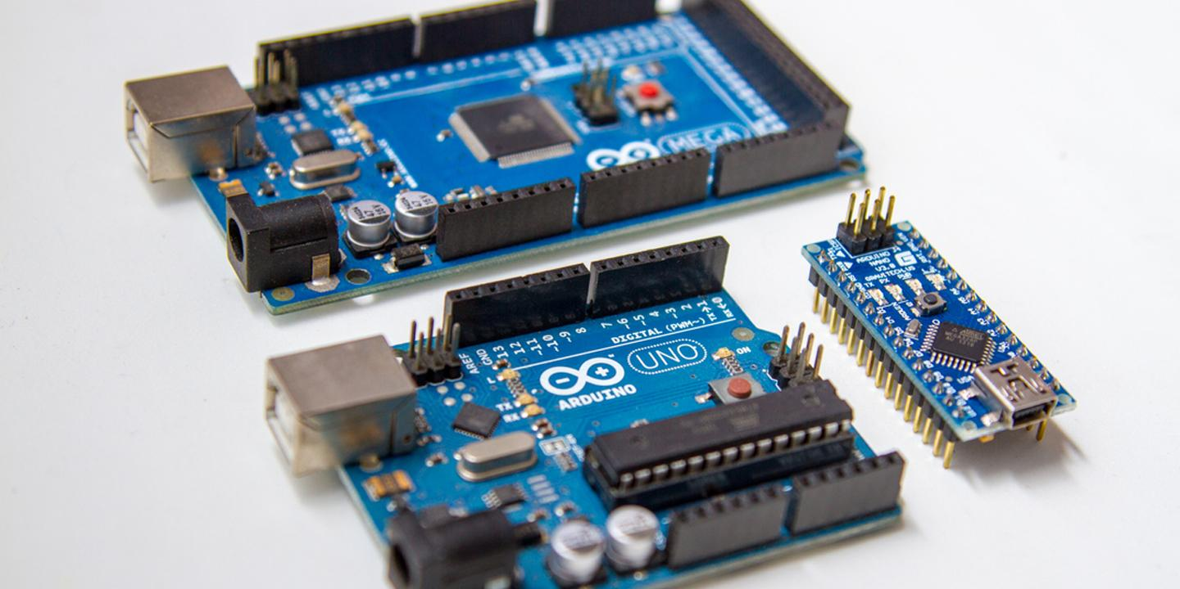
More Advanced Components
Microcontrollers: very powerful, versatile functions (eg, A/D signal output to computer, both wired and wirelessly)
Image retrieved from https://octopart.com/blog/archives/2018/11/create-your-way-at-your-level-and-beyond-with-arduino-uno-nano-and-mega

Slide 31
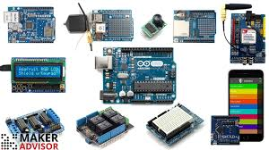
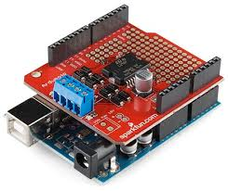
Arduino Shields/Attachments
Image retrieved from https://makeradvisor.com/top-10-most-useful-arduino-shields/
Image retrieved from https://learn.sparkfun.com/tutorials/arduino-shields/all
Notes:
Image links
https://learn.sparkfun.com/tutorials/arduino-shields/all
https://makeradvisor.com/top-10-most-useful-arduino-shields/
https://www.autodesk.com/products/eagle/blog/arduino-shield-buying-designing/

Slide 32
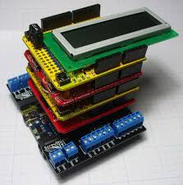
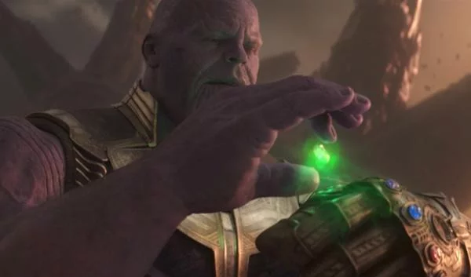
More Attachments, More Power
Image retrieved from
https://www.technobuffalo.com/avengers-4-doctor-strange-tricked-thanos-with-cursed-time-stone
Image retrieved from https://www.autodesk.com/products/eagle/blog/arduino-shield-buying-designing/

Slide 33
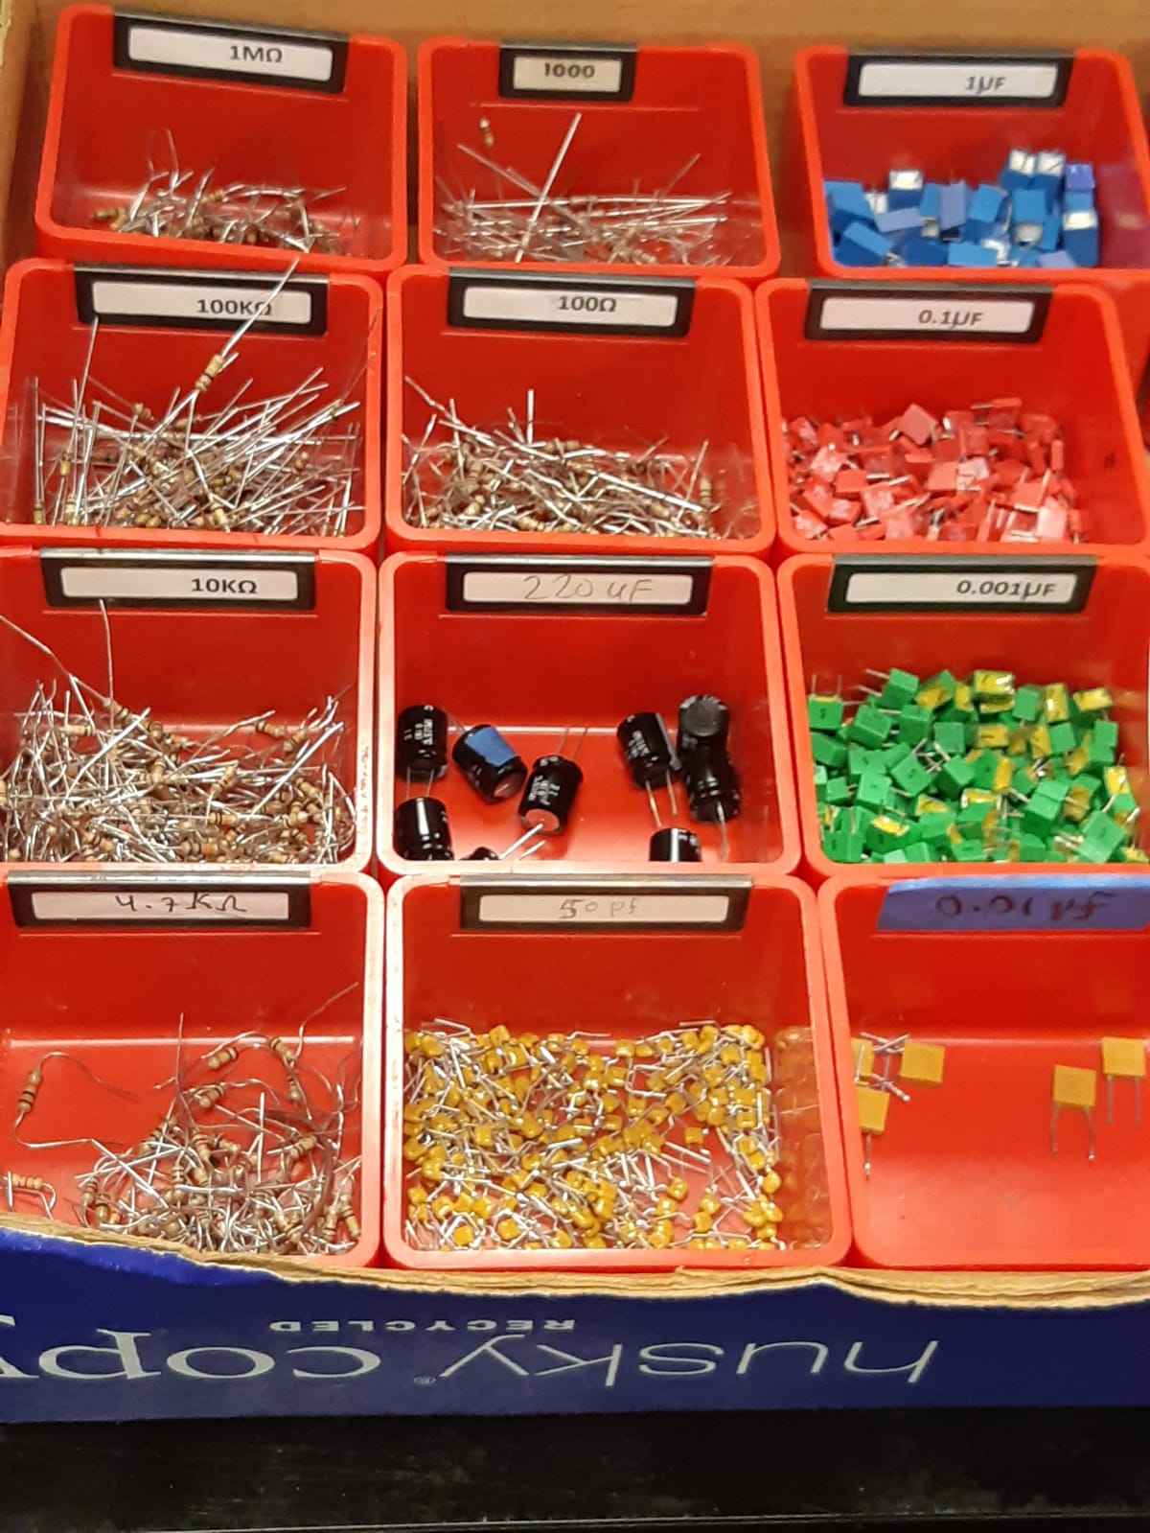
The Ingredients
Image retrieved from
https://starlitecuisine.com/independent-month-chucks-produce/chucks-produce-lined-produce-image/

Slide 34
The “Heart Beat Sensor”
Image retrieved from https://www.electronicshub.org/heartbeat-sensor-using-arduino-heart-rate-monitor/

Slide 35
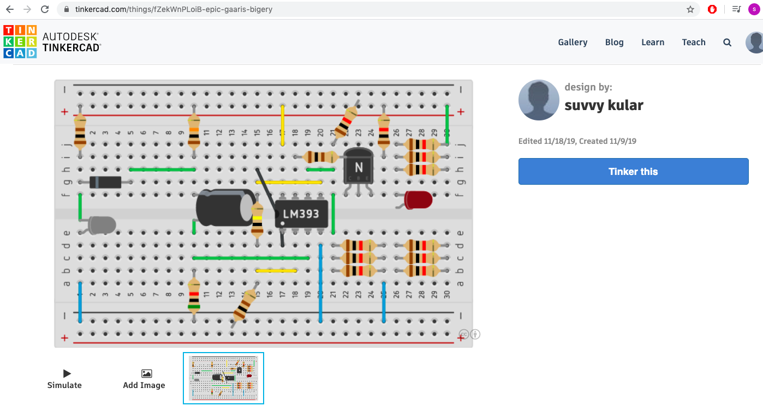
Image screenshot from https://tinkercad.com/things/fZekWnPLoiB-epic-gaaris-bigery

Slide 36
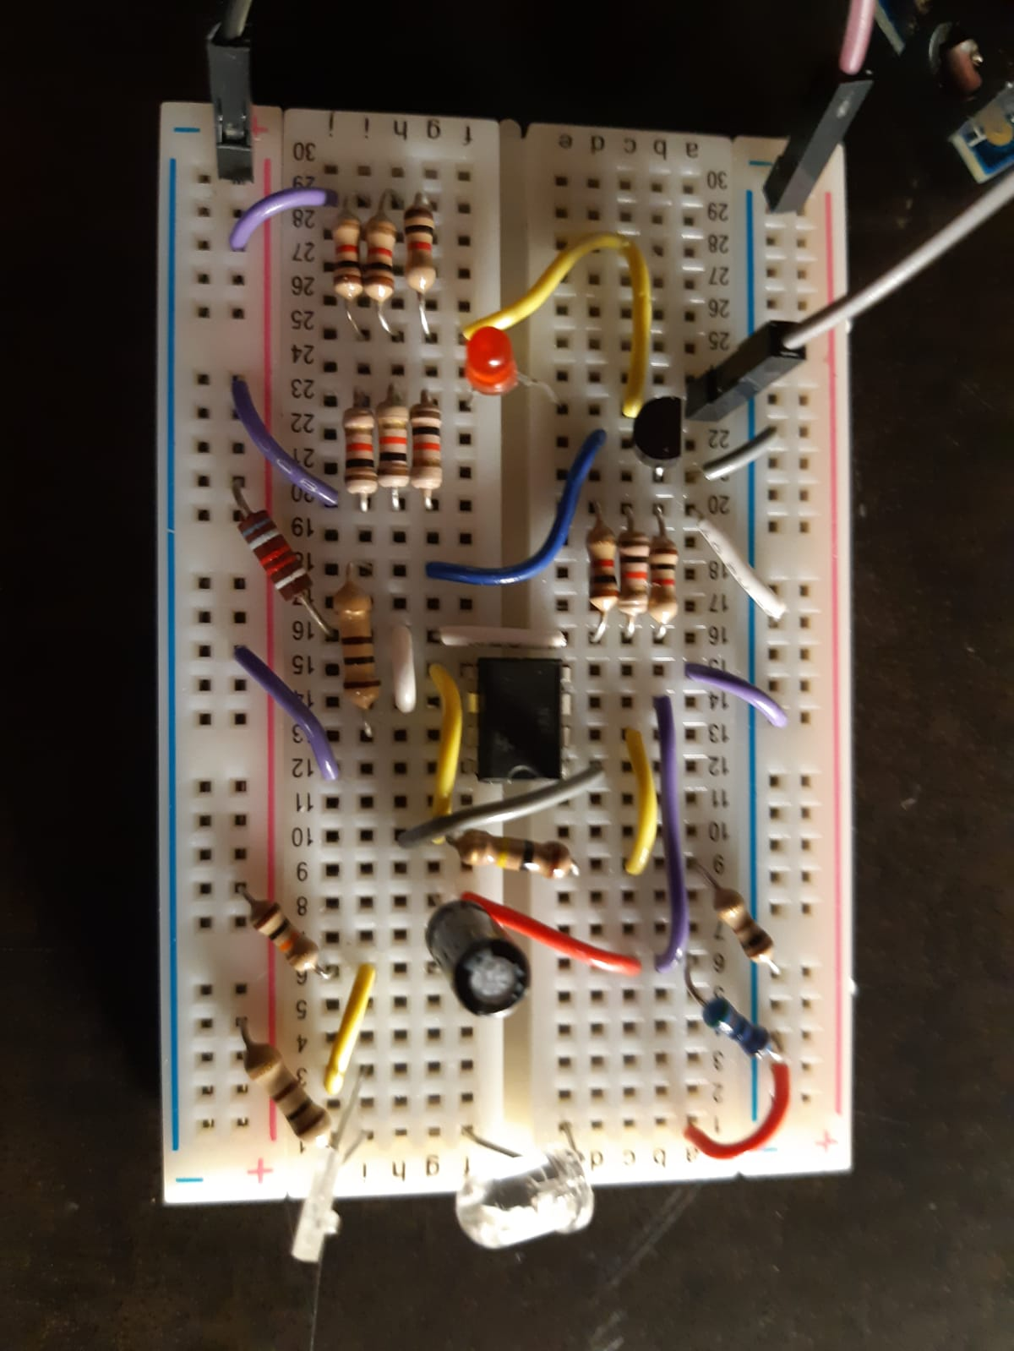
The “Heart Beat Sensor”
Image retrieved from https://www.electronicshub.org/heartbeat-sensor-using-arduino-heart-rate-monitor/

Slide 37
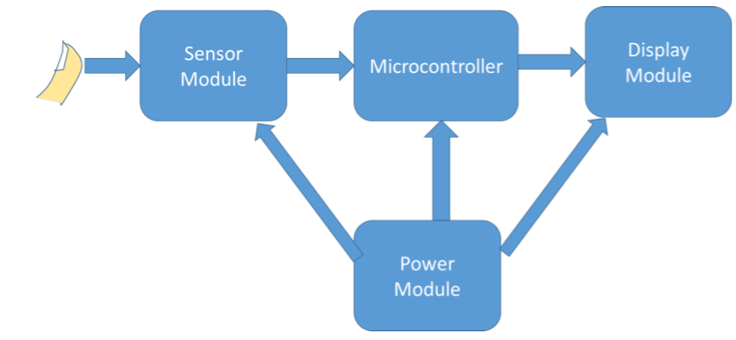
Block diagram created by Ying Wang, retrieved from https://courses.engr.illinois.edu/ece445/getfile.asp?id=6917

Slide 38
Image retrieved from https://www.electronicshub.org/heartbeat-sensor-using-arduino-heart-rate-monitor/

Slide 39
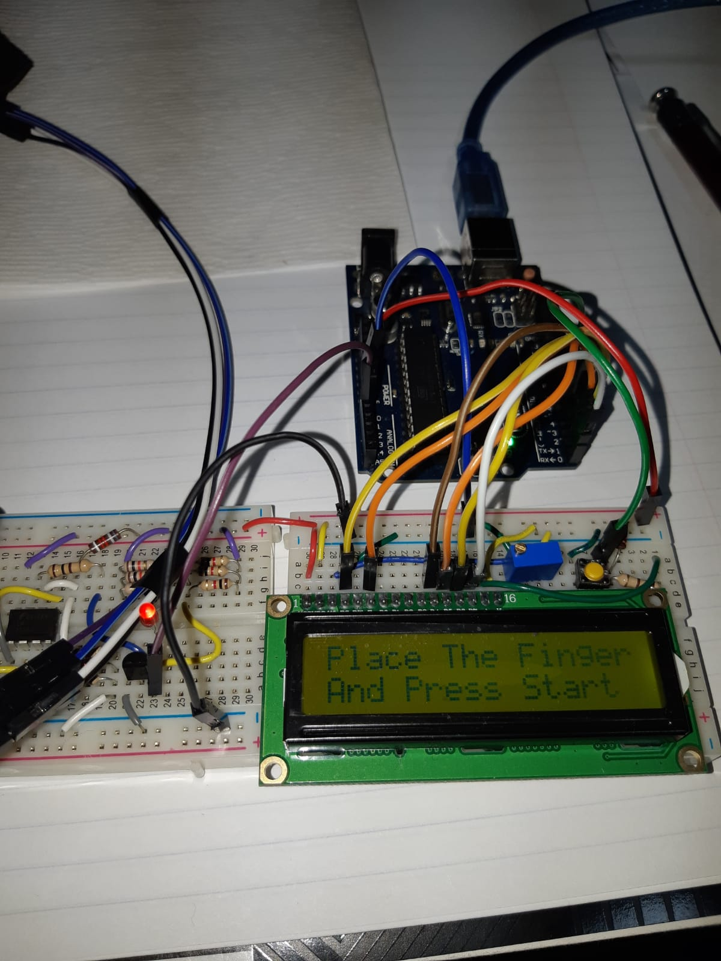
The 4 Modules

Slide 40
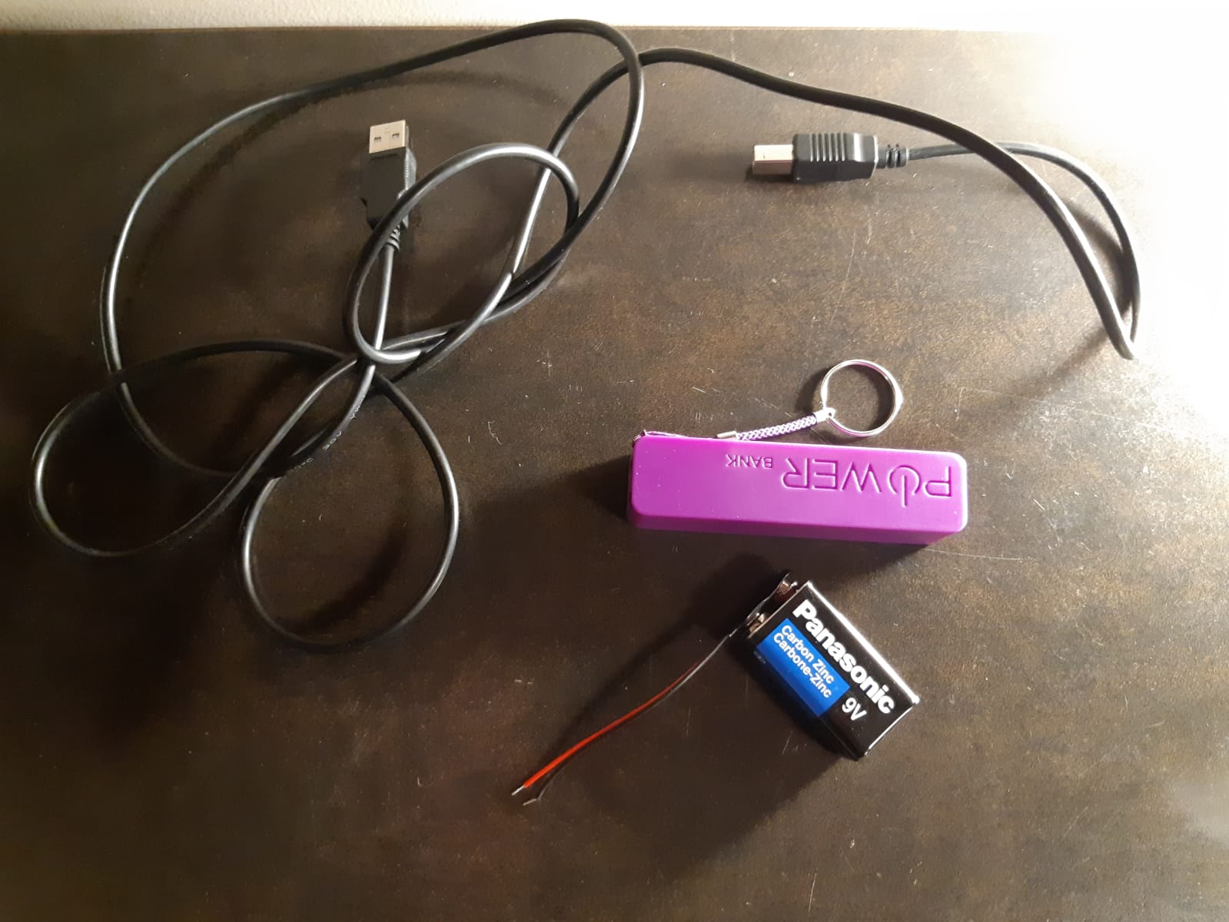
Power Module

Slide 41
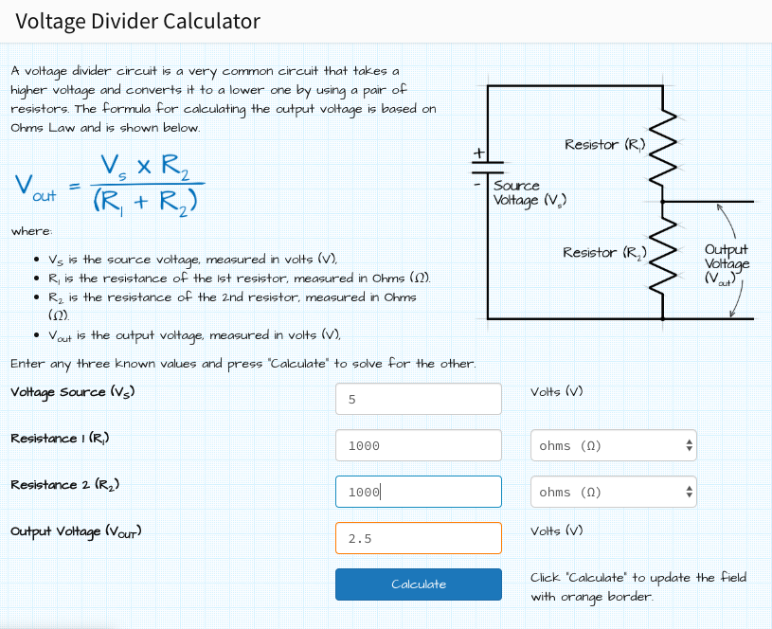
Voltage Divider
Image screenshot from https://ohmslawcalculator.com

Slide 42
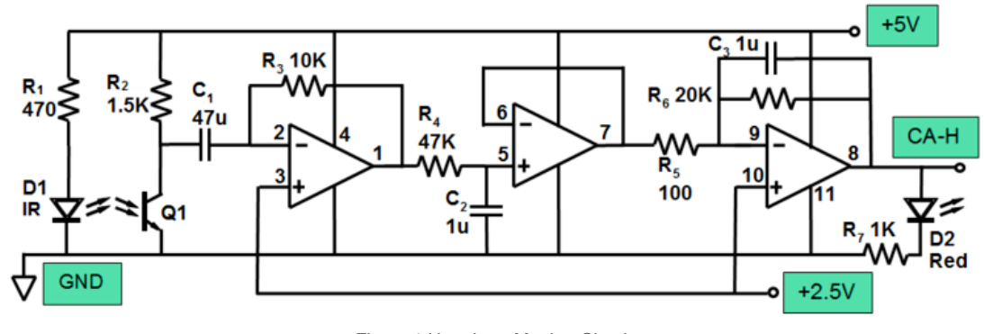
Design 2
Image retrieved from https://wiki.analog.com/university/courses/alm1k/alm-lab-heart-rate-mon

Slide 43
Display Module
Displays output from microcontroller

Slide 44
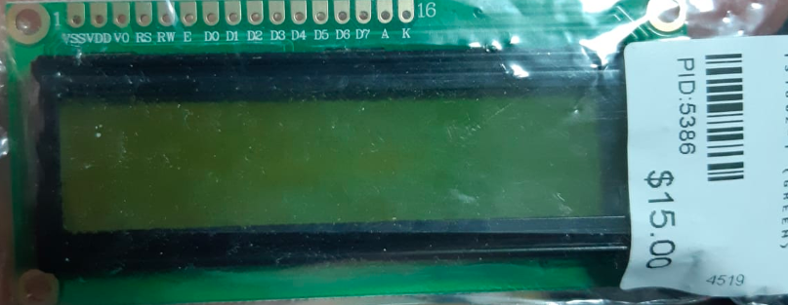
Some Assembly Required

Slide 45
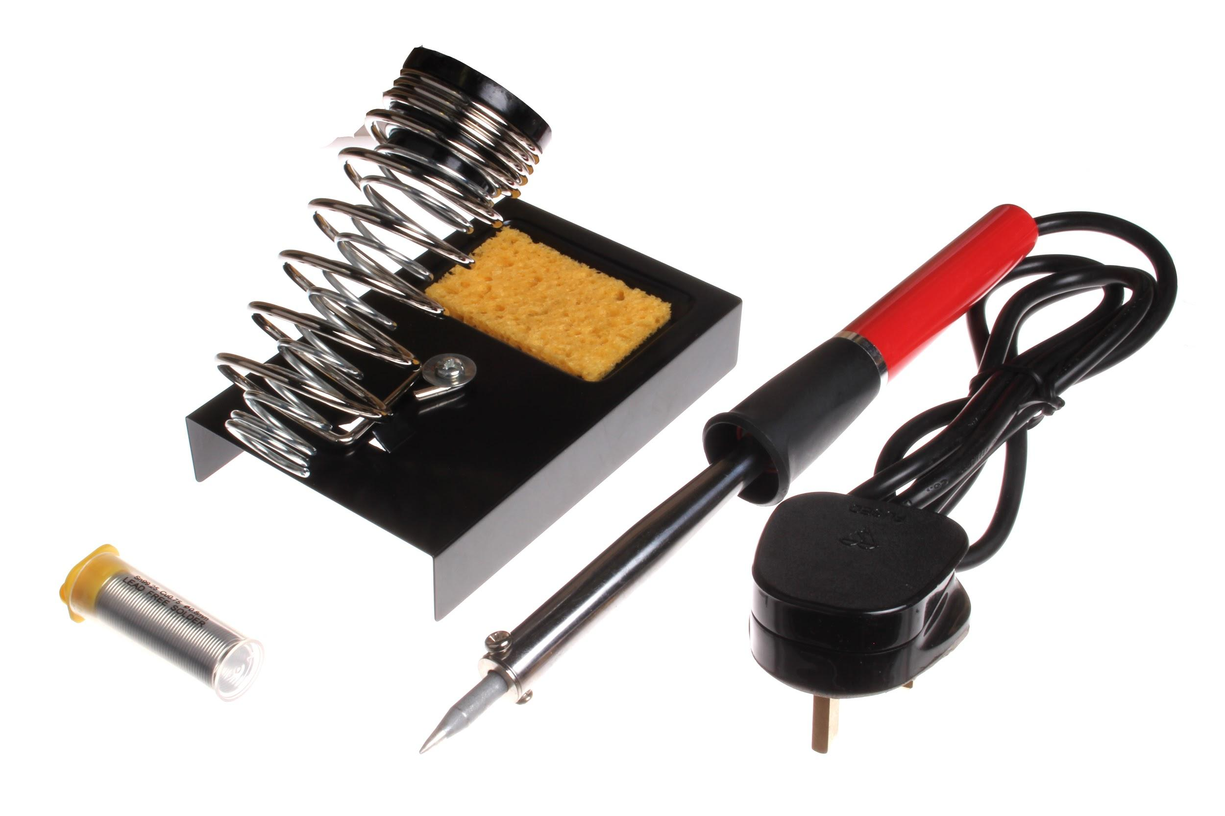
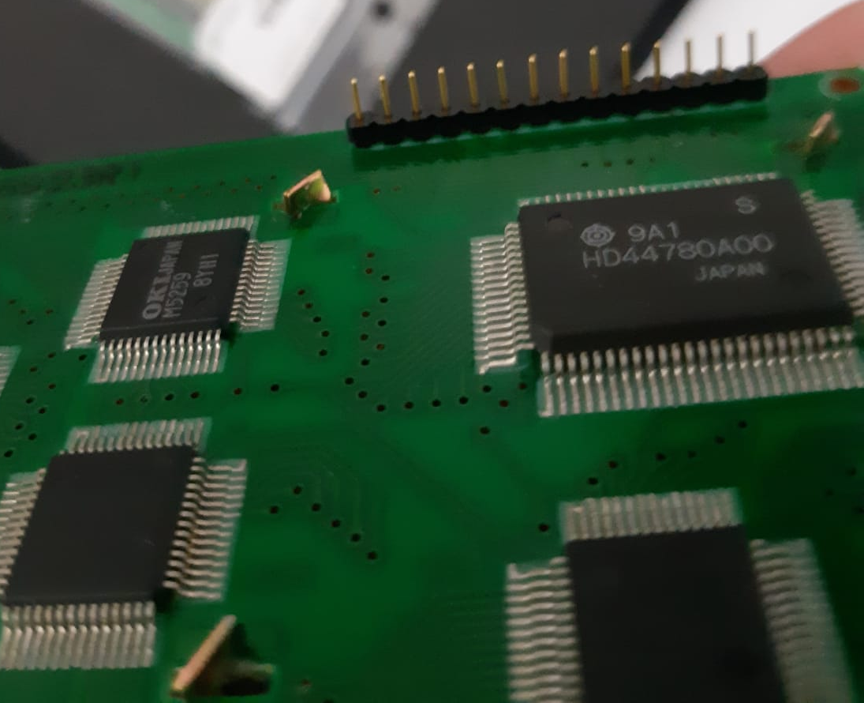
Some Assembly Required
Image retrieved from Clip Art

Slide 46
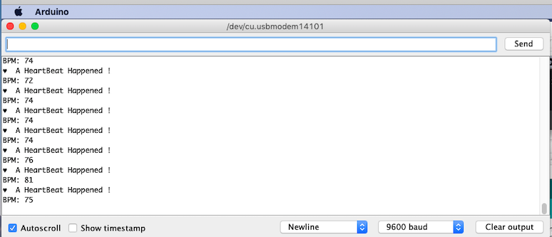
Computers can also Display

Slide 47
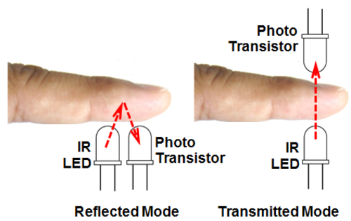
Sensor Module
Signal emission and detection
2 possible orientations: detecting reflection/transmission
More current passes through Transistor with more reflected light
Amplifiers used to collect signal, filter noise
Image retrieved from https://wiki.analog.com/university/courses/alm1k/alm-lab-heart-rate-mon
Notes:
ER image
https://www.clinuvel.com/photomedicine/physics-optics-skin/electromagnetic-spectrum/understanding-the-electromagnetic-spectrum

Slide 48
The “Heart Beat Sensor”
Image retrieved from https://www.electronicshub.org/heartbeat-sensor-using-arduino-heart-rate-monitor/

Slide 49


Slide 50


Slide 51


Slide 52


Slide 53


The EM Spectrum
Image retrieved from
https://en.wikipedia.org/wiki/Electromagnetic_radiation#/media/File:EM_spectrumrevised.png
Image retrieved from
https://www.zulily.com/p/wwe-john-cena-you-cant-see-me-fleece-throw
-278126-39684507.html

Slide 54
The “Heart Beat Sensor”
Image retrieved from https://www.electronicshub.org/heartbeat-sensor-using-arduino-heart-rate-monitor/

Slide 55




Image retrieved from https://www.electronicshub.org/heartbeat-sensor-using-arduino-heart-rate-monitor/
Notes:
Block diagram created by Yui Wang

Slide 56
Image retrieved from https://www.electronicshub.org/heartbeat-sensor-using-arduino-heart-rate-monitor/

Slide 57

Image screenshot from arduino.cc
Notes:
https://create.arduino.cc/

Slide 58

Image screenshot from arduino.cc

Slide 59


Slide 60

Demo Time
Image retrieved from https://giphy.com/gifs/pulse-Dpz3px6erCFeU

Slide 61


Applications
Heart Beat Sensor(s)
Image retrieved from
https://circuitdigest.com/microcontroller-projects/heartbeat-monitoring-using-pic-microcontroller-and-pulse-sensor
Image retrieved from
http://embedded-lab.com/blog/arduino-heart-rate-meter-seven-segment-led-display/

Slide 62


Image retrieved from https://support.apple.com/en-ca/guide/watch/apda88aefe4c/watchos
Image retrieved from
https://www.digikey.ca/product-detail/en/sparkfun-electronics/SEN-11574/1568-1247

Slide 63

Image retrieved from https://shop.openbci.com/products/pulse-sensor?variant=22543672899

Slide 64

Applications of Optics
Image retrieved from https://www.mcall.com/opinion/mc-opi-radar-speeding-police-pennsylvania-reaction-20190628-g3svqdubxnb4jntpfc5mqafcbu-story.html

Slide 65

Factors Affecting Heart Rate
Diet
Exercise
Stress
Age
Image retrieved from https://www.pinterest.ca/pin/347762402447992235/

Slide 66

Image retrieved from
https://www.businesswire.com/news/home/20160229007002/en/Heart-MobileHelp%C2%AE-Whitepaper-Consumers-Tips-Long-Term-Heart

Slide 67
Questions/ Discussion

Slide 68
Bonus
Student PHYS 420 Web Pages: https://www.phas.ubc.ca/~janis/Courses/420/420.2019.html
Alejandro https://phas.ubc.ca/~alexesqu/
Giovanni https://phas.ubc.ca/~gcald/webpage.htm
James https://phas.ubc.ca/~jmward/
Kayla https://phas.ubc.ca/~kaylalb7/Homepage.html
Linh https://www.phas.ubc.ca/~linhphan/linh_420.html
Suvvy https://phas.ubc.ca/~suvvyk/

