Slide 1
How to build a Geiger Counter
Hisham al Hashmi
University of British Columbia

Slide 2
Introduction
Who am I?
Why am I here?
What are we going to do today?

Slide 3
Presentation Plan
Radioactive decay refresher.
What are Geiger Counters
How I built my own Geiger Counter

Slide 4
Radioactive decay
https://www.scienceabc.com/wp-content/uploads/2017/01/Notation-Nuclear-Reaction.jpg

Slide 6
What is a Geiger Counter?
Geiger counters detect ionising radiation ($α, β$ particles and $γ$ rays).
Can you think of an example where Geiger counters can be used?
Cancer treatment
Nuclear facility safety measurements
To detect radioactive minerals and rocks

Slide 7
https://www.youtube.com/watch?v=TRL7o2kPqw0&ab_channel=Veritasium

Slide 8
How do Geiger counters work?
https://forumautomation.com/uploads/default/original/2X/c/cf18d82a417e6ddd050f20cfd2197fc60385c891.png

Slide 9
Geiger Tube
https://ae01.alicdn.com/kf/H192a18fd0a3141dbaf2116ff4135bdb4A.jpg

Slide 10
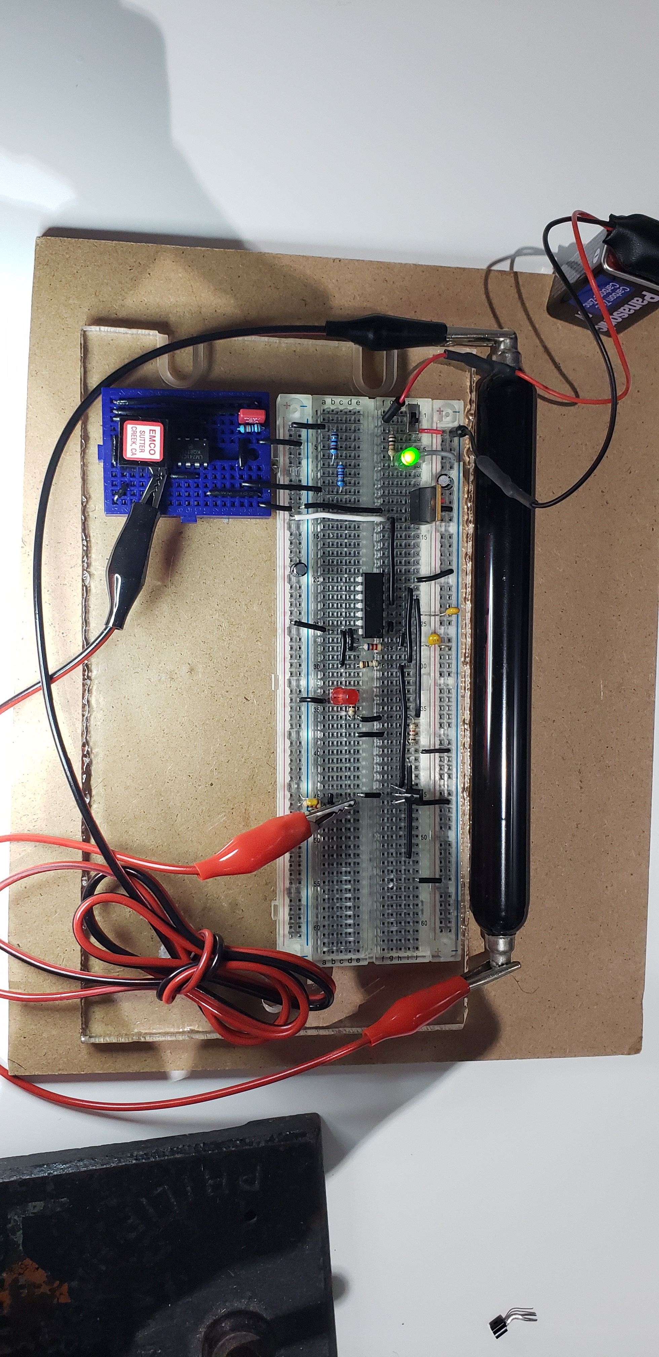
My Geiger counter
Detects $β$ particles and $γ$ rays.
The detections are displayed using an LED.

Slide 12
Circuit Diagram
Adopted from: https://ocw.mit.edu/courses/nuclear-engineering/22-s902-do-it-yourself-diy-geiger-counters-january-iap-2015/labs/MIT22_S902IAP15_gc_instruct.pdf

Slide 13
Breadboard
https://cdn.sparkfun.com/assets/3/d/f/a/9/518c0b34ce395fea62000002.jpg

Slide 14
Challenges and how to solve them
https://forumautomation.com/uploads/default/original/2X/c/cf18d82a417e6ddd050f20cfd2197fc60385c891.png

Slide 15
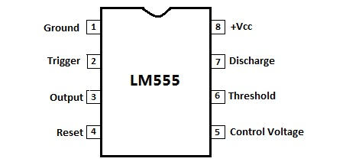
Integrated Circuits
https://www.elecparts101.com/wp-content/uploads/2019/10/lm555-pinout.jpg
http://www.learningaboutelectronics.com/Articles/LM741-op-amp-pinout-connections

Slide 16
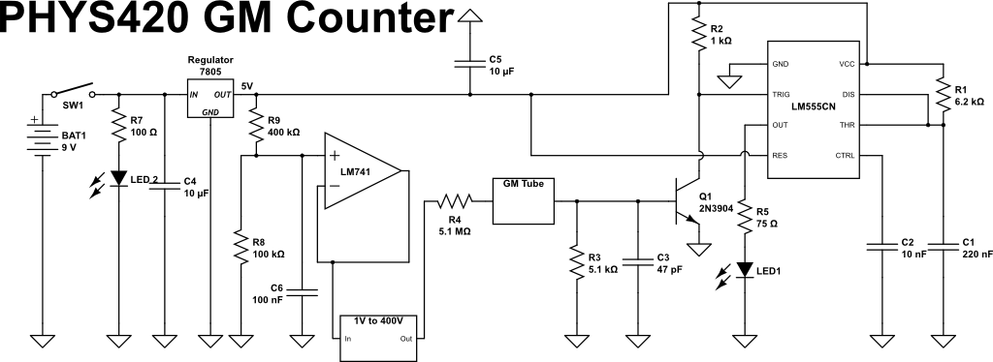
Circuit Diagram

Slide 17
Q&A
Thanks!

