Slide 1
The Aerodynamics of Flight From Airplanes and Birds to Insects
Shengman Zhang

Slide 2
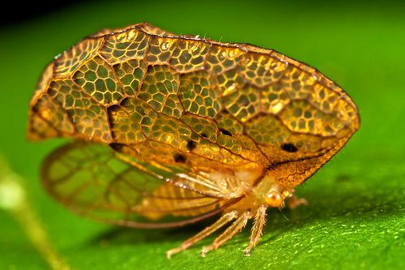
About Me
Fourth year physics student at UBC
UWCSEA Class of 2017
Insects lover since young
Zoological physics course at UBC
Treehopper (Oeda Inflatas) project

Slide 3
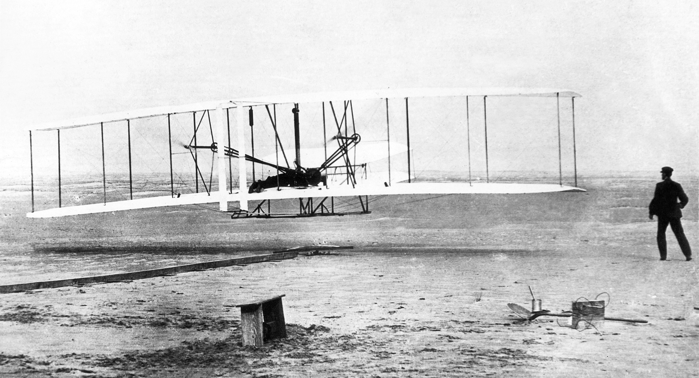
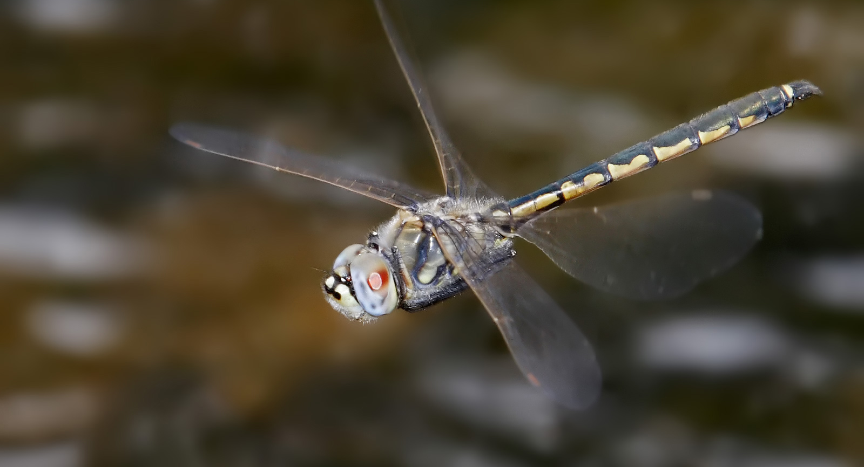
Introduction
Human – Wrights brothers, 1903
Birds ~ 125 million years
Insects ~300 million years

Slide 4
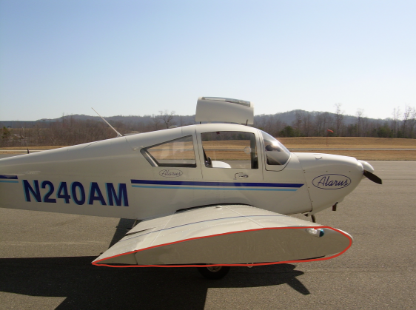
How Do Airplanes fly?
What forces are acting on the wing?
A - Lift
B - Force of Gravity
C - Thrust
D - Drag
E – All of the above

Slide 5
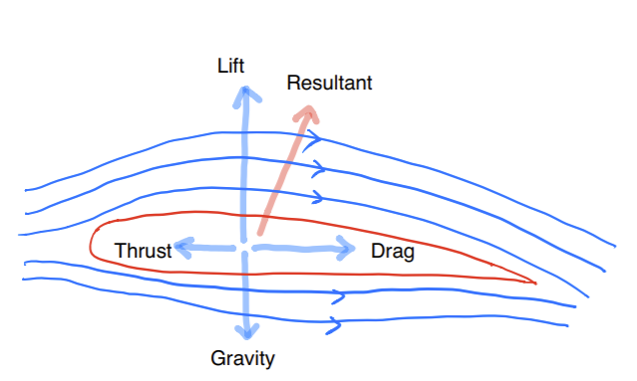
How Do Airplanes fly?
Drag - oriented in the direction of relative fluid flow
Lift - is generally directed upwards (perpendicular to the drag force)
Thrust – opposition the drag force, created by the engine
Force of Gravity

Slide 6
How Do Airplanes fly?
Bernoulli equation:
Equal time argument is wrong.
(Babinsky, 2003)
Fluid tend to follow the shape of
the wing due to Coanda effect.
Newton’s third law of motion

Slide 7
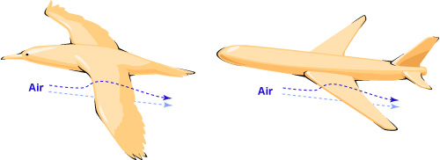
How Do Birds Fly?
Shape of wings shares similarities between birds and airplanes.
Birds use their muscles to power their flights, while airplanes use engines.
Birds generate thrust (hence lift) through their flapping wings.

Slide 8
How Do Birds Fly?
Retrieved from https://www.youtube.com/watch?v=3So7OMwNgy8&ab_channel=thependulumswing

Slide 9
How Do Birds Fly?
Lift in steady motion:
Function of speed U, wing surface area S, density of air 𝛒, and constant C_{L}

Slide 10
Three Types of Flights
Gliding flight
Upward aerodynamic force is equal to the weight
Flapping flight
Opposed to gliding, powered by the muscle to develop lift, the rotating motion provides a forwarding thrust, increases its speed
Bounding flight
Short bursts of flapping used by small birds

Slide 11
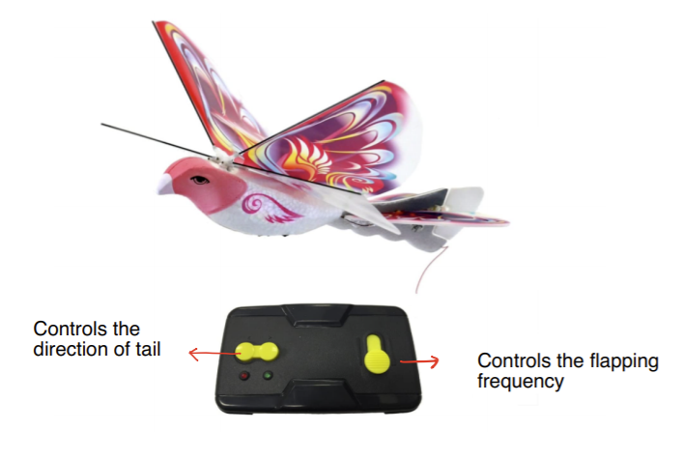
The eBird from Amazon

Slide 12
Flapping Flight

Slide 13
Gliding Flight

Slide 14
How Does the EBird Fly?
Hybrid between airplanes, birds, and insects
It does flip its wings, but not the same as real birds
It has an extra pair of wings, which is a feature of insects
Super light weight: only weight 14 g
Flapping frequency: extremely fast (~10 per second lowest)
Highest recorded flapping frequency of a hummingbird: 88 per second
(a tiny bird weight 3.2g)

Slide 15
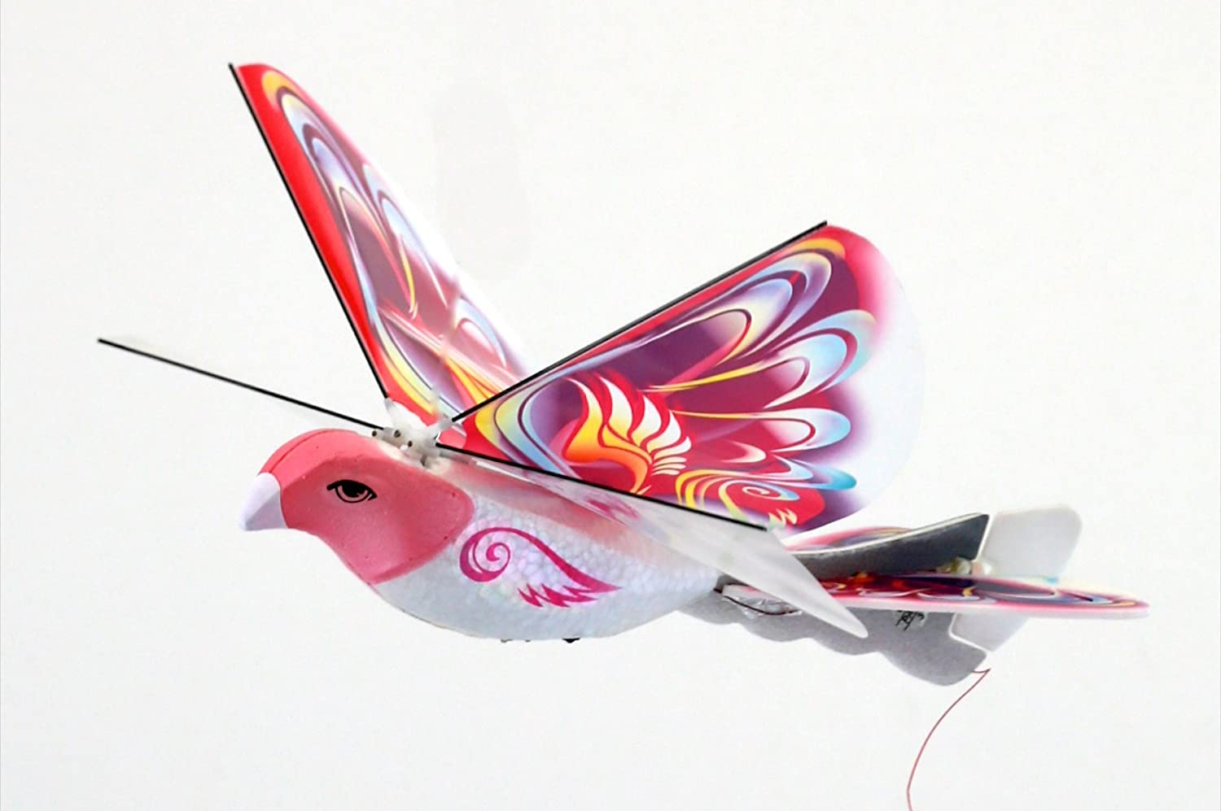
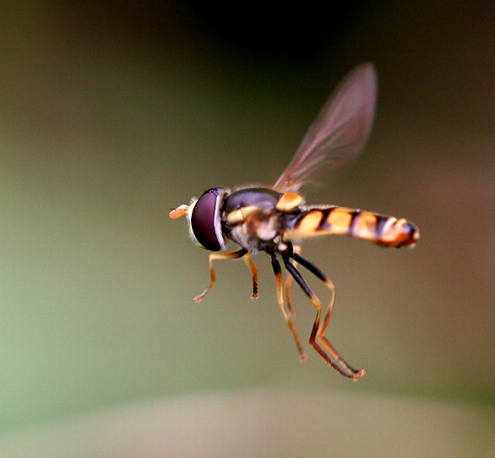
From eBird to Insects:
Most insects have two pairs of wings, which sometimes have a different shape and function
Only small birds and insects are able to hover motionless in midair.
Small birds and insects hover by beating their wings very rapidly at a frequency range from 30Hz to 500 Hz

Slide 16
How Do Insects Fly?
The flying mechanism of insects is a rather complex subject
Only with recent developments in high-speed videography have allowed researches to make rapid progress in understanding insect flight.
https://www.youtube.com/watch?v=Cnn9CfsYJqc&ab_channel=AntLab
The two mostly studied aerodynamic models of insect flight are the leading-edge vortex model and clap-and-fling model.

Slide 17
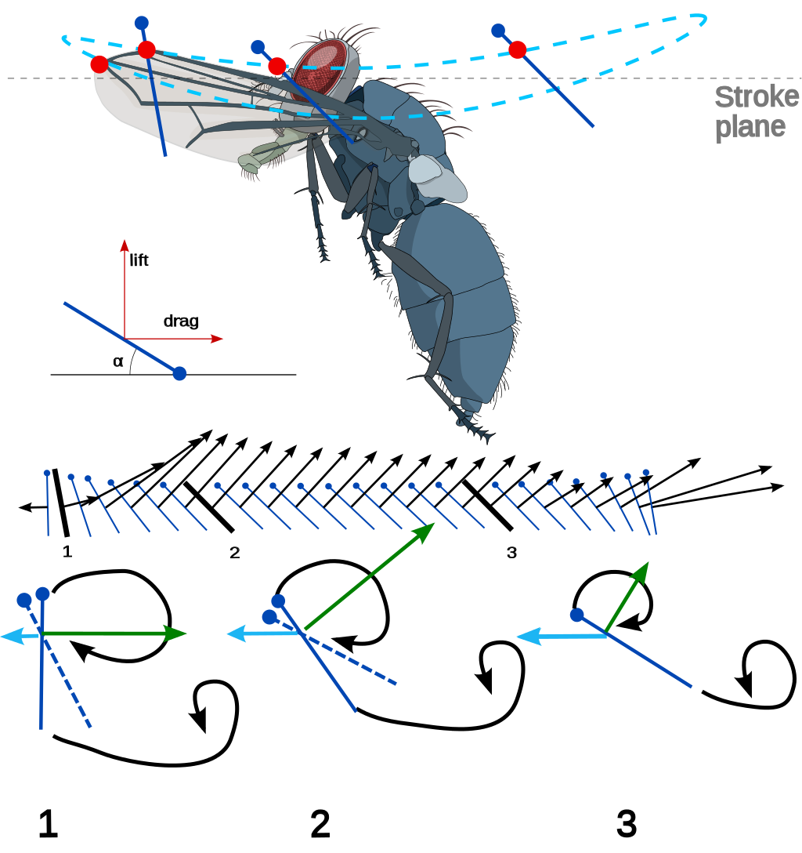
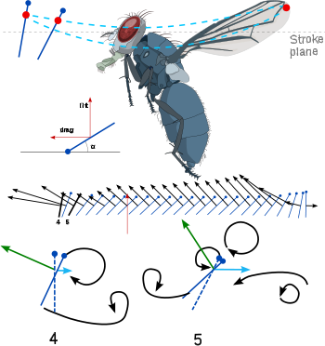
The Leading-Edge Vortex
Diagrams Retrieved from https://en.wikipedia.org/wiki/Insect_flight#/media/File:Insect_flight_downstroke.svg

Slide 18
The Leading-Edge Vortex
Retrieved from https://www.youtube.com/watch?v=cJJowVxiaRU&ab_channel=UniversityofVirginia

Slide 19
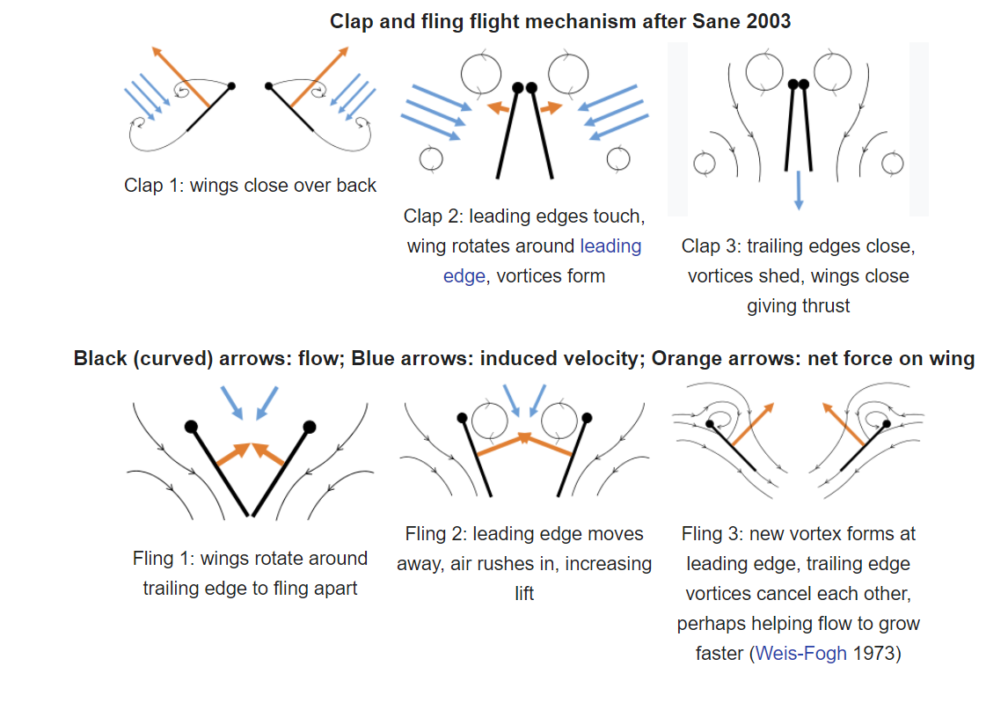
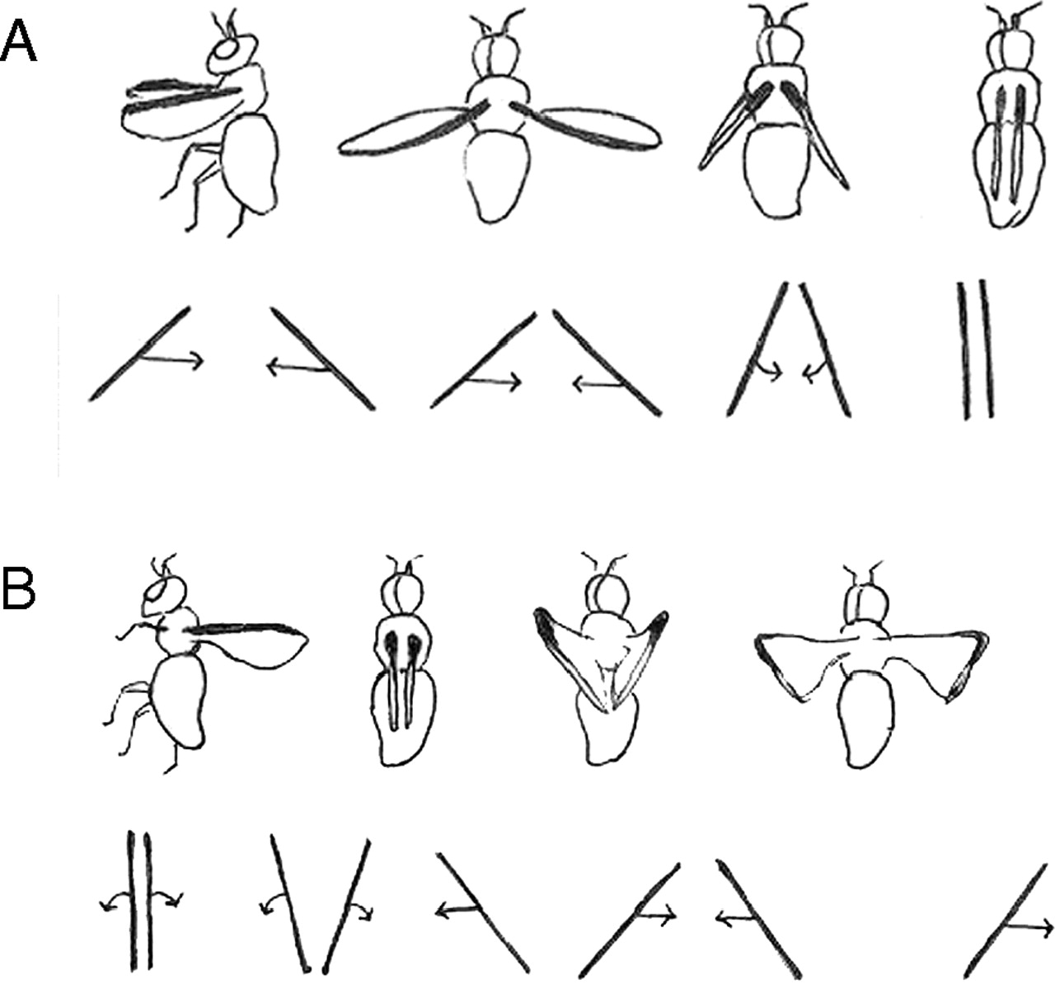
The Clap-and-Fling Model
Diagrams Retrieved from https://en.wikipedia.org/wiki/Insect_flight#/media/File:Insect_flight_downstroke.svg

Slide 20
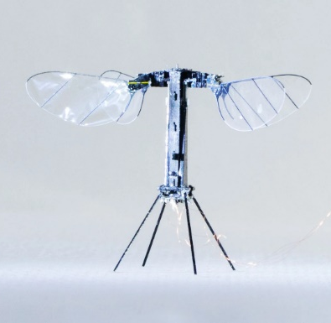
Can We Build an eFly?
https://www.youtube.com/watch?v=loHzoeFP9Io&ab_channel=naturevideo
RoboBee X-Wing built by Harvard Microrobotics Lab

Slide 21
My eFly Prototype

Slide 22
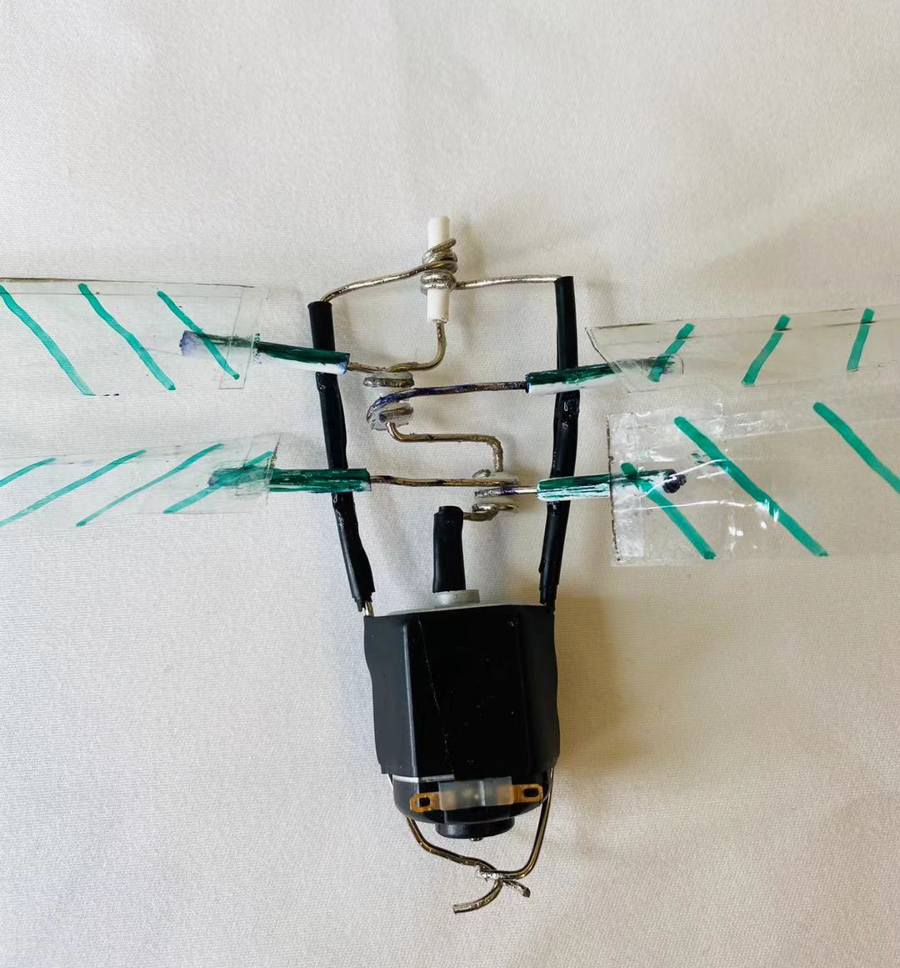
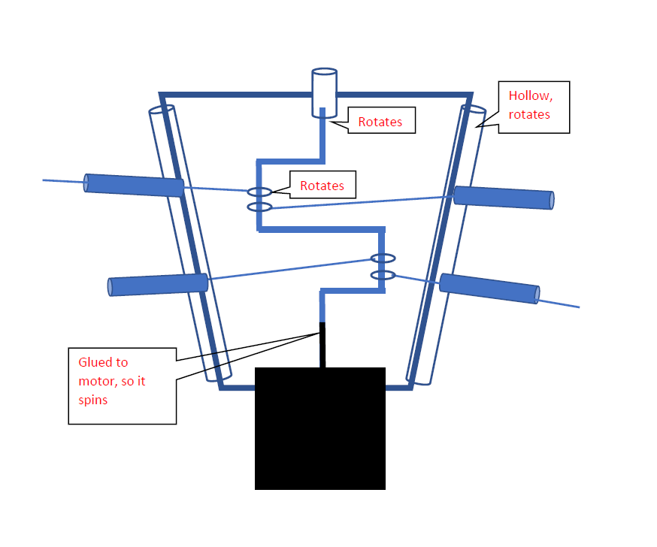
3.5 cm
4.5 cm
2.5 cm

Slide 23
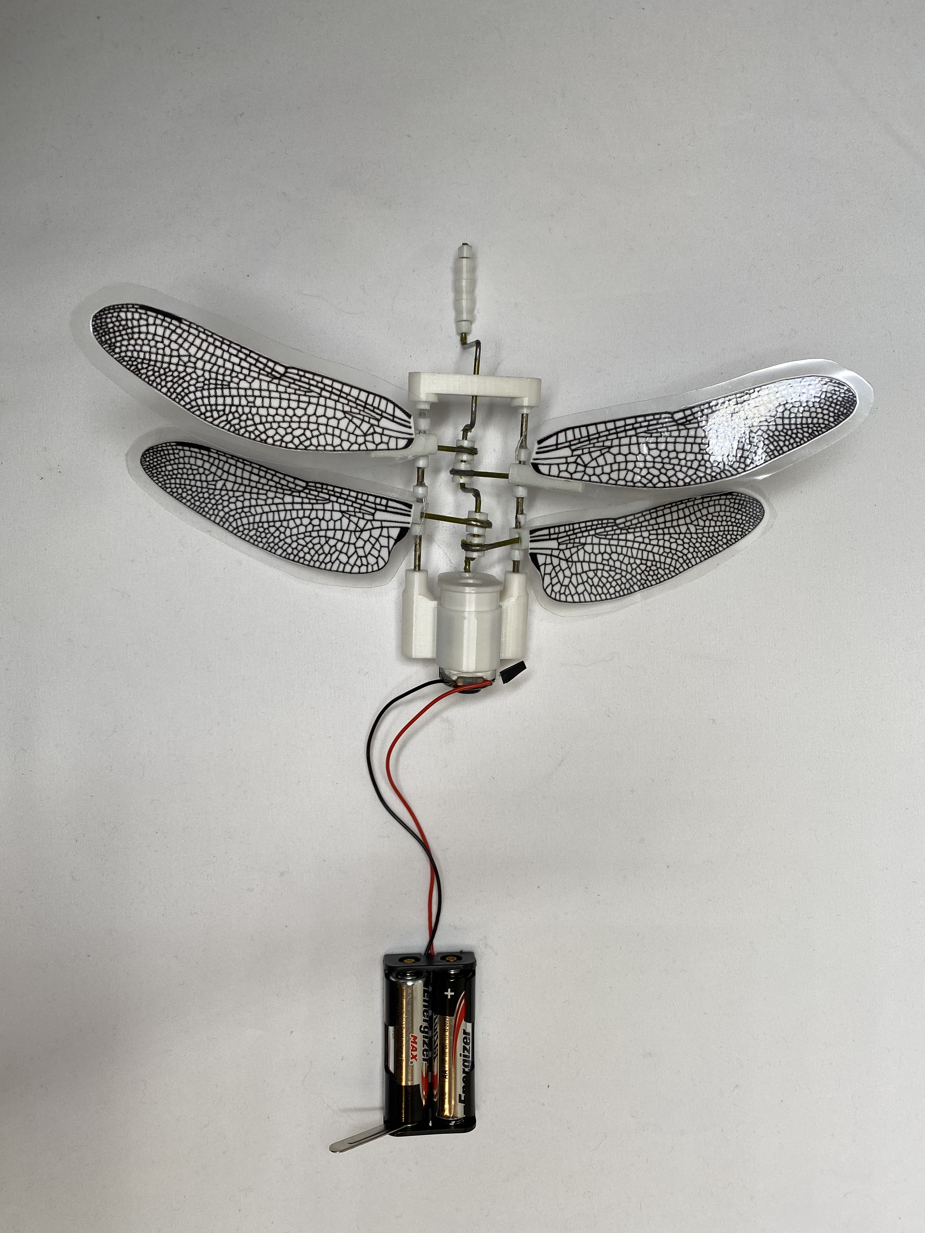
3D Printed Model

Slide 24
Try Build Your Own eFly
Steps for my eFly can be found at: https://phas.ubc.ca/~shengman/
My email: shengman456@gmail.com
@shengman_z

Slide 25
Reference
Ant Lab (2020, Aug 20). Insect Flight | Capturing Takeoff & Flying at 3,200 FPS
Ahlborn, B. K. (2004). Zoological physics quantitative models of body design, actions, and physical limitations of animals. Berlin: Springer.
Simon, M. (n.d.). What Could Possibly Be Cooler Than RoboBee? RoboBee X-Wing. Retrieved September 25, 2020, from https://www.wired.com/story/robobee-x-wing/
Sane, S. P. (2003). The aerodynamics of insect flight. Journal of Experimental Biology, 206(23), 4191-4208. doi:10.1242/jeb.00663

Slide 26
Questions

