Slide 1
The Physics of Timekeeping
Angelo (AJ) Pellizzari
PHYS 420 Presentation
February 22, 2022
Angelo Pellizzari, PHYS 420 Presentation, Feb 2022

Slide 2
A Quick introduction
Angelo (AJ) Pellizzari
4th year B.Sc. Physics, Minor Mathematics
UBC Vancouver
J. L. Crowe Graduate 2016
Interests: Hiking, Swimming, Tabletop Games
Angelo Pellizzari, PHYS 420 Presentation, Feb 2022

Slide 3
What is time?
Angelo Pellizzari, PHYS 420 Presentation, Feb 2022

Slide 4
Time
Time can be defined a few ways
The relation of the progression of events from the past to the present and beyond
What is measured by a clock
Time is incredibly useful for us as humans
It lets us understand the relationship between two events
It can help us get context on why certain things are happening in the present
Time is also important for physicists
It allows us to measure changes in things which can help us to model how the universe works
Angelo Pellizzari, PHYS 420 Presentation, Feb 2022

Slide 5
What are some quantities we need time to understand?
Angelo Pellizzari, PHYS 420 Presentation, Feb 2022

Slide 6
Time & Physics
As we mentioned, physicists use time to measure changes
Velocity is a measure of how something changes position with respect to time
Acceleration is a measure of how something changes velocity w.r.t time
Frequency is the number of times something happens in a stretch of time
Angelo Pellizzari, PHYS 420 Presentation, Feb 2022

Slide 7
Measuring Time
Time is measured using the second as its standard unit
All other measures of time are based off the second
1 minute = 60 seconds, 1 hour = 60 minutes = 3600 seconds, etc.
The definition of one second has changed a few times but is currently based on atomic transitions of the cesium atom
The best way to measure time is by using a clock
Clocks are devices that are specifically built to measure time accurately
Nearly all clocks have measures for minutes and hours but some also have seconds
In digital clocks, there can also be smaller increments of time included
Angelo Pellizzari, PHYS 420 Presentation, Feb 2022

Slide 8
A brief history of time(keeping)
Angelo Pellizzari, PHYS 420 Presentation, Feb 2022

Slide 9
What are some devices for measuring time?
Angelo Pellizzari, PHYS 420 Presentation, Feb 2022

Slide 10
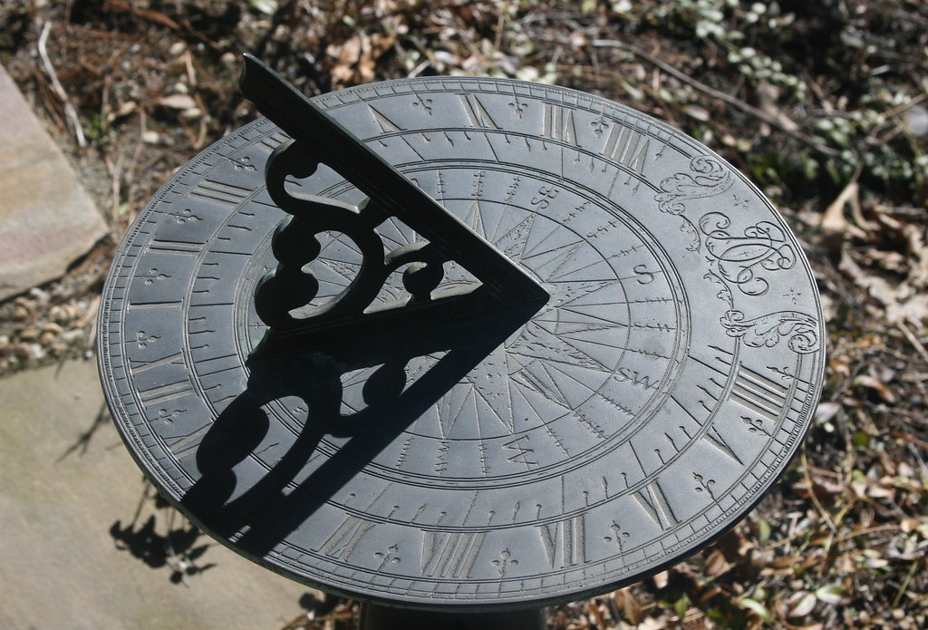
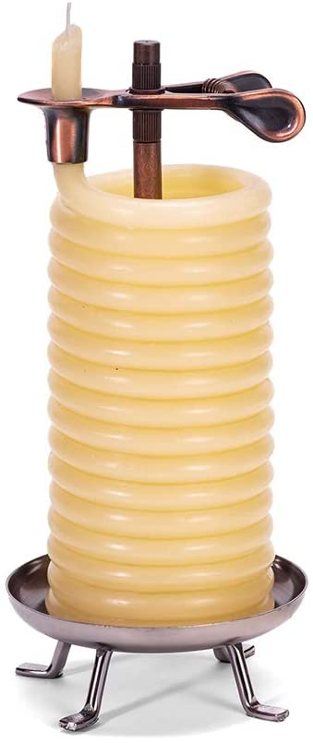
Early Clocks
One of the earliest form of clocks was the sundial/obelisk
The sun shining on the sundial/obelisk would create a shadow
The position of that shadow would then determine what time of day it was
Another form of early clock was the candle clock
Candle clocks are candles with a set rate of burning
The amount of candle burned through was the amount of time that had passed
Angelo Pellizzari, PHYS 420 Presentation, Feb 2022

Slide 11
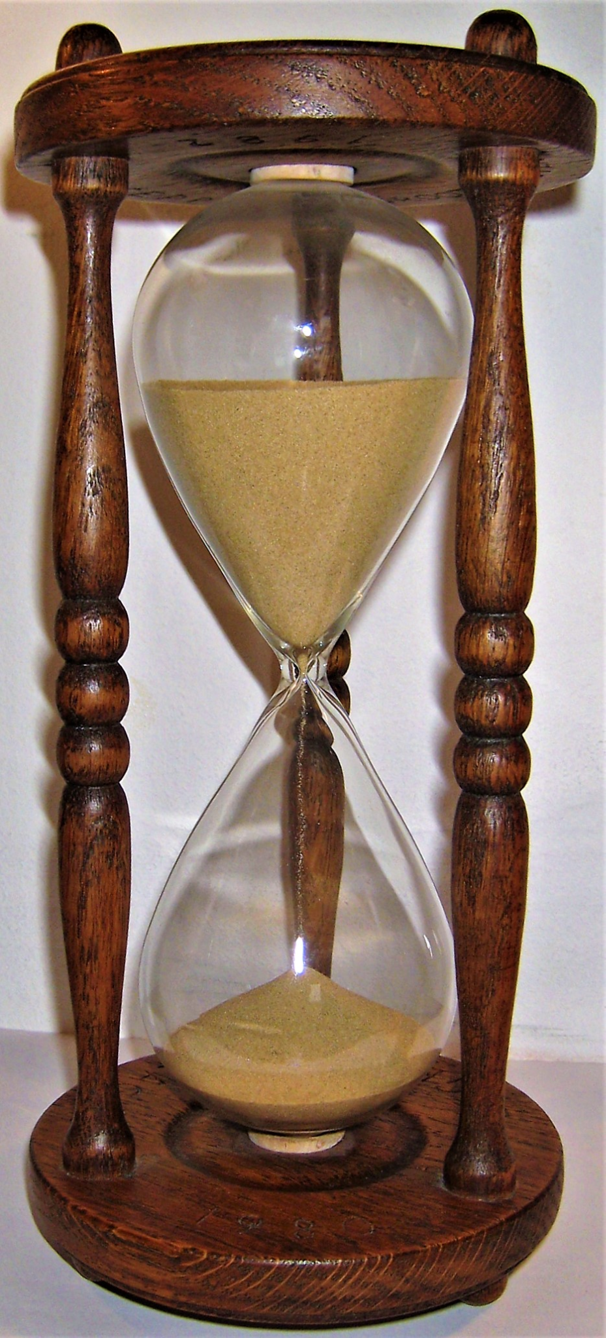
Early Clocks
Hourglasses were another type of early clock that used grains of sand to keep time
A set amount of sand was put into the hourglass that would pour at a set rate
Once the sand in one half emptied into the other, an amount of time will have passed
Angelo Pellizzari, PHYS 420 Presentation, Feb 2022

Slide 12
What are some problems with these clocks?
Angelo Pellizzari, PHYS 420 Presentation, Feb 2022

Slide 13
Problems with Early Clocks
While early clocks were great for their time, they had a few drawbacks
Sundials required the presence of the sun to work
They also only work at the latitude they were built for
Candle clocks require very precise materials to work correctly
They are also time consuming to make and are single-use
Hourglasses can only measure a specific time accurately
Also, hourglasses must be flipped regularly to keep time beyond their intended make
Angelo Pellizzari, PHYS 420 Presentation, Feb 2022

Slide 14
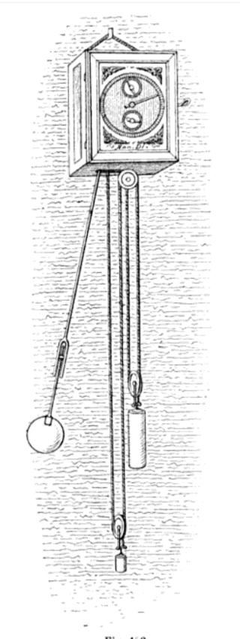
Enter the Pendulum Clock
In 1656, the pendulum clock was invented by Dutch scientist Christiaan Huygens
The pendulum clock uses the motion of a pendulum to keep time
The clock has a pendulum of a set length
Based on its length, the pendulum swings with a set period
The swinging of the pendulum moves a set of gears in the clock
These gears then drive the hands of the clock to tell time
This version of the clock was the most accurate to date
The motion of the pendulum can be described as simple harmonic motion
Angelo Pellizzari, PHYS 420 Presentation, Feb 2022

Slide 15
b.socrative.com/login/student/
Room Code: WATCHJLC
Angelo Pellizzari, PHYS 420 Presentation, Feb 2022

Slide 16
How do we find the period of a pendulum?
a) P = √(length)
b) P = √(length/mass)
c) P = √(length/g)
d) P = √(length*mass)
Angelo Pellizzari, PHYS 420 Presentation, Feb 2022

Slide 17
How do we find the period of a pendulum?
a) P = √(length)
b) P = √(length/mass)
c) P = √(length/g)
d) P = √(length*mass)
Angelo Pellizzari, PHYS 420 Presentation, Feb 2022

Slide 18
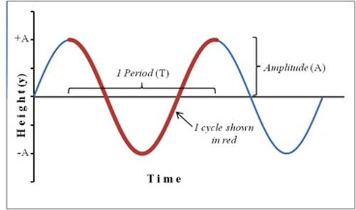
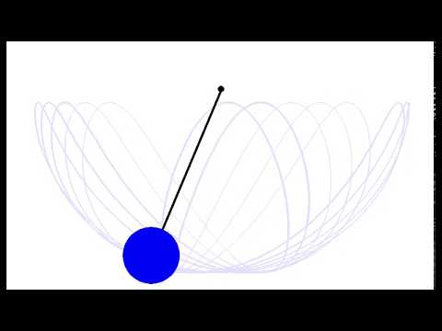
Problems at Sea
While the pendulum clock was an amazing advancement in timing technology, it had its drawbacks
The pendulum clock is a 2-D oscillator
The pendulum moves along the x-axis and y-axis
Sailors attempted to use these clocks at sea
The motion of the boat turns them into 3-D oscillators
This makes them inaccurate as the period changes
Angelo Pellizzari, PHYS 420 Presentation, Feb 2022

Slide 19
How do we go about fixing this?
Angelo Pellizzari, PHYS 420 Presentation, Feb 2022

Slide 20
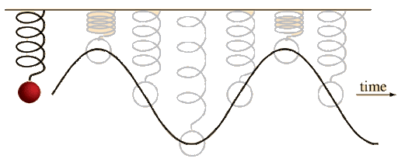
Springs!
Oscillators are still a great way to keep time
If we can’t use a pendulum, why not try a spring?
Springs with a mass on them will oscillate at a set frequency once started
However, just hanging a mass on a spring is no better than a pendulum
Why?
Angelo Pellizzari, PHYS 420 Presentation, Feb 2022

Slide 21
What is a possible issue with a mass on a spring approach?
a) The spring can become a 3D oscillator
b) The spring won’t oscillate forever
c) The spring changes its period as it oscillates
d) Some combination of the above
Angelo Pellizzari, PHYS 420 Presentation, Feb 2022

Slide 22
What is a possible issue with a mass on a spring approach?
a) The spring can become a 3D oscillator
b) The spring won’t oscillate forever
c) The spring changes its period as it oscillates
d) Some combination of the above
Angelo Pellizzari, PHYS 420 Presentation, Feb 2022

Slide 23
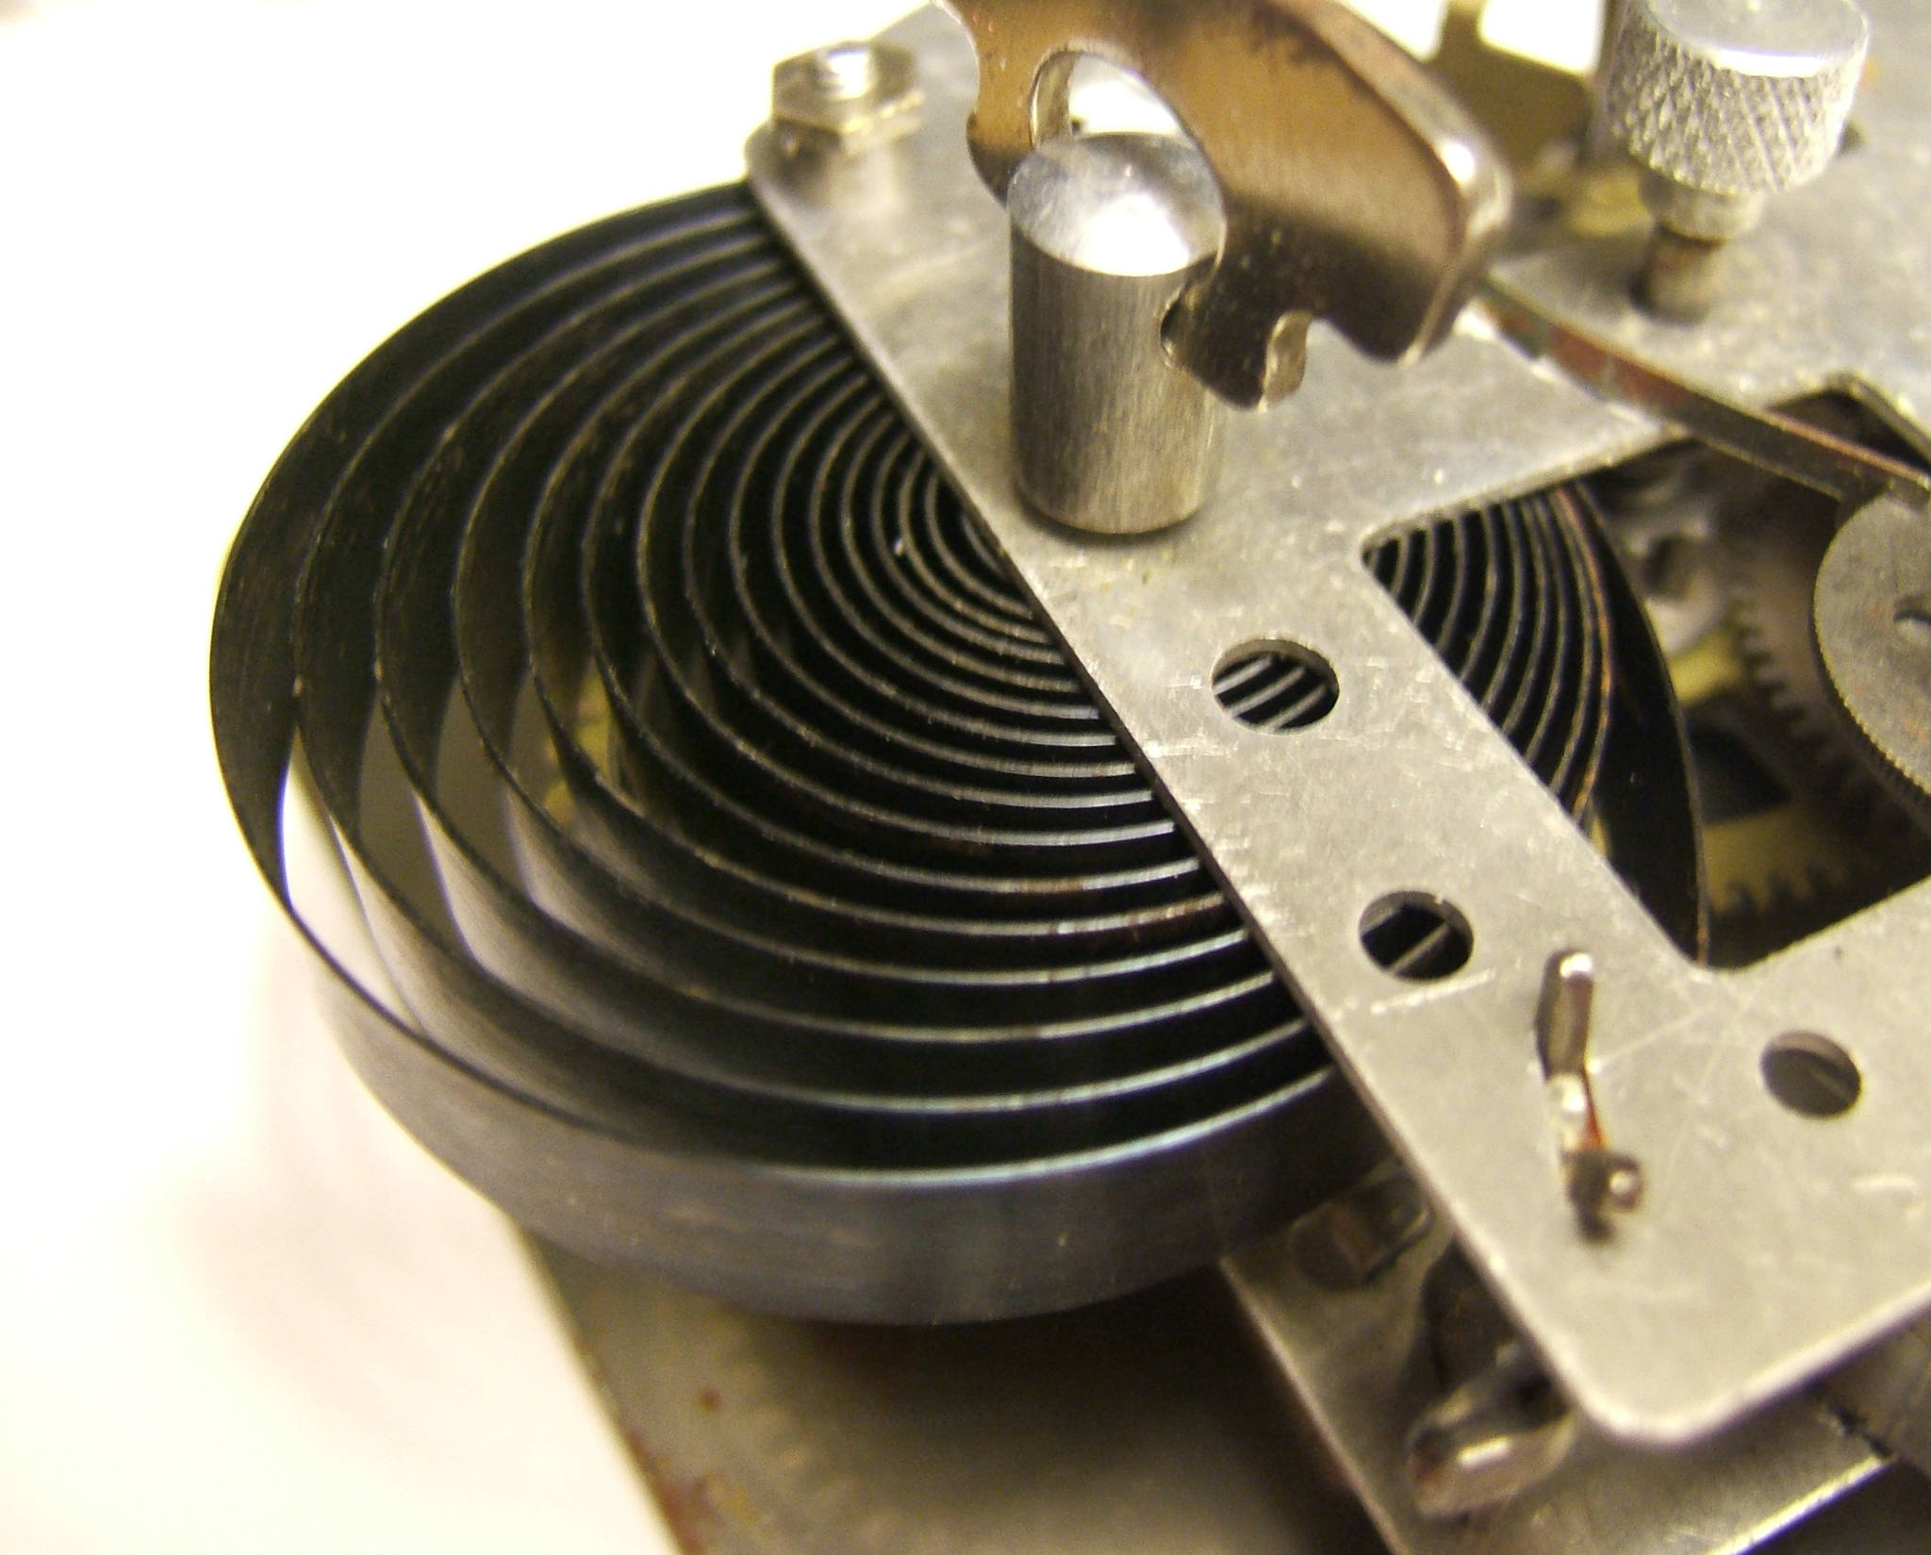
A New Solution - The Mainspring
Since using a hanging spring isn’t ideal, inventors came up with a new idea, a coiled spring
In the 15th century, clockmaker Peter Henlein developed the mainspring
The mainspring is a coiled spring inside the clock or watch
The spring is wound by the user and it will attempt to uncoil itself
In uncoiling, it imparts a force to other parts of the clock
This force can then drive gears which have a set ratio to turn the clock at the right pace
Angelo Pellizzari, PHYS 420 Presentation, Feb 2022

Slide 24
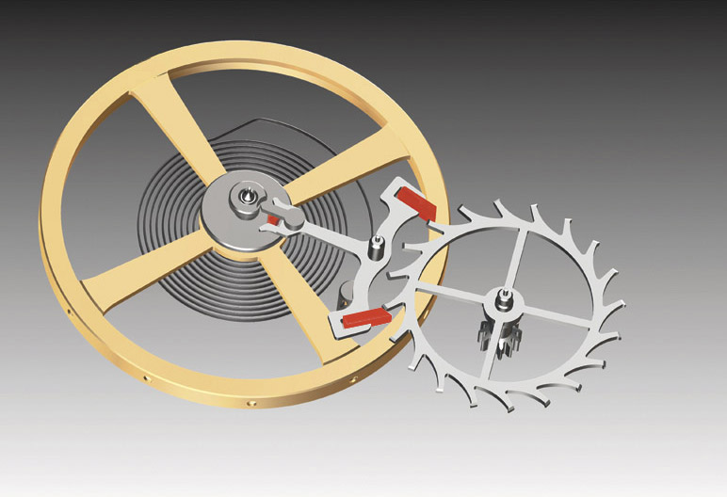
The Balance Spring & Escapement
Using just the mainspring on its own proved to still be relatively inaccurate
Thus the balance spring was added
The balance spring is a second spring inside the watch that helps keep time more accurately
It is paired with something called the escapement which allows the clock to keep ticking
Angelo Pellizzari, PHYS 420 Presentation, Feb 2022

Slide 25
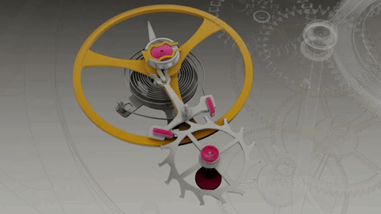
The Balance Spring & Escapement
The escapement takes force from the mainspring and rotates
A fork attached to the balance wheel stops it from fully rotating
This then drives the balance wheel and coils the balance spring
The balance spring then uncoils to turn the fork the other way
This lets the next tooth of the escapement go
This repeats until the mainspring fully unwinds
Angelo Pellizzari, PHYS 420 Presentation, Feb 2022

Slide 26
The Mechanical Watch
The combination of the mainspring, balance spring, and escapement help create the “heart” of the mechanical watch
These watches were more accurate than most clocks before them and were portable!
These even reduced the impact of motion on the accuracy of time
They were not without their drawbacks though
Certain interactions could still cause these watches to lose time
Angelo Pellizzari, PHYS 420 Presentation, Feb 2022

Slide 27
What are some possible physics phenomena that cause mechanical watches to lose time?
a) Heating up the watch
b) Energy loss
c) Magnets
d) None of the above
Angelo Pellizzari, PHYS 420 Presentation, Feb 2022

Slide 28
What are some possible physics phenomena that cause mechanical watches to lose time?
a) Heating up the watch
b) Energy loss
c) Magnets
d) None of the above
Angelo Pellizzari, PHYS 420 Presentation, Feb 2022

Slide 29
How Mechanical Watches Lose Time
There are a few ways that mechanical watches lose time
The main source is the loss of energy over time through various means
Friction of the components in the watch
Sound and heat generation by the components
The mainspring fully uncoiling
Drops in the force of the mainspring as it uncoils
Another source is heating up the watch
If the watch is heated up, the components can expand or warp
One other source of losing time is magnetism
If the watch was placed in a powerful enough magnetic field or became magnetized itself, it could throw off its timing
Angelo Pellizzari, PHYS 420 Presentation, Feb 2022

Slide 30
Demo
Angelo Pellizzari, PHYS 420 Presentation, Feb 2022

Slide 31
Oscillator Demo
As we can see, like with the mainspring, the oscillating ruler will eventually lose energy and stop “ticking”
If this is the mainspring of a watch, that means we have to be constantly winding it or the clock will stop altogether
If you happened to forget to wind your watch, you might not have an accurate clock to compare it to for a while
So how do we go about avoiding this energy loss?
Angelo Pellizzari, PHYS 420 Presentation, Feb 2022

Slide 32
The Electromagnetic Watch
One major leap in watch innovation was the introduction of electricity to watches
With the advent of small watch-sized batteries, electricity could be put onto a person’s wrist
With this came designs for battery powered watches
One of the first designs was through the use of an electromagnet
Angelo Pellizzari, PHYS 420 Presentation, Feb 2022

Slide 33
The Electromagnetic Watch
Watches that used an electromagnet became popular in the 60’s
They worked by having a sort of metal tuning fork that would vibrate at a resonant frequency and propel the watch mechanism forward
When the tuning fork vibrates in one direction, a circuit is completed and an electromagnet, powered by the battery, is enabled
This then pushes the tuning fork away from the magnet
When the fork is pushed away the circuit is broken and the electromagnet turns off
This then lets the fork move towards the magnet again due to a restoring force and the process repeats
Angelo Pellizzari, PHYS 420 Presentation, Feb 2022

Slide 34
Demo
Angelo Pellizzari, PHYS 420 Presentation, Feb 2022

Slide 35
What are some ways that the electromagnet watch could stop working?
Angelo Pellizzari, PHYS 420 Presentation, Feb 2022

Slide 36
The Electromagnetic Watch
There are a few ways the electromagnet watch could stop ticking
The first is if the battery dies
Once the battery is dead, the tuning fork simply oscillates like in the first demo until it runs out of energy
Another way this can happen is if the fork is not deflected far enough to oscillate back and trigger the circuit again
Angelo Pellizzari, PHYS 420 Presentation, Feb 2022

Slide 37
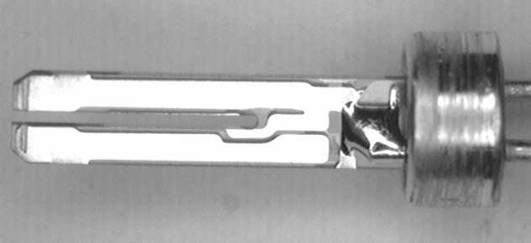
The Quartz Watch
The electromagnet and tuning fork design was soon replaced with what most modern watches use today, quartz
Quartz watches, initially produced in 1969, make use of a small tuning fork made of quartz crystal
The tuning fork vibrates at a frequency of 32,768 Hz
This high frequency makes the watch very accurate
The main difference between the quartz watch and the electromagnet watch is how the two operate
Angelo Pellizzari, PHYS 420 Presentation, Feb 2022

Slide 38
The Quartz Watch - Piezoelectric Effect
While the electromagnet watch uses a tuning fork driven by an electromagnet, the quartz watch makes use of the piezoelectric effect
Quartz has a unique property in that it is piezoelectric
This means that its structure allows it to generate or respond to energy
Angelo Pellizzari, PHYS 420 Presentation, Feb 2022

Slide 39
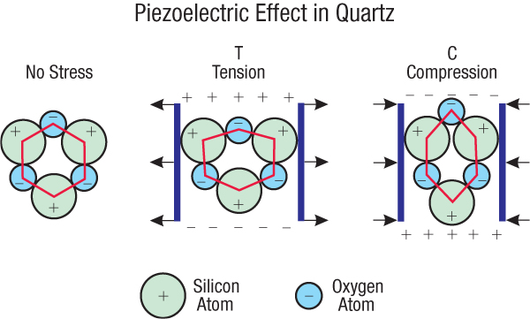
The Quartz Watch - Piezoelectric Effect
Quartz is made up of Silicon and Oxygen atoms arranged in a lattice
Silicon is slightly positively charged and oxygen is slightly negatively charged
When at rest in the lattice, the quartz is electrically neutral
But, if it is deformed by compression or tension, it creates an electric potential
Angelo Pellizzari, PHYS 420 Presentation, Feb 2022

Slide 40
The Quartz Watch - Piezoelectric Effect
The reverse is also true of quartz in that if you pass electricity over it, it will deform
In the case of our quartz tuning forks, it will start to vibrate at its resonant frequency
Angelo Pellizzari, PHYS 420 Presentation, Feb 2022

Slide 41
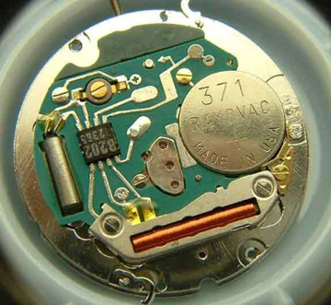
The Quartz Watch
This is what makes up the mechanism behind quartz watches
An electrical pulse is sent from a battery to the quartz crystal
This causes the crystal to start vibrating at 32,768 Hz
An onboard microchip then counts the number of vibrations
On the 32,768th oscillation, it delivers a single pulse to move the second hand of the watch
Angelo Pellizzari, PHYS 420 Presentation, Feb 2022

Slide 42
The Quartz Watch
The design of the quartz watch makes it incredibly precise
Since the frequency of the quartz is a power of 2 (2¹⁵), it makes it much easier for the electronics to quickly distinguish when to pass a pulse to the watch
Additionally, quartz is not as heavily affected by magnets or heat compared to metallic watch components
Angelo Pellizzari, PHYS 420 Presentation, Feb 2022

Slide 43
What are some possible drawbacks of the quartz watch design?
a) If it gets hit, it will short circuit
b) It stops when the battery dies
c) Magnets
d) None of the above
Angelo Pellizzari, PHYS 420 Presentation, Feb 2022

Slide 44
What are some possible drawbacks of the quartz watch design?
a) If it gets hit it will short circuit
b) It stops when the battery dies
c) Magnets
d) None of the above
Angelo Pellizzari, PHYS 420 Presentation, Feb 2022

Slide 45
Demo
Angelo Pellizzari, PHYS 420 Presentation, Feb 2022

Slide 46
Quartz Oscillator Circuit
Angelo Pellizzari, PHYS 420 Presentation, Feb 2022

Slide 47
Atomic Clocks
The current most accurate way to keep time is with an atomic clock
Atomic clocks use the cesium atom to keep time
In the clock, cesium atoms are hit with microwave radiation at a certain frequency
If the frequency is correct, it will change the energy level of some of the cesium atoms
These atoms then reach a detector and it counts the ones with the new energy level and corrects the frequency of the microwaves
This repeats until 9,192,631,770 cycles of radiation have occurred at which point one second is counted
Angelo Pellizzari, PHYS 420 Presentation, Feb 2022

Slide 48
The Future of Timekeeping
Scientists and engineers are still actively researching new ways to keep time
There are currently active studies into using light in the visible range as the escapement for atomic clocks
These are called optical clocks
There are also proposed ideas for clocks that use quantum information to tell time though optical clocks currently seem more promising with current research
Angelo Pellizzari, PHYS 420 Presentation, Feb 2022

Slide 49
Questions
Angelo Pellizzari, PHYS 420 Presentation, Feb 2022

Slide 50
Thank You!
Angelo Pellizzari, PHYS 420 Presentation, Feb 2022

