Slide 1
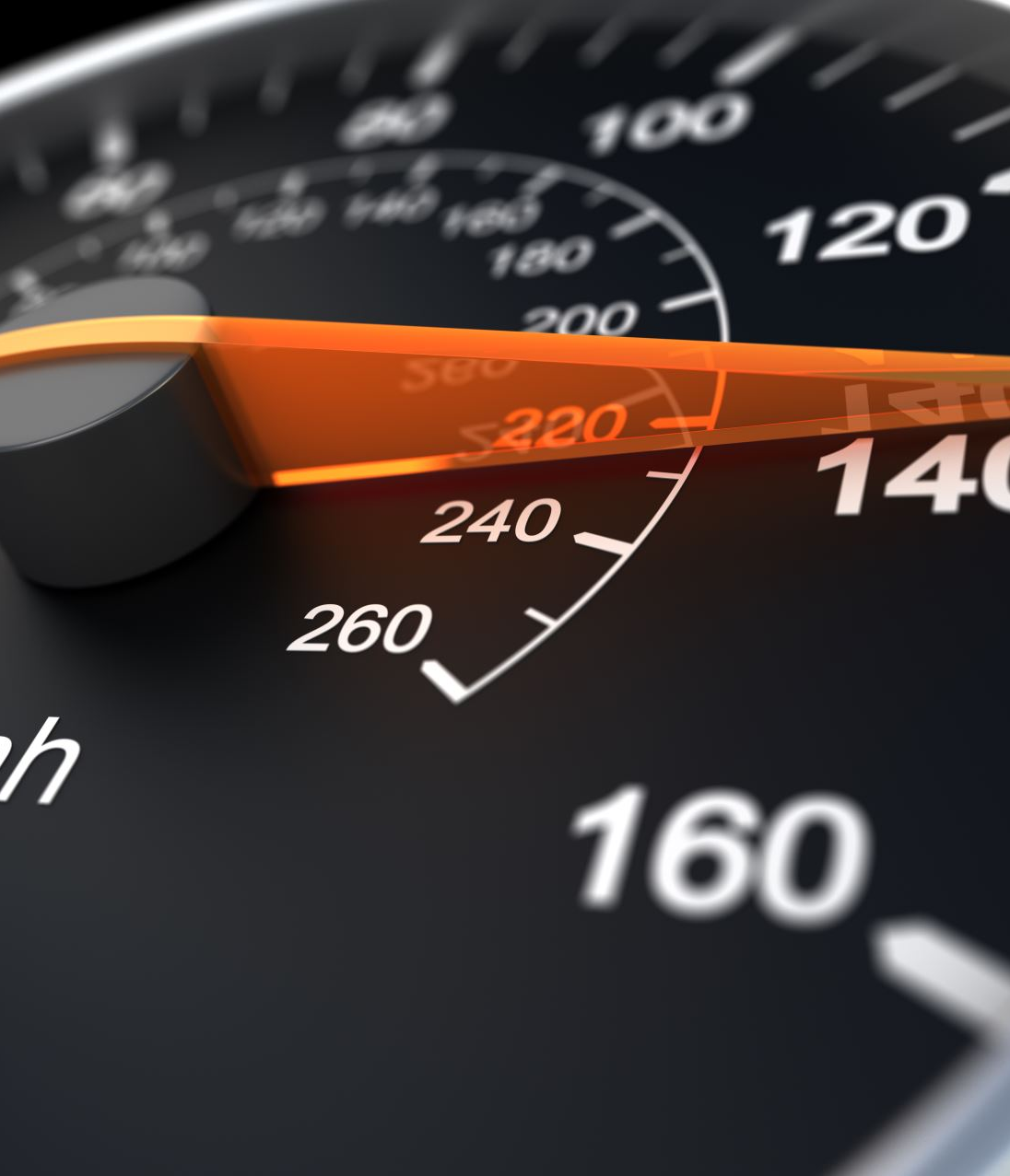
The Physics of Car Crashes
Can we use physics concepts to help design safer vehicles?
Notes:
Image came from powerpoint suggestion

Slide 2
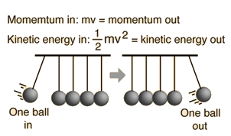
Collisions overview – Elastic
Momentum in = momentum out
$$Kinetic Energy in:\frac{1}{2}mv^{2}=kinetic energy out$$
Image credit: Georgia state university
Notes:
https://www.youtube.com/watch?v=ofgeRSCLyXc

Slide 3
Collisions overview – Elastic
Momentum in = momentum out
$$Kinetic Energy in:\frac{1}{2}mv^{2}=kinetic energy out$$
Image credit: Georgia state university
Notes:
https://www.youtube.com/watch?v=ofgeRSCLyXc

Slide 4
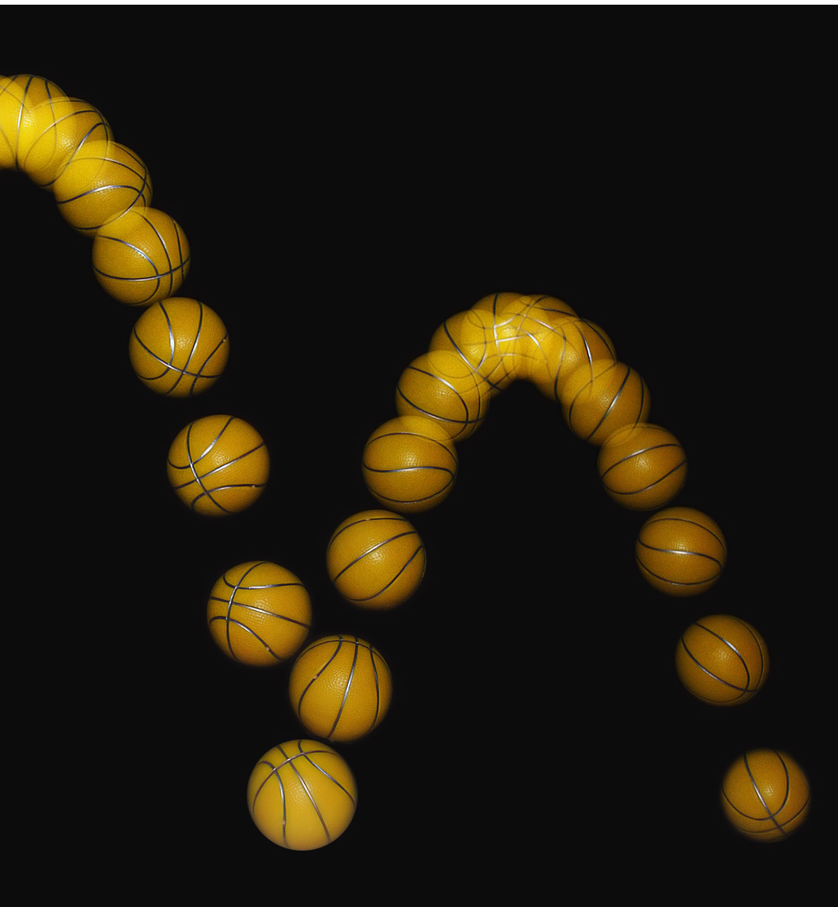
Collisions overview – Inelastic
Momentum in (mv) = momentum out (for the whole system)
Kinetic energy in = $\frac{1}{2}{mv}^{2}≠$ kinetic energy out
Image credit: wikipedia

Slide 5
Collisions overview – Inelastic
Momentum in (mv) = momentum out (for the whole system)
Kinetic energy in = $\frac{1}{2}{mv}^{2}≠$ kinetic energy out
Some KE into-> Sound and heat here
Image credit: wikipedia

Slide 6
Energy of a Falling Object

Slide 7
Energy of a Bouncing Object
Notes:
Very high acceleration during brief impact

Slide 8
Energy of a Bouncing Object
Notes:
Very high acceleration during brief impact

Slide 9
Acceleration during collision
(Whiteboard)
$5\frac{m}{s} →−1.25\frac{m}{s}$, and lets say that takes 0.1 s to completely bounce
$v_{f}=v_{i}+at$
Rearranging
$a=\frac{{v_{f}−v}_{i}}{t}$
$a=\frac{6.25\frac{m}{s}}{.1s}=62.5\frac{m}{s^{2}}≈ 6g$

Slide 10
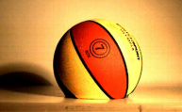
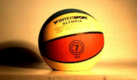
Restitution
Simple Basketball Experiment
Notes:
KE=1/2mv^2
Ei = mgh = mv^2

Slide 11
Restitution
Newton's law of restitution says that when two objects collide, their speeds after the collision depend on the material from which they are made

Slide 12
Restitution properties
Depends on
Shape of materials
geometry of collision
When the material can be deformed or broken (its yield strength defeated) the coefficient of restitution will be lower

Slide 13
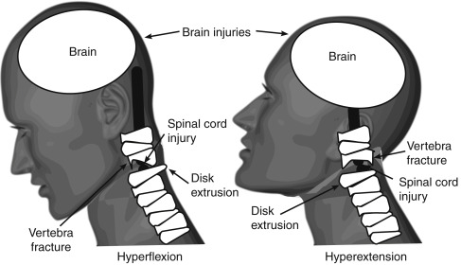
Acceleration can hurt humans!
$$\vec{a}$$

Slide 14
Acceleration can hurt humans!
$$\vec{a}$$
$$\vec{F}=m\vec{a}$$
$$τ=\vec{F}⋅r$$

Slide 15
How do we cause less harm in collisions?
How can we reduce acceleration?
(live demo)

Slide 16
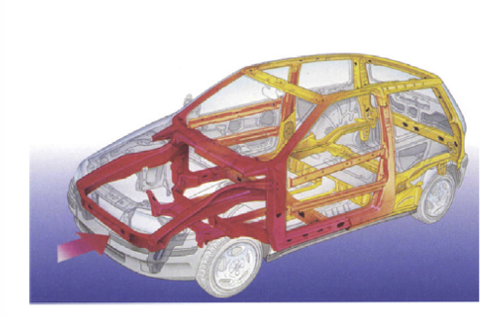
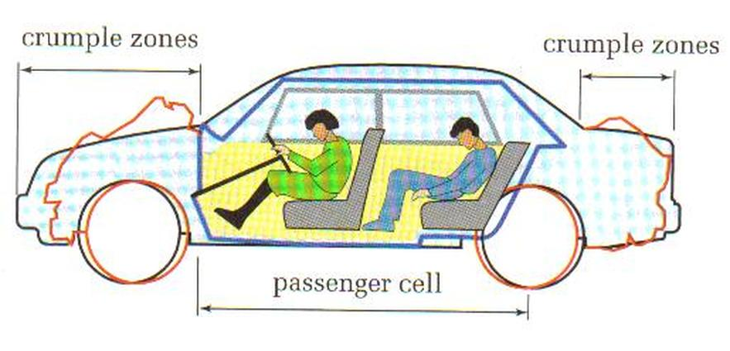
Brainstorming Solutions
How might we try to make the passengers in the vehicle safer
crumple zone to absorb energy and a passenger zone, which can’t be crushed
Image Source:
left cartrade.com
right: Vehicle Collision Dynamics by Dario Vangi
Notes:
Figure from chapter 1 of Vehicle collision dynamics

Slide 17
Image Source: Vehicle Collision Dynamics by Dario Vangi

Slide 18
Material | Collision Duration (end –start) (s) | Peak acceleration (m/s²) | Comments
Baseline (no bumper)
Big bubble
cardboard foil cone
Tin foil cone single layer
Tin foil cone 4x layer
Bubble Wrap
Cardboard tube
Styrofoam 1
Styrofoam 2
Notes:
Need a volunteer to write the table

Slide 19
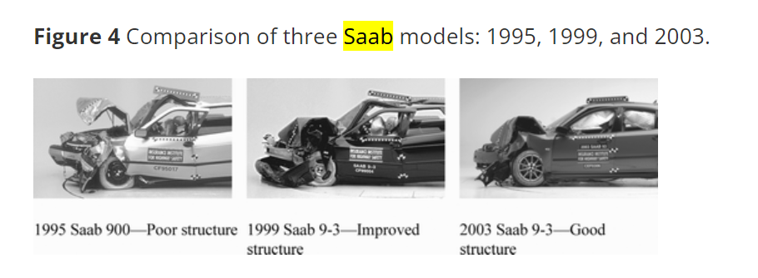
Crumple zone technology has improved over the years

Slide 20
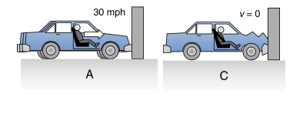
It won’t work without the seatbelt & airbag
Without Seatbelt:
t_{i}
t_{f}
Newton’s first law: passenger in the top vehicle continues moving inside the vehicle has their own new collision inside the car
All the work absorbing the crash and spreading out the impulse of the crash isn’t passed to the passenger if they aren’t wearing a seatbelt
With Seatbelt:
t_{i}
t_{f}
Source image: Exploring Engineering 5th edition Chapter 16 Bioengineering

Slide 21
Real life crash testing and simulations
Vehicle manufacturers are still required to perform crash tests
They also use that crash data to inform their crash simulations
Its possible to do a really cool approximation of large scale crash test with simple stuff like your phone and some household items

Slide 22
Questions?

