Slide 1
Theremin
A circuitry and E&M demo
Kara Deane for PHYS 420
University of British Columbia
b.socrative.com/login/student/
Room Code:
Notes:
Introductory slide.
QR code goes to Socrative polling service login, to be used for collecting question responses throughout the demonstration.

Slide 2
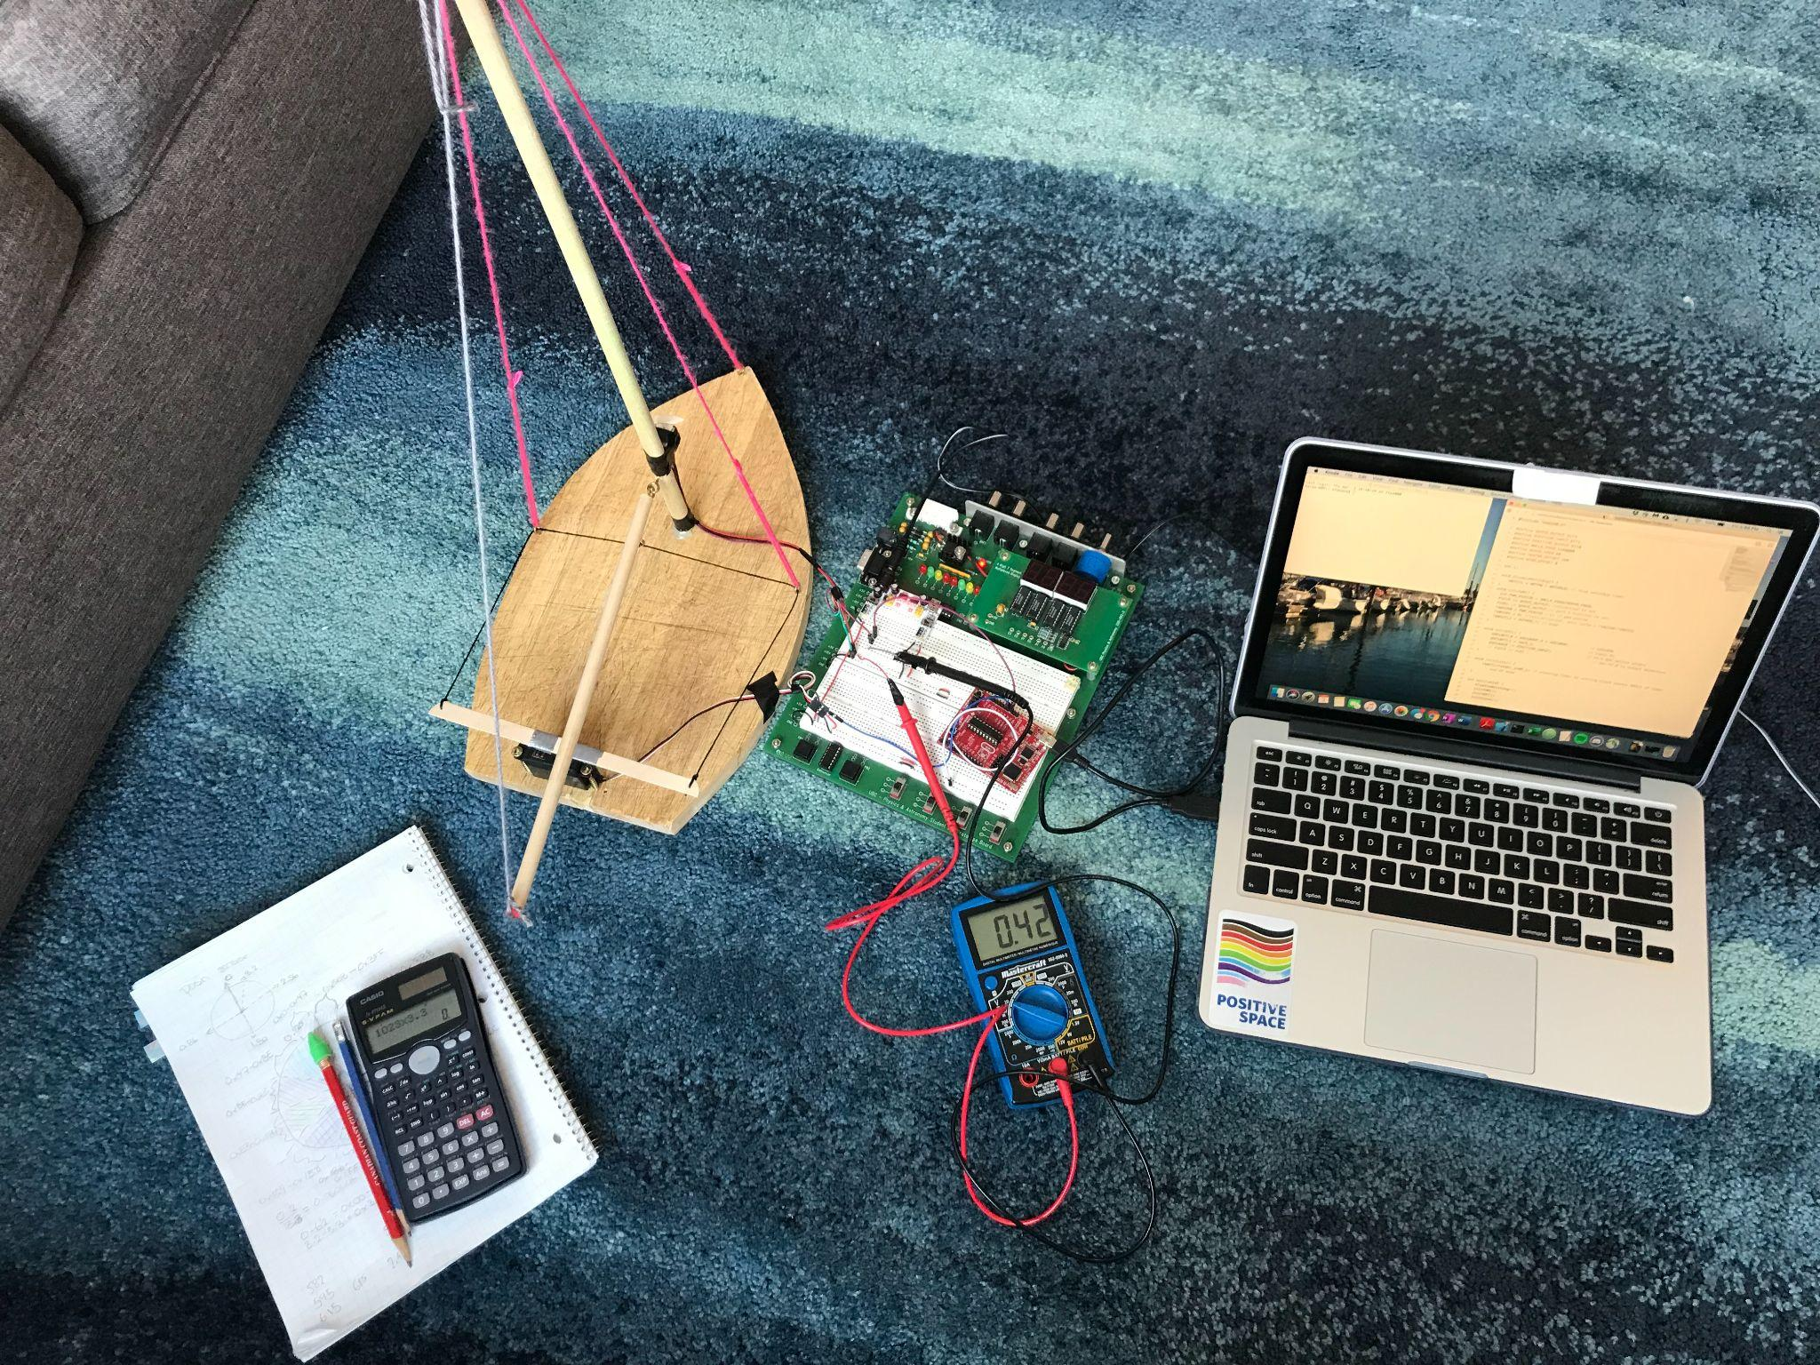
About me
J.L. Crowe 2016
Combined Physics + Computer Science, UBC Vancouver
Involved in a lot of science outreach
In my spare time I like to ski, sail, and read sci-fi
b.socrative.com/login/student/
Room Code:
Notes:
Presenter introduction slide, with a picture of a previous project.
QR code goes to Socrative polling service login, to be used for collecting question responses throughout the demonstration.

Slide 3
Introduction - The Theremin
a unique instrument that makes music using capacitance in circuits
an eerie, otherworldly sound
used in sci-fi, horror
theremin concerts broadcast to extraterrestrials
used in rock music, classical covers
2000 Lightyears from Home - The Rolling Stones
Little People - The White Stripes
Whole Lotta Love - Led Zeppelin
Notes:
Introduce what the theremin is, share some interesting facts.

Slide 4
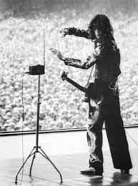
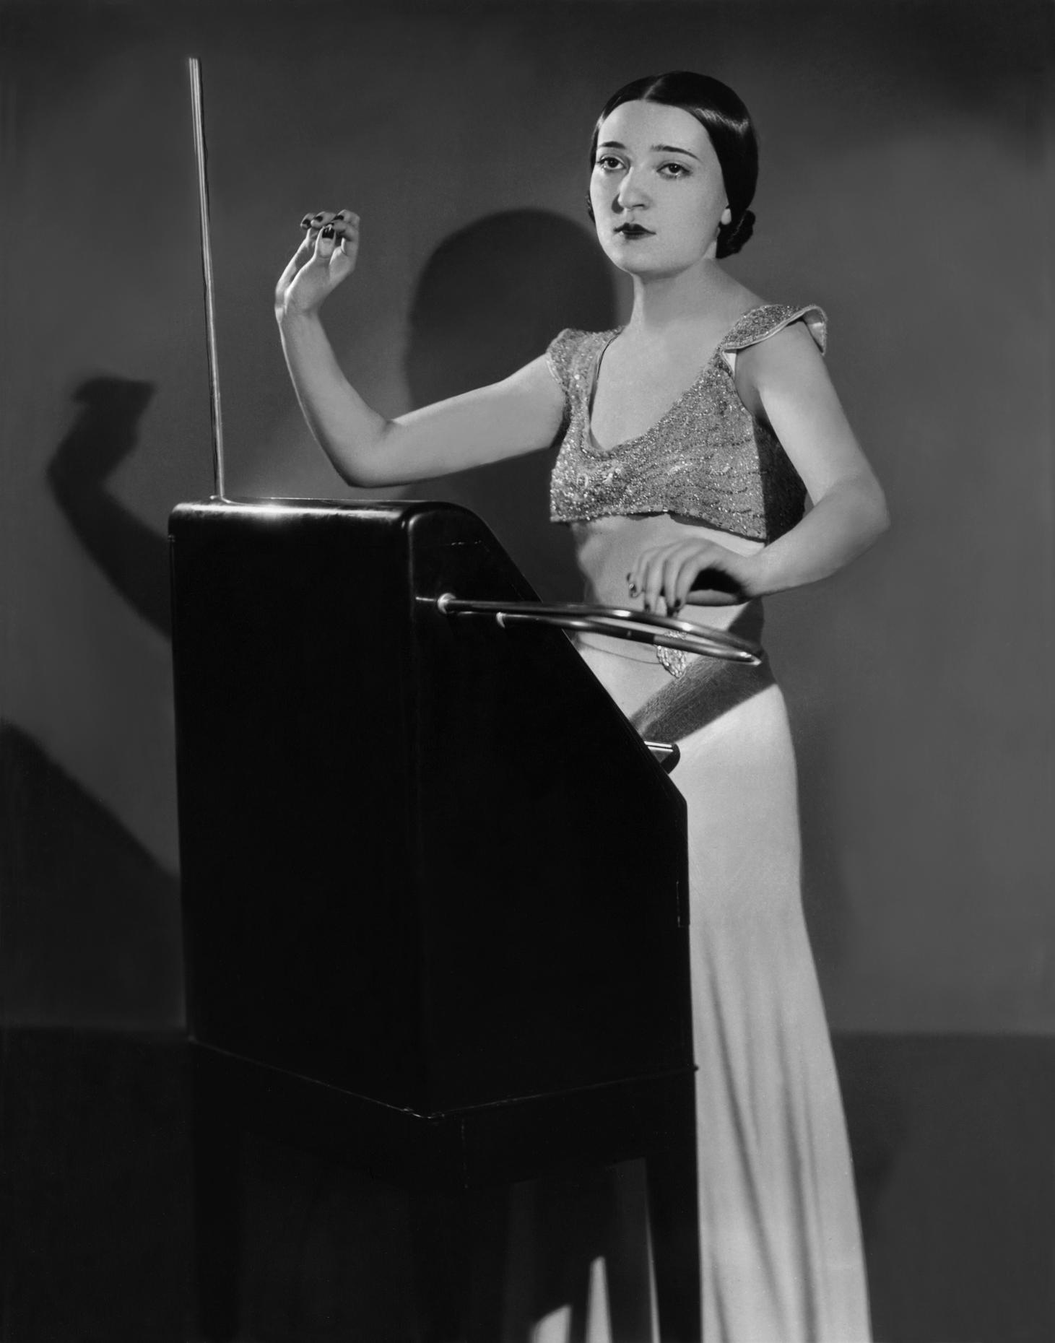
Introduction - The Theremin
Notes:
Share examples of people playing the theremin, what it looks like.
Jimmy Page playing the theremin:
tangerine13. (2018, March 19). Jimmy Page playing theremin. Tumblr. https://tangerine13.tumblr.com/post/172048338202/jimmy-page-playing-theremin.
Clara Rockmore, Leon Theremin’s protégé:
Photo: © Renato Toppo, courtesy of the Nadia Reisenberg-Clara Rockmore Foundation for WNYC (https://www.wnyc.org/story/inventor-and-virtuoso-leon-theremin-and-clara-rockmore-listening-room/).

Slide 5
Video - Leon Theremin
Notes:
Leon Theremin, the inventor of the theremin, playing his instrument. He invented it around 1920. Notice that he is not touching anything, just moving his hands near the antennae!
Video source:
slonikyouth. “Leon Theremin playing his own instrument" youtube.com, 14 January 2018, https://www.youtube.com/watch?v=w5qf9O6c20o&t=3s&ab_channel=slonikyouth.

Slide 6
So how does it work?
Sound is a wave
high-level: theremin needs to make a wave, player needs to be able to control the properties of the wave
Sound: pitch depends on frequency, volume depends on amplitude
Notes:
At a high-level, the theremin makes music. Physically, that means it produces a sound wave and the frequency of that sound wave can be controlled by the player.

Slide 7
So how does it work?
Makes use of the following concepts:
circuits can oscillate
circuits can produce an electric field
interacting with the electric field can affect the properties of the circuit
waves oscillating at similar frequencies can be combined to produce "beats"
the current from an oscillating circuit can be sent through a speaker to produce a sound wave
Notes:
Go over the physical principles underlying the theremin that we will be discussing during this presentation.

Slide 8
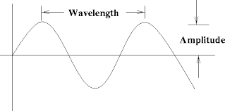
Wave properties
Period (T): time to complete one wavelength
Frequency (ƒ): how many wavelengths per time
ƒ = 1/T
Notes:
Go over some fundamental properties of waves so that students are comfortable with the related terms and concepts used throughout the presentation.
Image source:
Properties of Waves, https://theory.uwinnipeg.ca/mod_tech/node120.html.

Slide 9
Poll Question 1: Wave properties
Changing the period (T) affects which of the following properties:
Amplitude
Frequency
Wavelength
All of the above
b.socrative.com/login/student/
Room Code:
Notes:
QR code goes to Socrative polling service login.
Ask the polling question, give students time to answer.

Slide 10
Poll Question 1: Wave properties
Changing the period (T) affects which of the following properties:
Amplitude
Frequency
Wavelength
All of the above
Notes:
Go over the answer to the polling question. Frequency = 1/period, so changing the period changes the frequency. Some students may choose wavelength, since period is the time to complete one wavelength, but wavelength doesn’t depend on period in the equations/model given in the previous slides.

Slide 11
Concept A: Circuits can oscillate
what does it mean to oscillate?
value changing periodically
Notes:
Explain the terms “oscillation” and “wave” and how periodic motion through time creates a wave form.
Ensure that students are comfortable with the related terms and concepts used throughout the presentation.
Gif source:
Best Transverse Wave Gifs. https://gfycat.com/gifs/search/transverse+wave.

Slide 12
Poll Question 2: Oscillating current
V = IR
If resistance (R) is constant and current (I) is oscillating, what will happen to the voltage (V) measured between ground and the point the current is measured at?
Voltage will remain constant
Voltage will oscillate
Voltage will do something different
Notes:
Ask the polling question, give students time to answer.

Slide 13
Poll Question 2: Oscillating current
V = IR
If resistance (R) is constant and current (I) is oscillating, what will happen to the voltage (V) measured between ground and the point the current is measured at?
Voltage will remain constant
Voltage will oscillate
Voltage do something different
Notes:
Go over the solution to the polling question. If I*R is changing periodically, then V = I*R is also changing periodically.

Slide 14
Concept A: Circuits can oscillate
what does it mean for a circuit to oscillate?
current "sloshing" around in the circuit
value of current is changing periodically
since V = IR, this means the voltage is as well (if resistance is constant)
can also think about the "signal" value
Notes:
Discuss how the term “oscillate“ can be applied to circuits. “Signal value” means just considering the current or voltage to be “high” or “low” rather than a specific value.

Slide 15
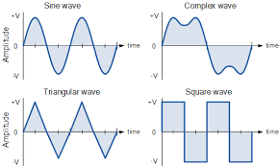
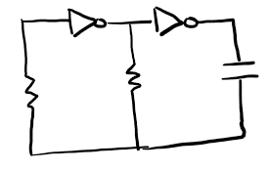
Concept A: Circuits can oscillate
waves and electricity
oscillating current
oscillating voltage
oscillating signal
Notes:
If we measure the voltage between ground and the green dot on the image on the left, we might get one of these wave shapes. Most students are probably familiar with a sine wave, and we are going to be seeing a lot of square waves throughout the presentation!
Source for image on right:
Cambridge Technicals in Engineering. https://www.ocr.org.uk/Images/208282-electrical-and-electronic-design.pdf.

Slide 16
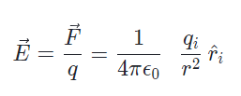
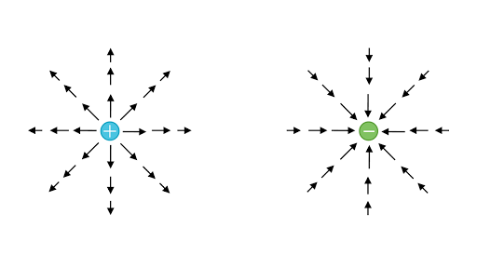
Concept B: Circuits can produce an electric field
Electric force per unit charge (on a + test particle)
depends on radius away from particle
accelerating charges radiate an oscillating electric field
sending current up and down an antenna
PHET simulation
Notes:
Discuss electric field very generally. Key points are that it radiates away from a source and can be produced by an antenna. The PHET simulation hyperlinked (“Radio Waves & Electromagnetic Fields”) shows a visual depiction of an electric field from an antenna.
Image source:
“Electric Field (Article) | Electrostatics.” Khan Academy, https://www.khanacademy.org/science/electrical-engineering/ee-electrostatics/ee-electric-force-and-electric-field/a/ee-electric-field.

Slide 17
Concept C: Interacting with an antenna can affect the circuit
we now know that an antenna sends out an electric field
two objects with an electric field between them - starting to seem a bit like a capacitor
Notes:
We have the antenna sending out an electric field, and we are going to be placing our hand near it. This set up is two objects with an electric field between them, like a capacitor.

Slide 18
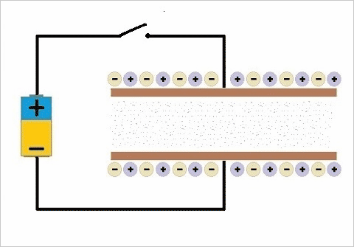
Concept C: Interacting with an antenna can affect the circuit
Capacitor:
two conductive objects (plates), separated by a non-conductive material
can be many different shapes
charge builds up on one side
electric field between
Notes:
Go over the basics of capacitors.
Gif source:
“Capacitors.” Microsoft MakeCode, https://makecode.adafruit.com/learnsystem/pins-tutorial/devices/capacitors.

Slide 19
Poll Question 3: Capacitance
Capacitance, a property of the capacitor, has the equation $C= ε\frac{A}{d}$ where A is the area of the plates and d is the distance between them. How could you change the capacitance?
Change the distance between the plates
Send more current through the capacitor
Increase the voltage in the circuit
Notes:
Ask the polling question and give students time to respond.

Slide 20
Poll Question 3: Capacitance
Capacitance, a property of the capacitor, has the equation $C= ε\frac{A}{d}$ where A is the area of the plates and d is the distance between them. How could you change the capacitance?
Change the distance between the plates
Send more current through the capacitor
Increase the voltage in the circuit
Notes:
Go over the answer. Distance is in the equation for capacitance, so changing distance will change capacitance. What are other ways to change the capacitance?

Slide 21
Concept C: Interacting with an antenna can affect the circuit
capacitance is a property of the circuit, so changing the capacitance of a capacitor in the circuit affects the circuit
How does this work with an antenna?
antenna = one plate
room = other plate
put hand between – other plate is now much closer, change the capacitance
Notes:
Explain how the antenna + hand can be a capacitor.

Slide 22
Concept D: waves oscillating at similar frequencies can be combined to produce "beats"
saw we have two oscillating circuits, with slightly different frequencies - what happens if we combine the two circuits?
beats simulation
Notes:
Show the hyperlinked beats simulation at https://academo.org/demos/wave-interference-beat-frequency/. Change the frequency of the source waves, zoom in to different parts of the beats wave to see where there is constructive and destructive interference. Notice what the resulting wave looks like and what the frequency of the “envelope” beats wave is compared to the source waves.

Slide 23
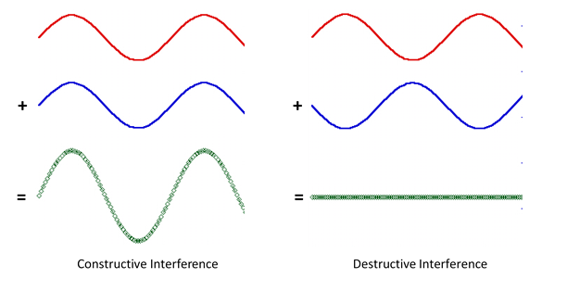
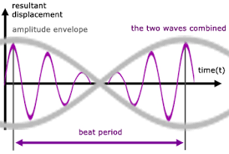
Concept D: waves oscillating at similar frequencies can be combined to produce "beats"
we get beats - a wave with a much lower frequency depending on the difference in frequency of the two added waves
Notes:
Reiterate how a beats wave is formed.
Image on left:
“Superposition: Waves Adding and Cancelling.” The New Zealand Physics Teachers Resource Bank, https://resource-bank.nzip.org.nz/draft-under-construction/teaching-suggestions/phys-3-3-waves-as-91523/superposition-waves-adding-and-cancelling/.
Image on right:
Electricity - Detailed Contents, https://www.a-levelphysicstutor.com/wav-beats.php.

Slide 24
Concept E: the current from an oscillating circuit can be sent through a speaker to produce a sound wave
how do we get from oscillating circuits to a sound wave?
current goes through speaker
voice coil in speaker produces electric field
electric field interacts with a permanent magnet
attracts and repels the voice coil
the cone the voice coil is attached to moves back and forth
creates a pressure wave in the air, can hear it at audible frequencies
Notes:
Explain how a speaker takes the output of an oscillating circuit and creates a soundwave.

Slide 25
Concept E: the current from an oscillating circuit can be sent through a speaker to produce a sound wave
Notes:
Key point: frequency of oscillation sent through speaker corresponds to frequency of sound wave produced.
Gif source:
enjoyingchild. “Generation of acoustic waves by loudspeaker" makeagif.com, https://makeagif.com/gif/131-generation-of-acoustic-waves-by-loudspeaker-tME9td.

Slide 26
Let's apply this to the theremin!
2 oscillating circuits
fixed frequency, variable frequency
Antenna
Mixer
Amplifier
Speaker
Variable frequency oscillating circuit: frequency altered by interacting with antenna
Notes:
These are the components of the theremin. Relate the components to the concepts we have discussed so far.

Slide 27
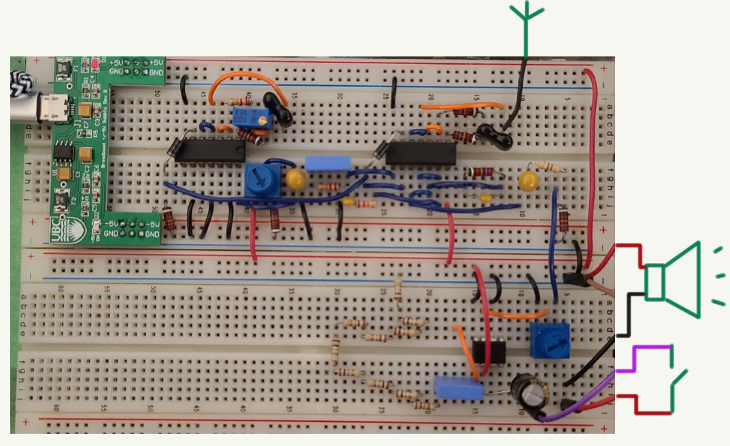
Notes:
Complete circuit overview.

Slide 28
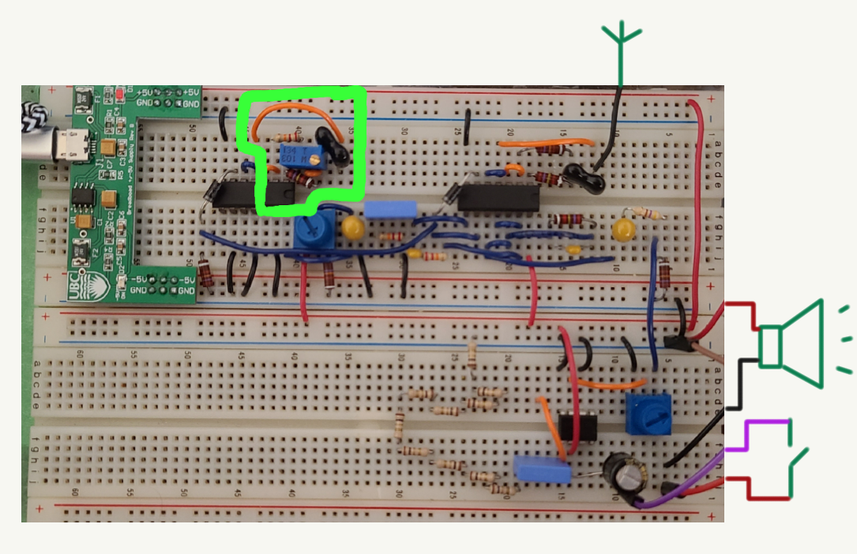
Notes:
Fixed RC oscillator circled in green.

Slide 29
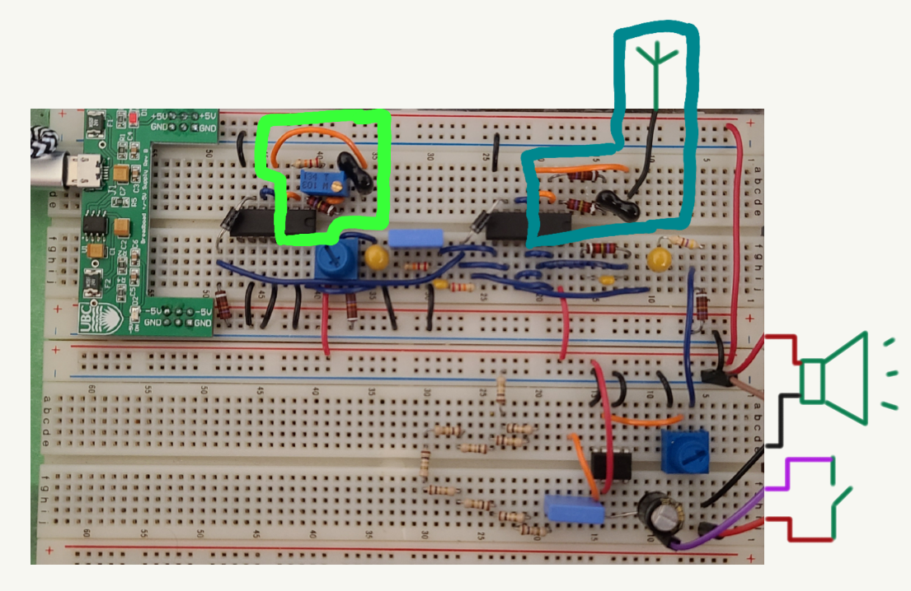
Notes:
Variable RC oscillator circled in blue.

Slide 30
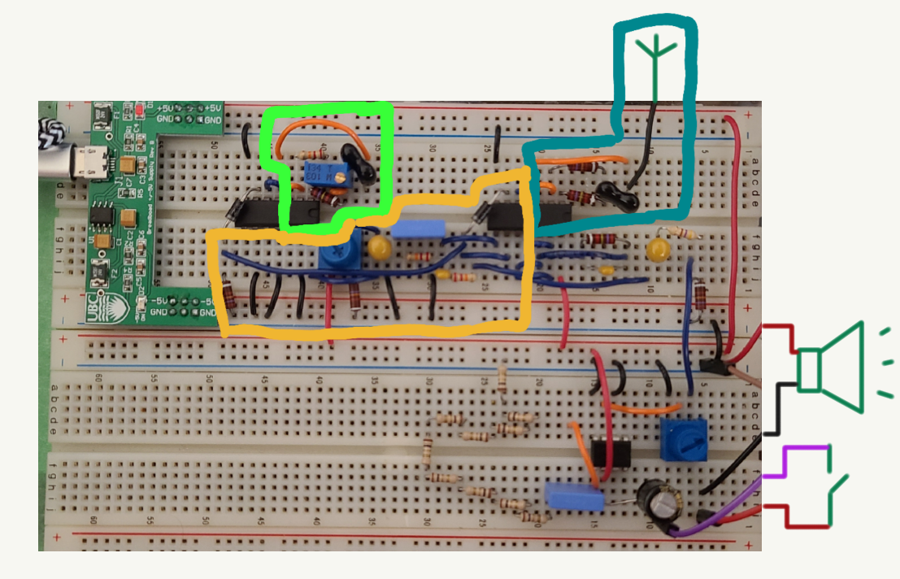
Notes:
Mixer circled in yellow.

Slide 31
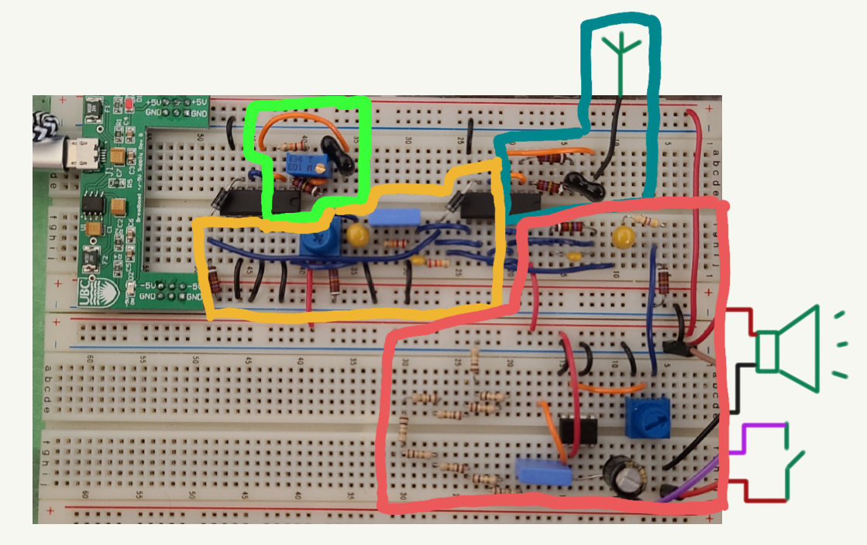
Notes:
Amplifier circled in red.

Slide 32
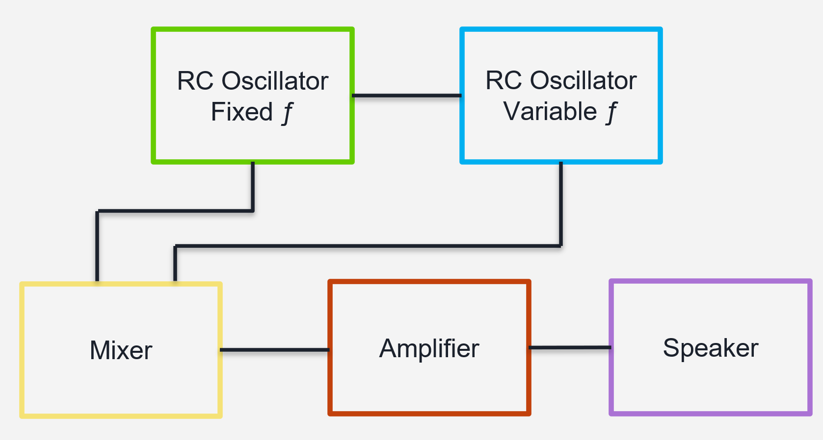
Notes:
Converting circuit to block diagram.

Slide 33
RC Oscillator
Fixed ƒ
RC Oscillator
Variable ƒ
Mixer
Amplifier
Speaker
Notes:
Complete block diagram.

Slide 34
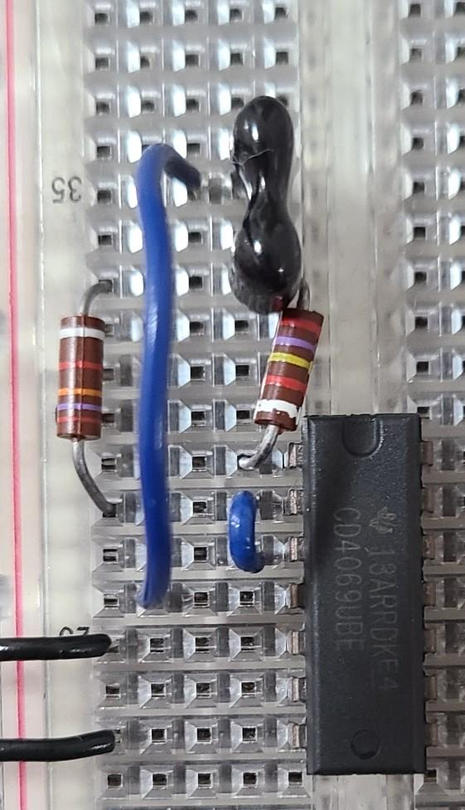
Oscillating circuit - fixed ƒ
Components:
R: resistor
C: capacitor
CMOS inverter
Notes:
Identify the components of the RC oscillator. CMOS stands for “Complimentary Metal Oxide Semiconductor”. The inverter is an integrated circuit, so it has some electronic components inside that perform a function called “inversion” on an input to produce an output.

Slide 35
Poll Question 4: Voltage
In the circuit pictured, consider the voltage at A and B, as measured between ground and the indicated points.
a) the voltage at A is greater than the voltage at B
b) the voltage at B is greater than the voltage at A
c) the voltage at A and B is the same
Notes:
Ask the poll question and allow students time to answer.

Slide 36
Poll Question 4: Voltage
In the circuit pictured, consider the voltage at A and B.
a) the voltage at A is greater than the voltage at B
b) the voltage at B is greater than the voltage at A
c) the voltage at A and B is the same
Some voltage drops across the resistor.
Notes:
Explain the answer: some voltage drops across the resistor (current flowing from high to low).

Slide 37
RC Oscillator - C
Capacitors:
parallel metal plates, separated by non-conductive material
charge builds up on plates -> electric field between
when fully charged: prevents any more current
time to charge: $τ=RC$
Notes:
Add a new capacitor concept to our understanding: when capacitors get fully charged, they stop current flow through them. Notice that the time to charge a capacitor depends on the resistance and capacitance in the circuit.
Gif source:
“Capacitors.” Microsoft MakeCode, https://makecode.adafruit.com/learnsystem/pins-tutorial/devices/capacitors.

Slide 38
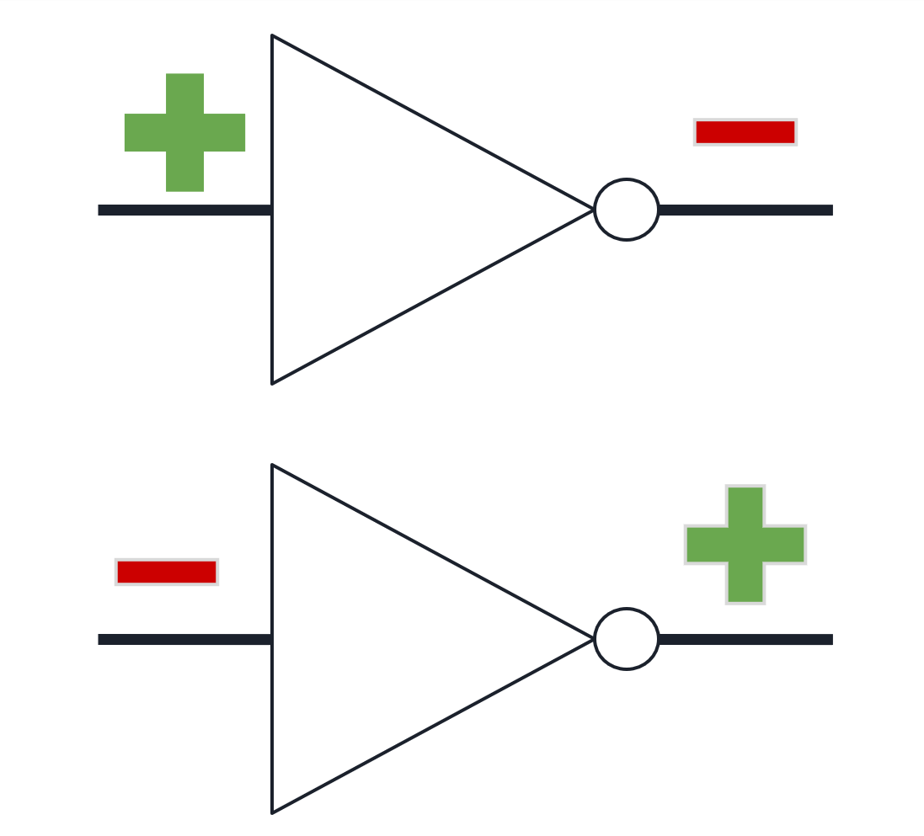
RC Oscillator – Inverter
CMOS inverter:
"inverts" input
threshold value
Notes:
Explain what the inverter function does (takes a high input and produces a low output, takes a low input and produces a high output). The inverter has its own power sources so it can output a high value even from a low input.

Slide 39
RC Oscillator – Inverter
CMOS inverter:
"inverts" input
threshold value
INPUT | OUTPUT
5V (high) | 0V (low)
3V (high) | 0V (low)
1V (low) | 5V (high)
0V (low) | 5V (high)
Notes:
If the input voltage is above the threshold, the inverter will see this as “high” and output “low”.
If the input voltage is below the threshold, the inverter will see this as “low” and output “high”.

Slide 40
RC Oscillator - fixed ƒ
Notes:
We’ll go through the RC oscillator by looking at the signal (current or voltage between here and ground) at the blue circle. Explain the circuit diagram symbols.

Slide 41
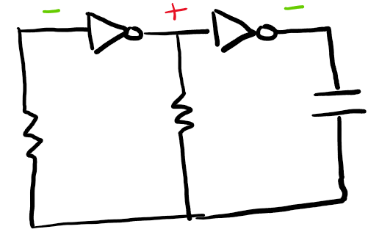
RC Oscillator - fixed ƒ
Notes:
Starting conditions: we have a low input to the first inverter and a high output. This means a high input to the second inverter and a low output.

Slide 42
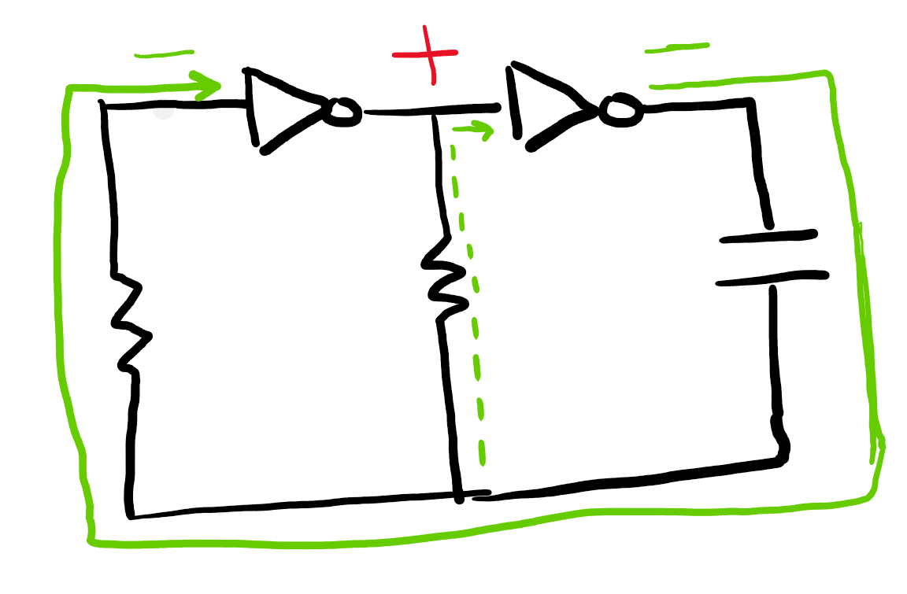
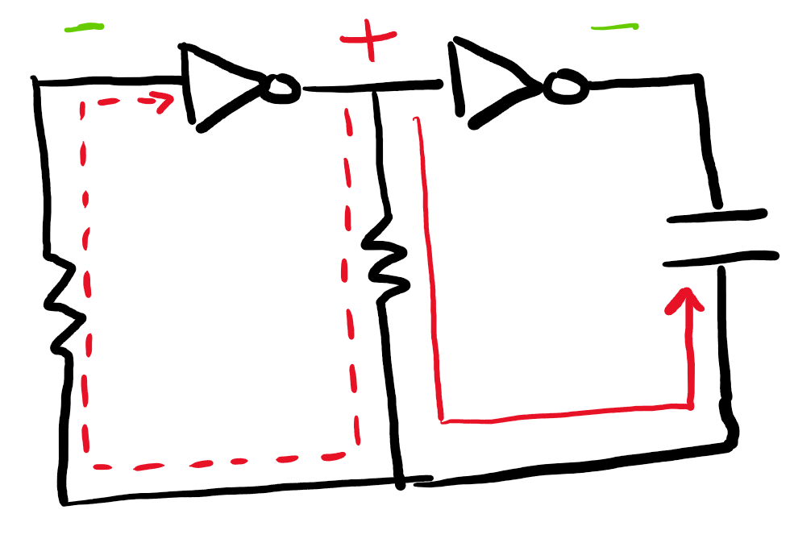
RC Oscillator - fixed ƒ
Notes:
Trace around the signal: the low signal going around won’t change the input value at the first inverter. The high signal goes to the capacitor and starts charging it. Some high signal goes to the input of the first inverter but isn’t enough to move it above the threshold to become a “high” input. For now, the low and high signals stay as they are (as per the green line).

Slide 43
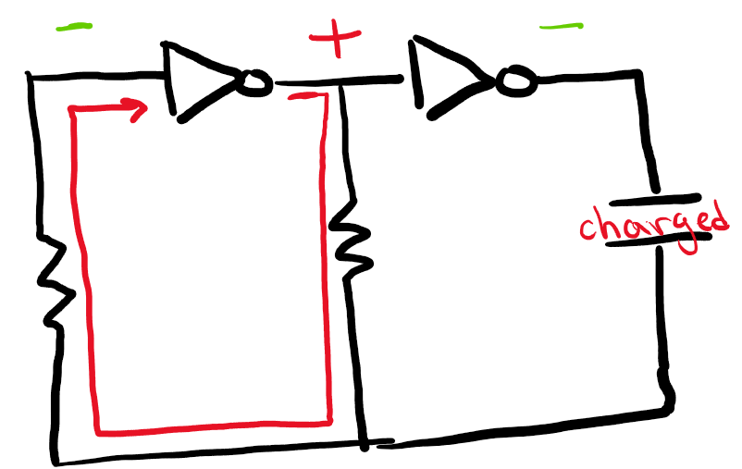
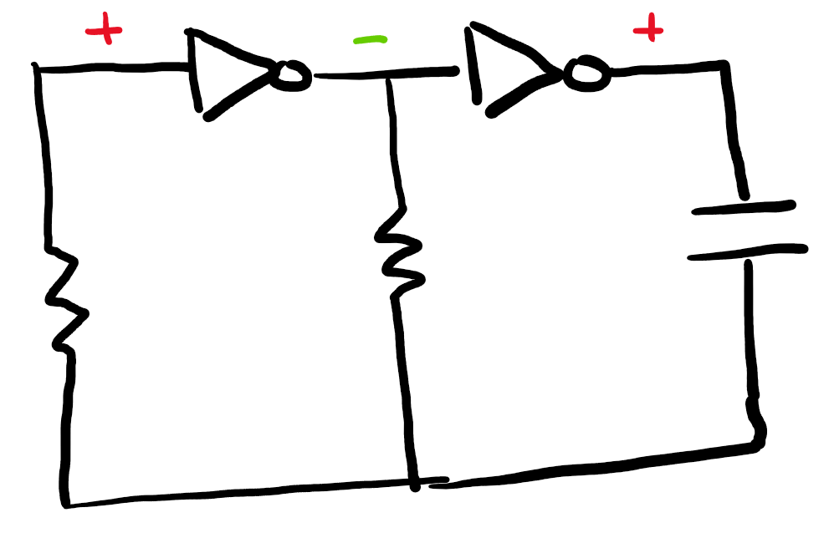
RC Oscillator - fixed ƒ
Notes:
Once the capacitor is charged, all of the high signal goes around to the input to the first inverter. Now it is enough to change the input to high. The input to the first inverter becomes high, so the output becomes low. Therefore, the input to the second inverter becomes low and the output becomes high. As per the orange line, the signal at the measuring point jumps up to high.

Slide 44
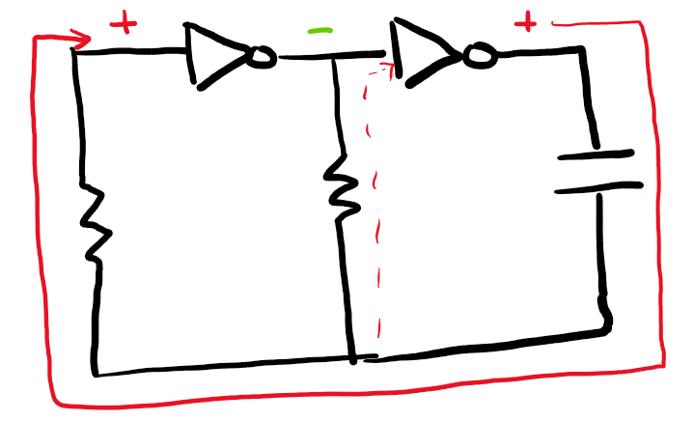
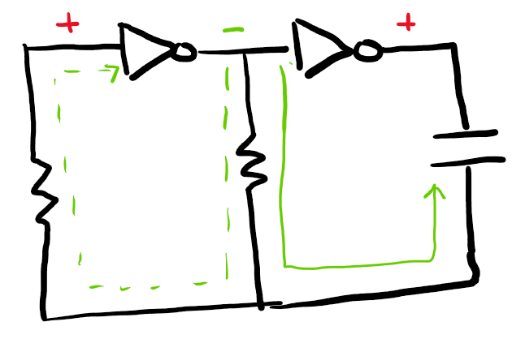
RC Oscillator - fixed ƒ
Notes:
Now we have these conditions. Like before, the state stays as is until the capacitor is charged.

Slide 45
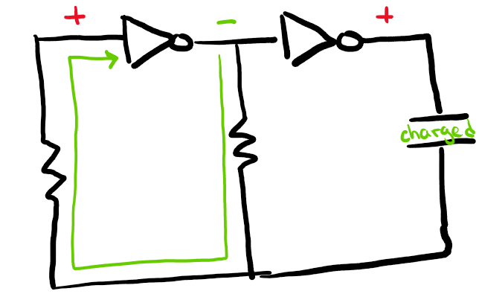
RC Oscillator - fixed ƒ
Notes:
Once the capacitor is charged again, the signal values will swap again. This is how we get a square wave, where the duration of a high or low section depends on the time it takes to charge the capacitor.

Slide 46
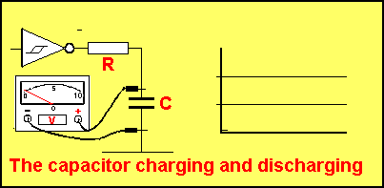
RC Oscillator - fixed ƒ
Notes:
Shows the square wave being created at the inverter output as the capacitor charges and discharges.
Gif source:
Gifer.com, https://gifer.com/en/8YRf.

Slide 47
Poll Question 5: RC Oscillator
If the time for the capacitor to charge depends on $τ=RC$, then the period of the oscillating circuit
a) depends on the supply voltage
b) is also proportional to $RC$
c) is proportional to $\frac{1}{RC}$
d) depends on the current
Notes:
Ask the polling question and give the students time to answer.

Slide 48
Poll Question 5: RC Oscillator
If the time for the capacitor to charge is depends on $τ=RC$, then the period of the oscillating circuit
a) depends on the supply voltage
b) is also proportional to $RC$
c) is proportional to $\frac{1}{RC}$
d) depends on the current
How long the circuit takes to oscillate between high and low is another way of thinking of period. This depends on the time for the capacitor to charge.
Notes:
Go over the answer. The amount of time that a value is high or low depends on R*C. Therefore, the amount of time to go through one cycle will also depend on R*C.

Slide 49
Demo Part 1
Fixed RC Oscillator
Notes:
This demo is using the “simple RC oscillator”. Connect the oscilloscope and observe the resulting square wave!

Slide 50
RC Oscillator
Fixed ƒ
RC Oscillator
Variable ƒ
Mixer
Amplifier
Speaker
Notes:
We can now fill in the RC oscillator box as we know what’s happening in there! We also know what kind of wave it produces.

Slide 51
Notes:
We can now fill in the RC oscillator box as we know what’s happening in there!

Slide 52
Poll Question 6: variable ƒ
How can we change the frequency of the RC oscillator?
a) change the value of the resistor R
b) change the value of the capacitor C
c) add more RC loops
d) more than one of the above
Notes:
Ask the polling question and give the students time to answer.

Slide 53
Poll Question 6: variable ƒ
Poll question: how can we change the frequency of the RC oscillator?
a) change the value of the resistor R
b) change the value of the capacitor C
c) add more RC loops
d) more than one of the above
In particular, changing R and C are both ways to change the frequency.
Notes:
Go over the answer. We know that the period depends on R*C from a previous question, and that frequency = 1/period. So changing the period by changing R*C will change the frequency.

Slide 54
RC Oscillator - variable ƒ
the period, T, depends on $RC$ which means the frequency (ƒ = 1/T) also depends on $RC$
changing R and/or C will change the frequency
Poll Question 7: Increasing C will make the frequency
a) larger
b) smaller
Notes:
Explain the equations following the previous question. Ask the polling question and give students time to answer.

Slide 55
RC Oscillator - variable ƒ
the period, T, depends on $RC$ which means the frequency (ƒ = 1/T) also depends on $RC$
changing R and/or C will change the frequency
Poll Question 7: Increasing C will make the frequency
a) larger
b) smaller
We are dividing by a larger number, so the result will be smaller.
Notes:
Explain the answer.

Slide 56
Demo Part 2
Variable RC Oscillator
Notes:
This demo is also using the “simple RC oscillator”. Connect the variable capacitor and the oscilloscope. Observe what happens as you alter the capacitance.

Slide 57
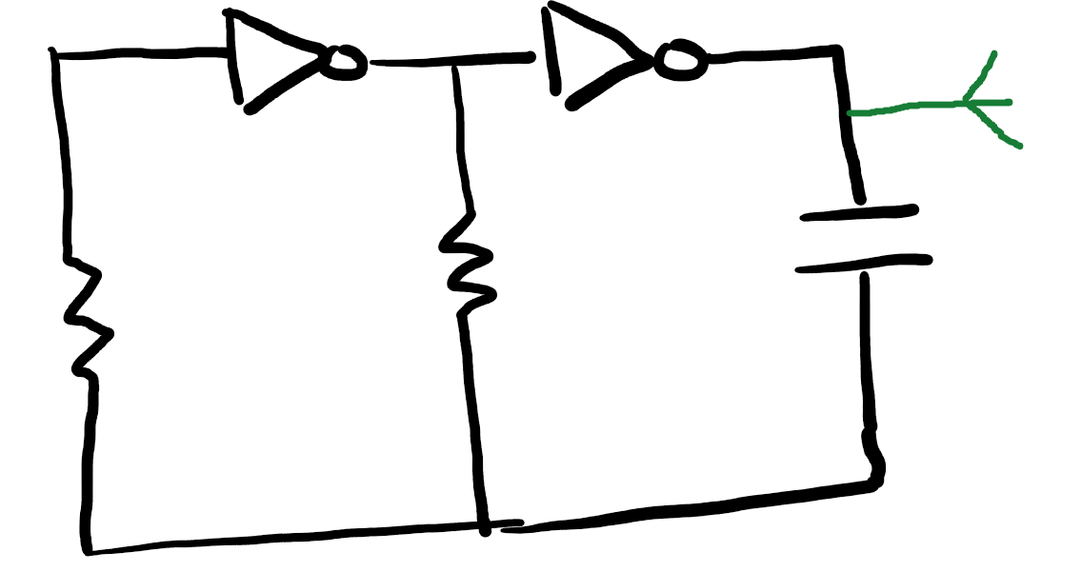
RC Oscillator - antenna
theremin uses an antenna for its variable capacitor
antenna + hand = capacitor
human body has natural capacitance & conductivity
Notes:
This is a similar circuit diagram to those we have seen before, but now with an antenna attached!

Slide 58
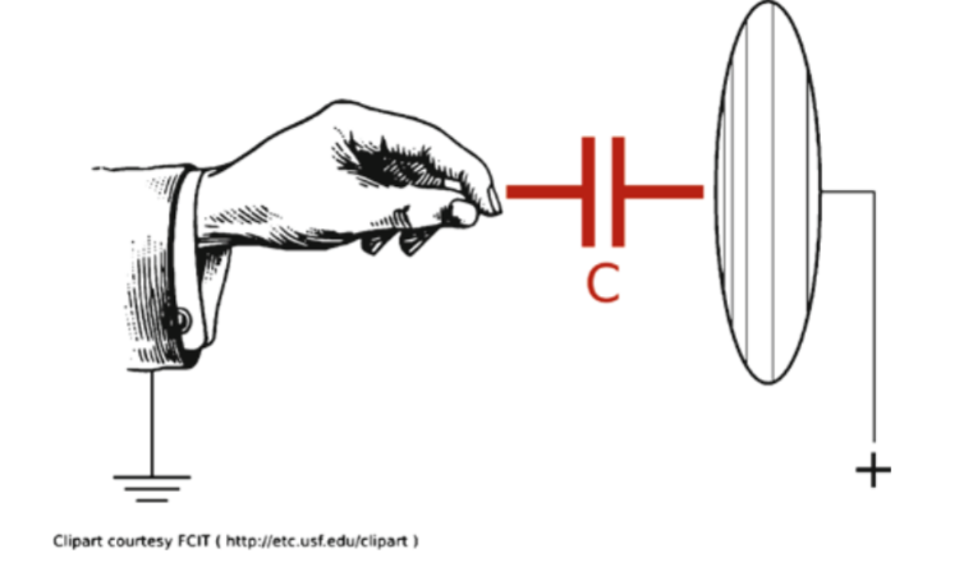
RC Oscillator - antenna
Antenna plate is one half of capacitor
Initially, room is other half
Put hand between antenna and room – now hand is other half
Notes:
Explain that in this circuit, we have a variable capacitor like we just saw in the demo. But this time, it’s the antenna + hand capacitor. Prior to the hand being nearby, the room can be thought of as the other plate – since the distance between plates is large, the capacitance is small. When we bring our hand near, there is now some appreciable capacitance.
Image source:
Ichickii. “Capacitive Sensor for Whole Body Interaction.” Interactive Computing, 19 Feb. 2014, https://ichickii.wordpress.com/2014/02/17/capacitive-sensor-for-whole-body-interaction/.

Slide 59
Poll Question 8: Antenna
If $C= ε\frac{A}{d}$ and $f= \frac{1}{RC},$then moving your hand toward the antenna will
a) increase both C and ƒ
b) decrease both C and ƒ
c) increase C and decrease ƒ
d) decrease C and increase ƒ
Notes:
Ask the polling question and give students time to answer.

Slide 60
Poll Question 8: Antenna
If $C= ε\frac{A}{d}$ and $f= \frac{1}{RC},$then moving your hand toward the antenna will
a) increase both C and ƒ
b) decrease both C and ƒ
c) increase C and decrease ƒ
d) decrease C and increase ƒ
d between plates gets smaller, so C gets bigger (dividing by a smaller number). In turn, ƒ gets smaller (dividing by a bigger number).
Notes:
Go over the answer.

Slide 61
RC Oscillator
Fixed ƒ
RC Oscillator
Variable ƒ
Mixer
Amplifier
Speaker
Notes:
We can now fill in the variable RC oscillator box as we know what’s happening in there! We also know what kind of wave it produces.

Slide 62
Notes:
We can now fill in the variable RC oscillator box as we know what’s happening in there.

Slide 63
Mixer
adds waves to get beats
audible frequency: 20 Hz - 20 kHz
RC oscillators have ƒ > 65 kHz
combines waves from RC oscillators into one wave with a smaller ƒ
Notes:
We know the purpose of a mixer. So far we have seen RC oscillators with a frequency of around 70 kHz. This is clearly too high a frequency to hear, so we use the mixer to bring the combined frequency of two RC oscillators with a high frequency into the audible range.

Slide 64
Mixer
set RC oscillators to same ƒ with hand outside of "sensing range"
bringing hand closer changes ƒ in variable RC oscillator slightly
this changes ƒ of the beats wave
hand position controls ƒ of resulting wave!
filters square wave into sine wave
Notes:
If we set the two RC oscillators to have the same capacitance when no hand is near the theremin, then the changes in capacitance caused by moving your hand will create a difference in the frequency between the two RC oscillators. This alters the frequency of the beats wave.

Slide 65
RC Oscillator
Fixed ƒ
RC Oscillator
Variable ƒ
Mixer
Amplifier
Speaker
Notes:
We can now fill in the mixer box as we know what’s happening in there and what kind of wave it produces.

Slide 66
Notes:
We can now fill in the mixer box as we know what’s happening in there.

Slide 67
Amplifier
increases amplitude of input wave
simply: amplifier chip connected to power, adds voltage to wave sent through it
Notes:
Briefly go over the amplifier.

Slide 68
RC Oscillator
Fixed ƒ
RC Oscillator
Variable ƒ
Mixer
Amplifier
Speaker
Notes:
We can now fill in the amplifier and speaker box as we know what’s happening in there.

Slide 69
Notes:
We can now fill in the amplifier box as we know what’s happening in there. We have the whole circuit filled in!

Slide 70
Notes:
Here’s the circuit without the overlay.

Slide 71
Demo Part 3
Theremin
Notes:
Now we get to pull out the theremin! Connect the oscilloscope to each module. Predict and observe what you see on the oscilloscope as you play it. Have students come up and try it!

